Slide 1
Delft Shell Architecture

Slide 2
Contents
Architecture, Design and Main Components
  Components
  Gui
  Classes
  Data Access Plugin
  Models Integration
Working Methodology
Example Applications
Code Overview

Slide 3
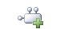
Delft Shell
Graphical User Interface
SOBEK Plug-in
Models, data & editors
SOBEK Engine(s)
F90
Delft3D Plug-in
Models, data & editors
Delft3D Engine(s)
F90
Delft Tools
Framework – set of libraries
TimeSeries Plug-In
Data & editors
Core
IApplication, IPlugin, Project, Task, IModel,
Gui
IGui, IMenuItem, IToolBarItem, IView
Utils
Threading, Xml, IO and other utilities
Data Objects
IDataItem, Quantity
ITimeSeries, IFunction
Gis Plug-In
Data & editors
Data Access
NHibernate
…

Slide 4
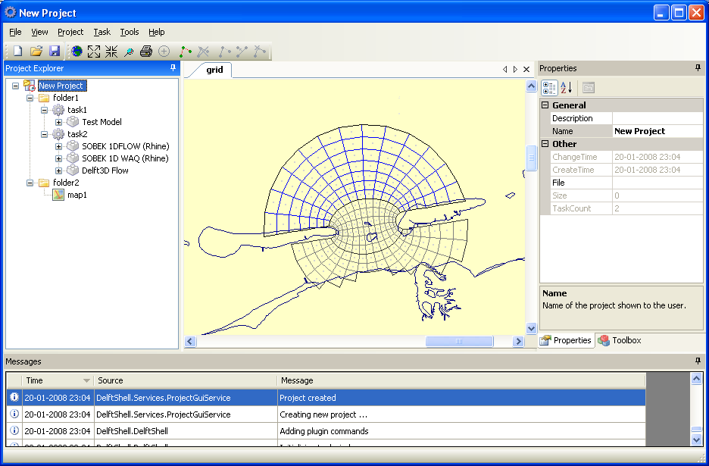
Design & architecture of the DelftShell
Project Explorer
Documents, tab-based
Property Grid
Logging Window
Toolbars & Menus
Positionering, branding en huisstijl Deltares -
12 september 2007
4
Notes:
Mention that FEWDOR showed examples of HABITAT, Verkenner
4

Slide 5
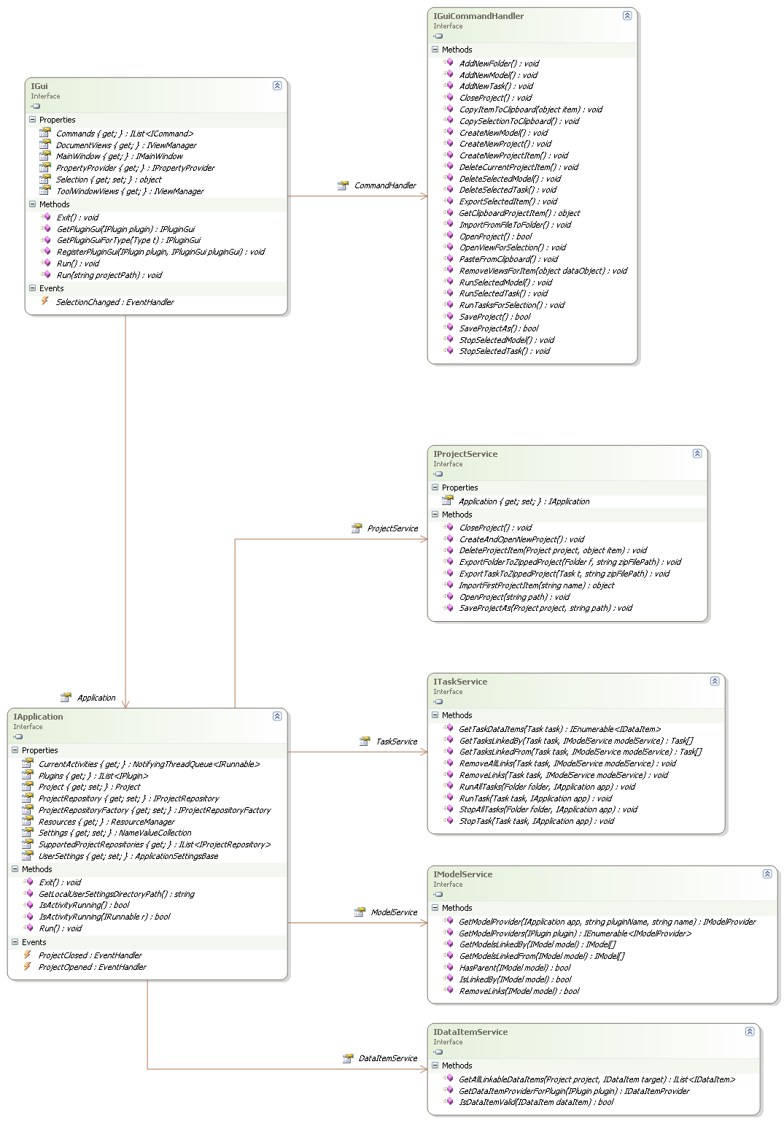
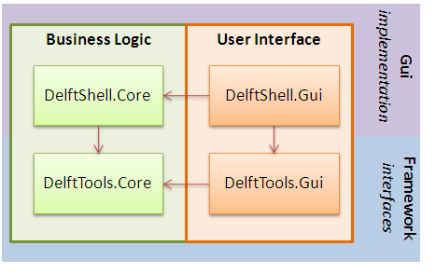

Slide 6
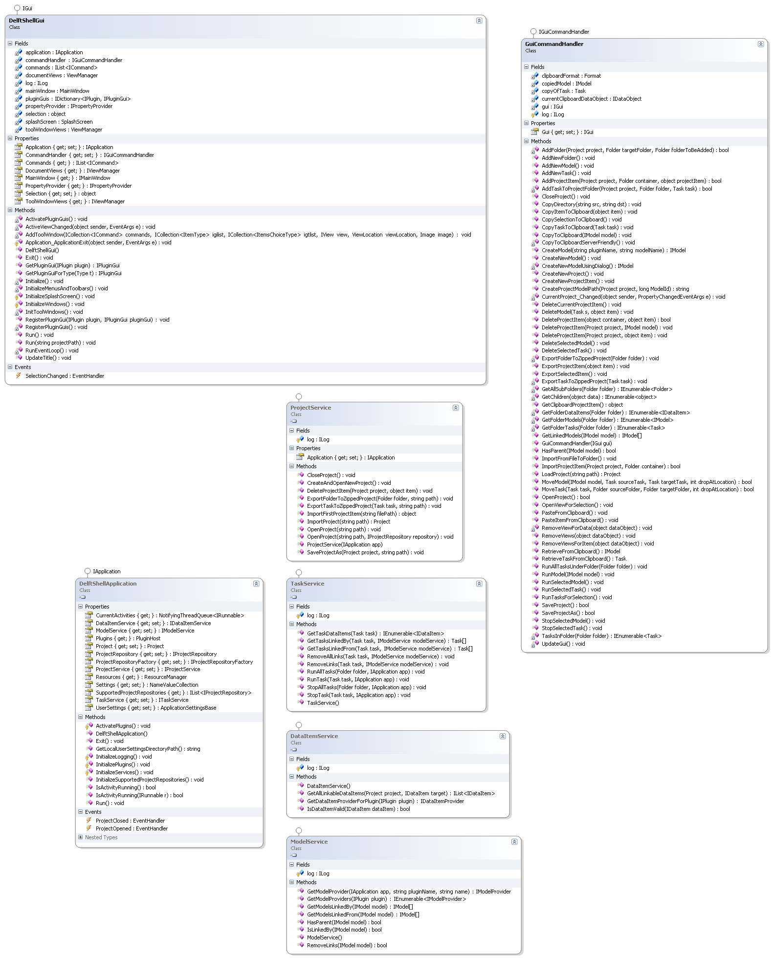

Slide 7
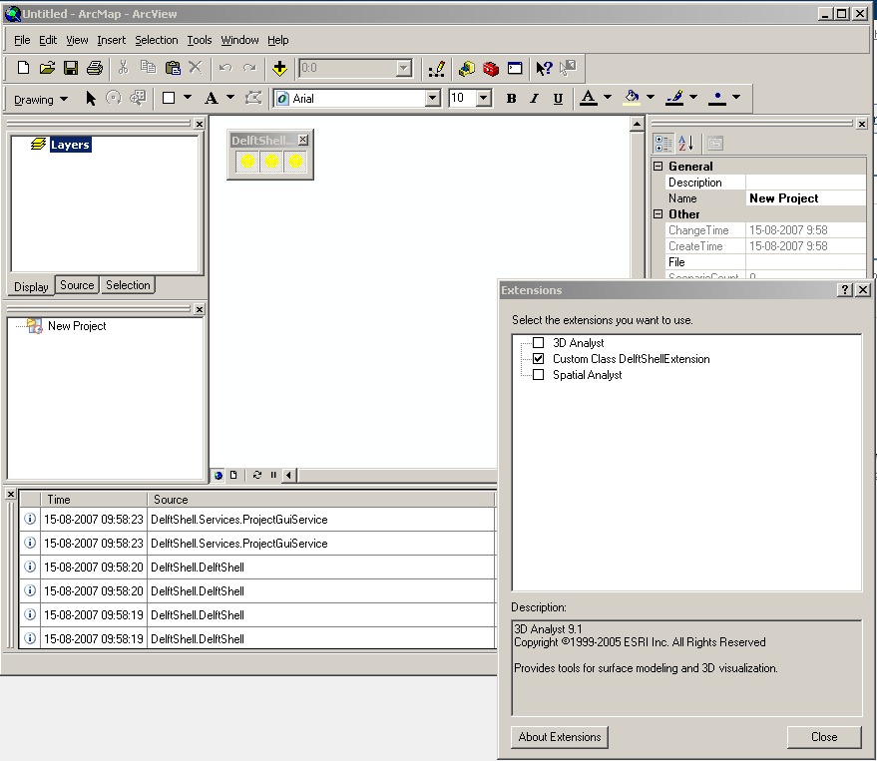
ArcGIS

Slide 8
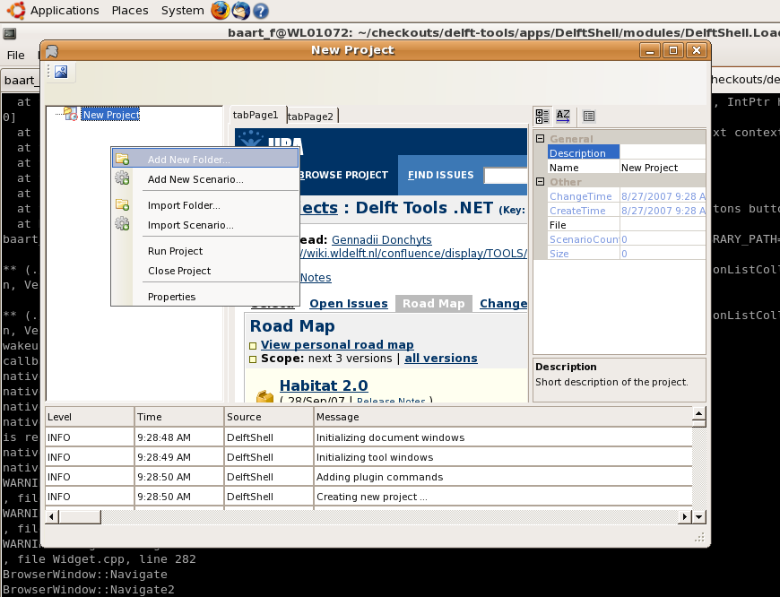
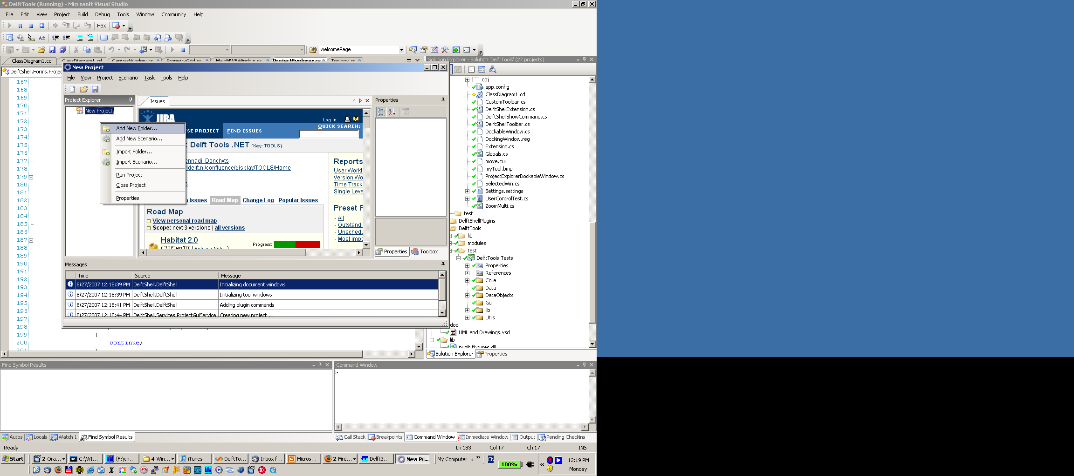
Linux

Slide 9
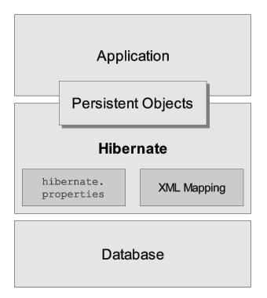
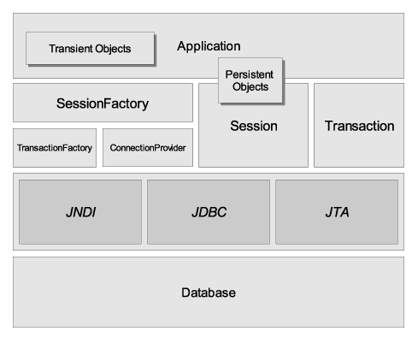
Data Access

Slide 10
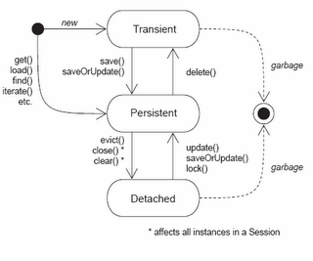
Data Access

Slide 11
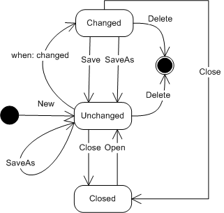
Data Access

Slide 12
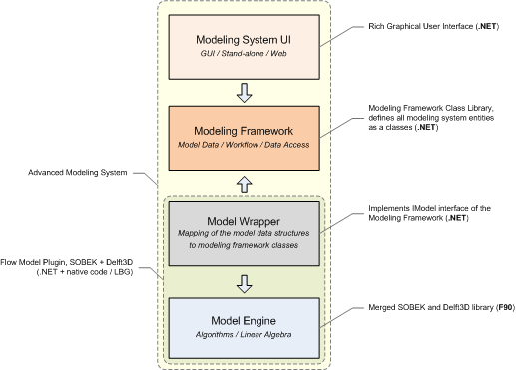
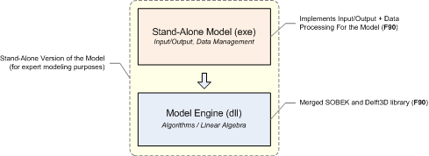
Models Integration

Slide 13
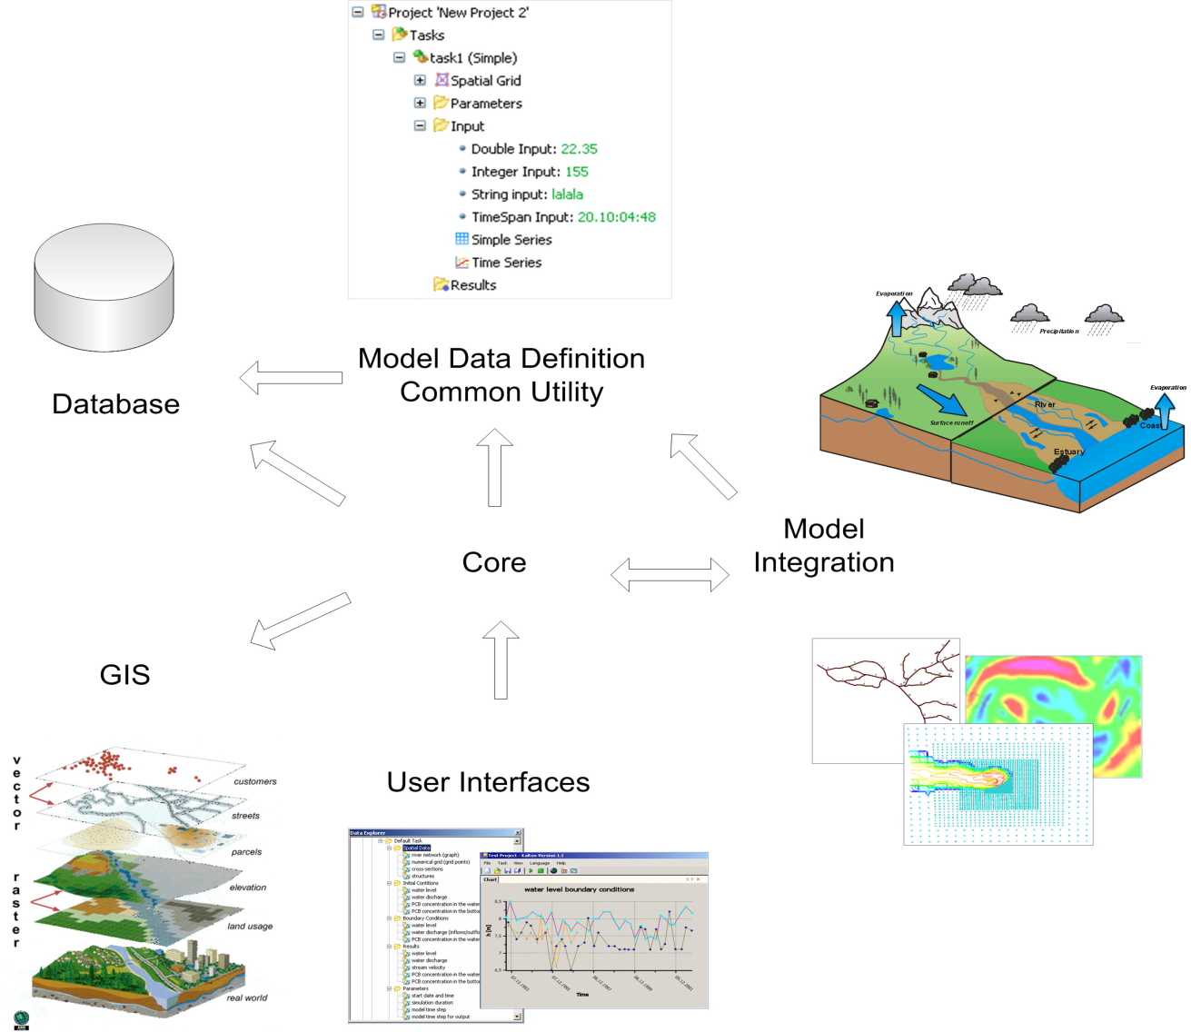
Delftshell

Slide 14
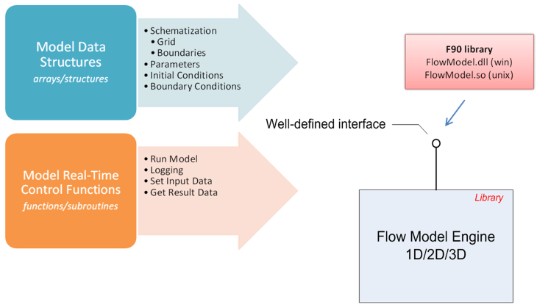

Slide 15
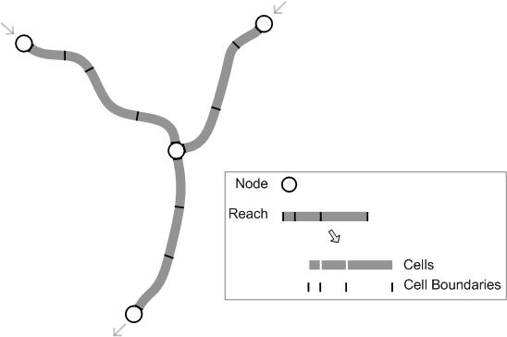
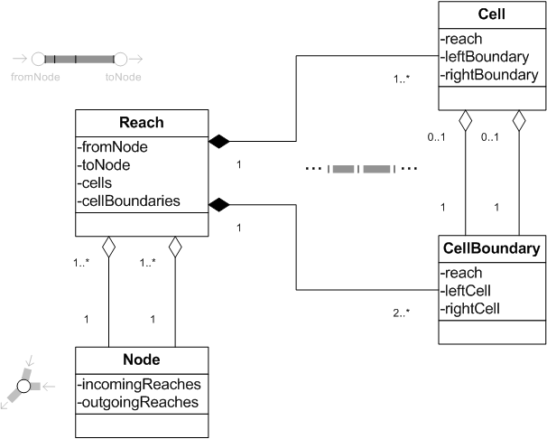
Design class library for all specific entities used in Delft models domain (Domain-Driven Approach)

Slide 16
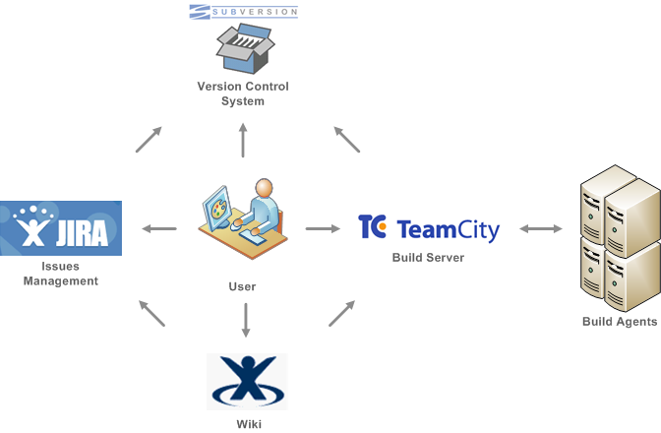
Working environment

Slide 17
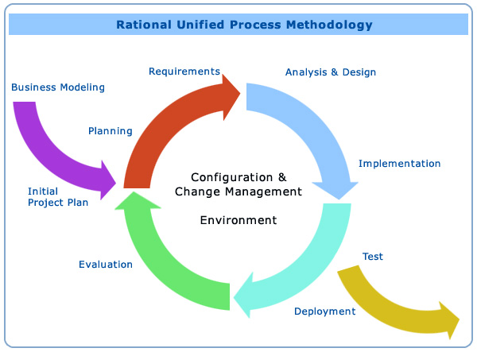
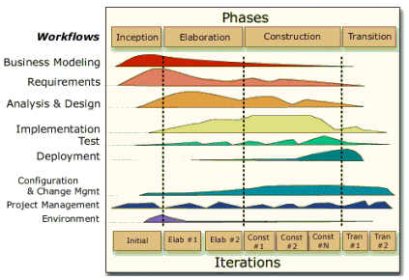
Project Life Cycle (Rational)

Slide 18
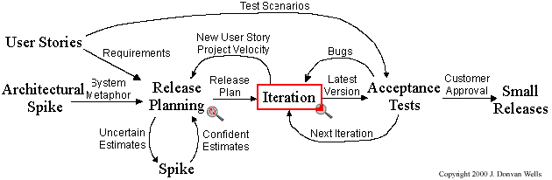
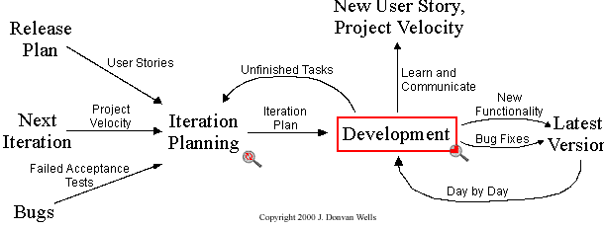
Project Life Cycle (XP)
Project
Iteration

Slide 19
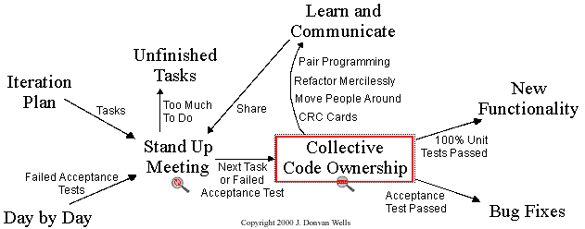
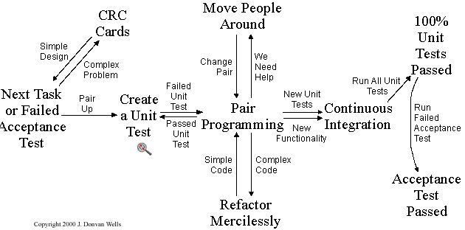
Project Life Cycle (XP)
Development

Slide 20
Communication
Pair programming (daily)
Work Meetings
Knowledge Management (wiki, blog, …)
Presentations/Lectures about software technologies, results
Move People Around

Slide 21
Management Tools (Web-based)

Slide 22
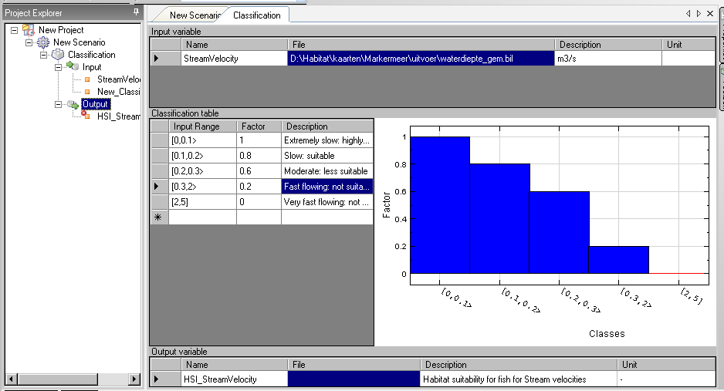
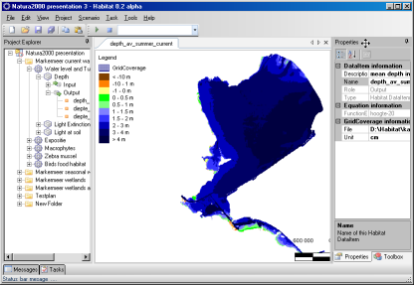
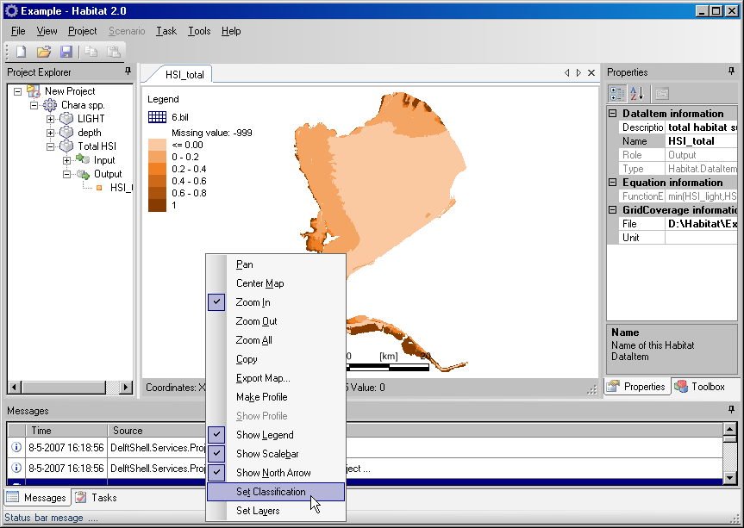
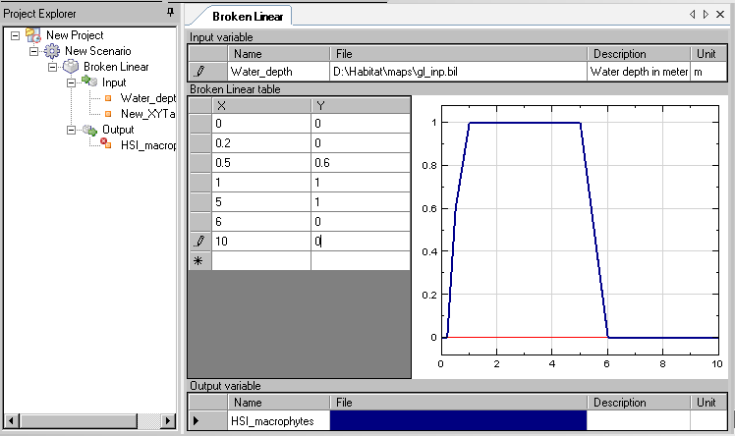
Habitat

Slide 23
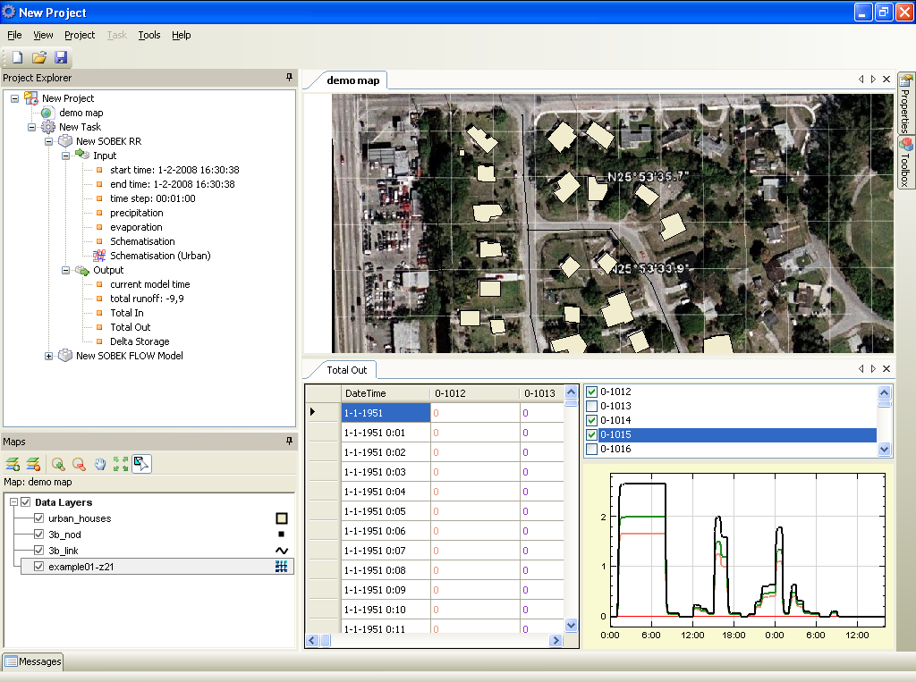

Slide 24
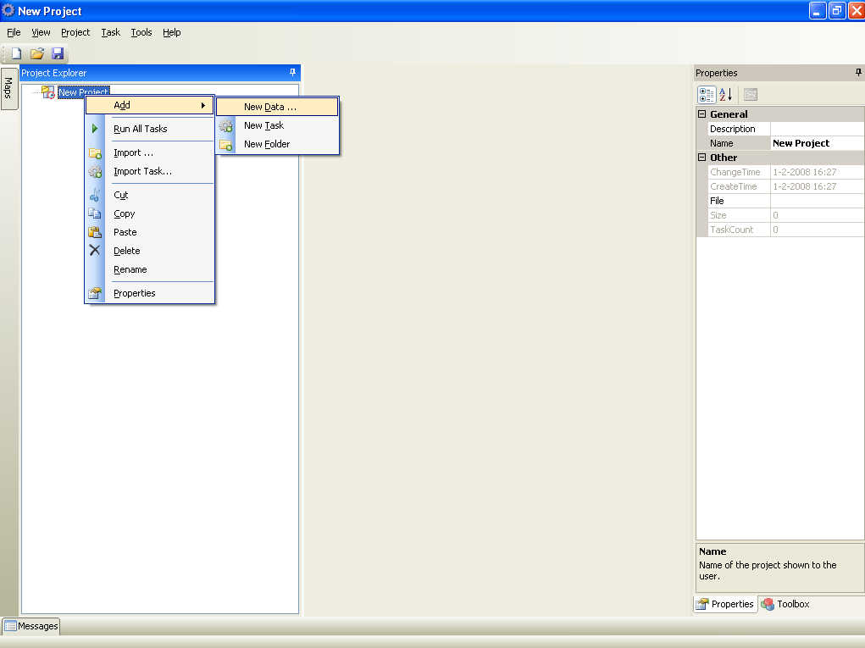

Slide 25
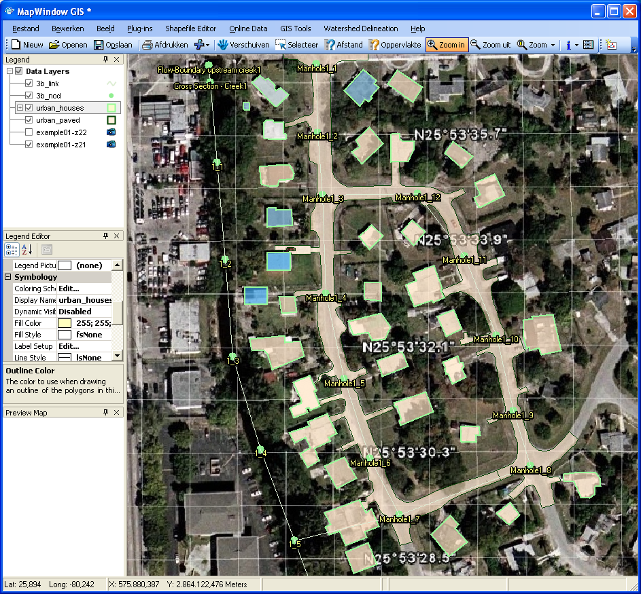

Slide 26
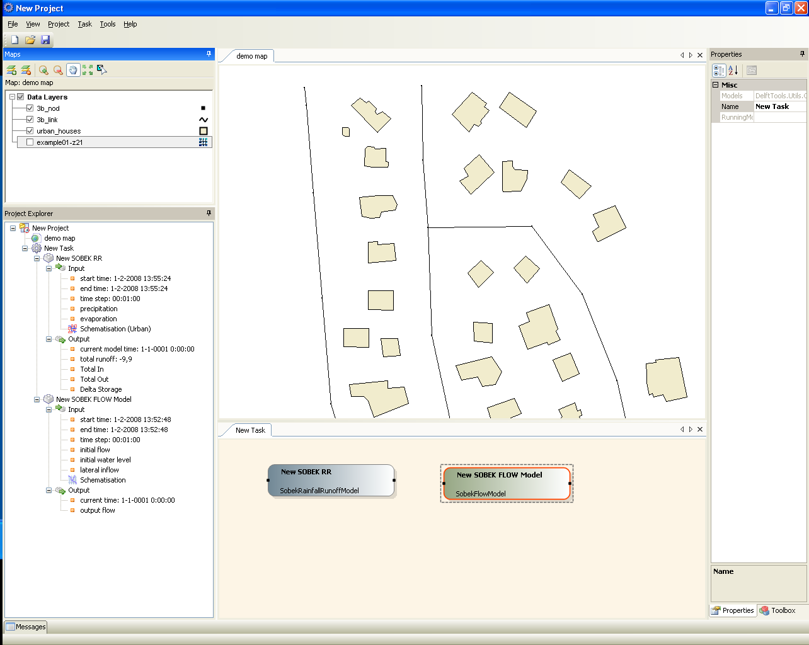

Slide 27
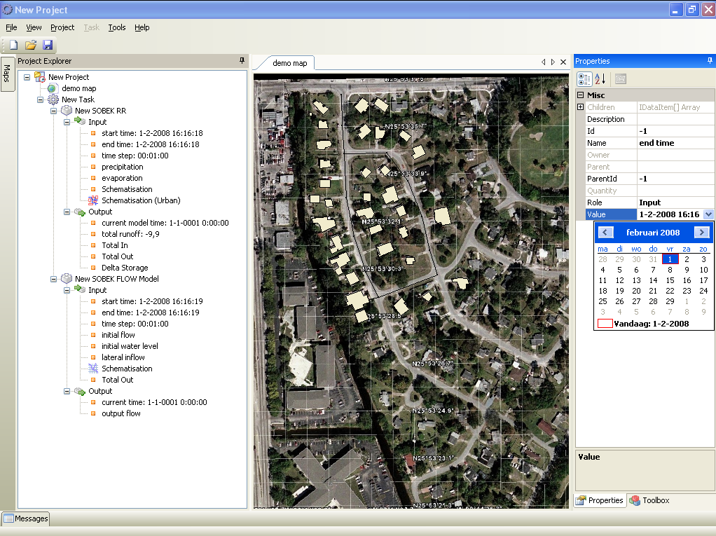

Slide 28
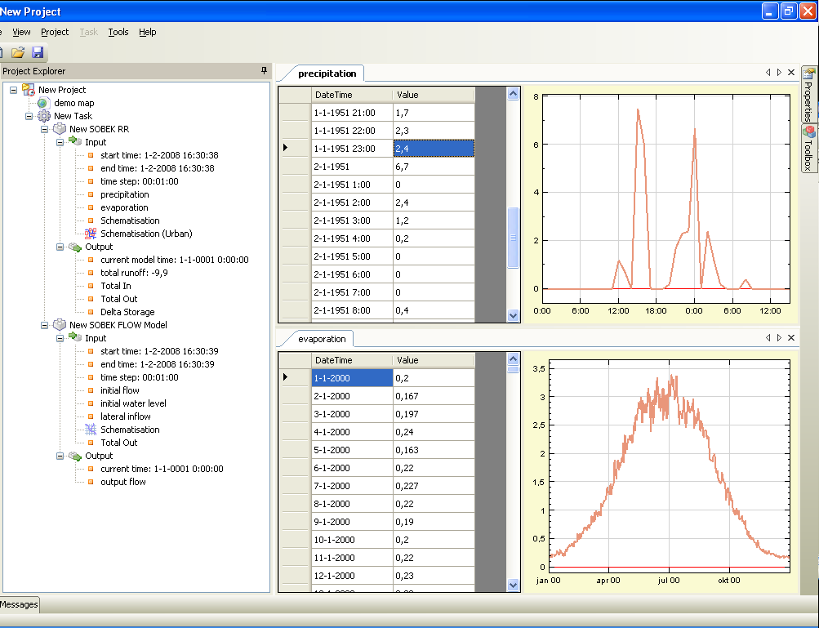

Slide 29
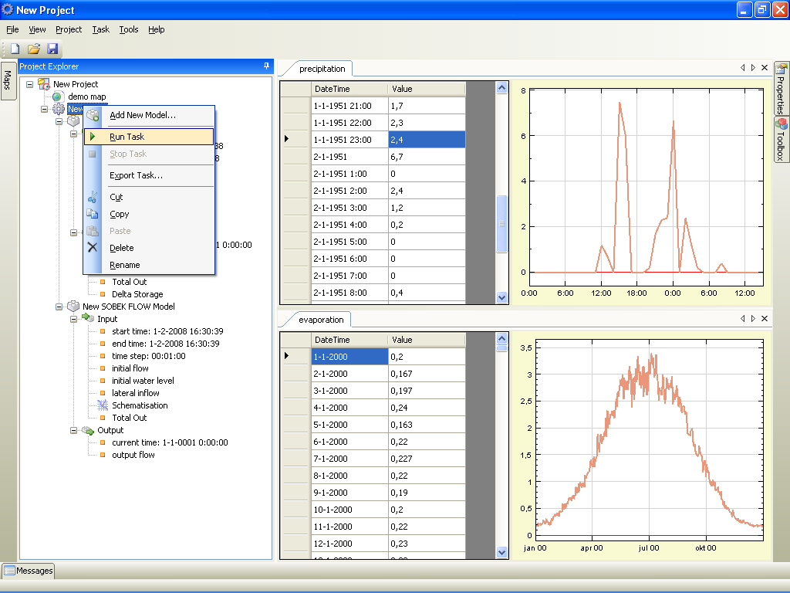

Slide 30
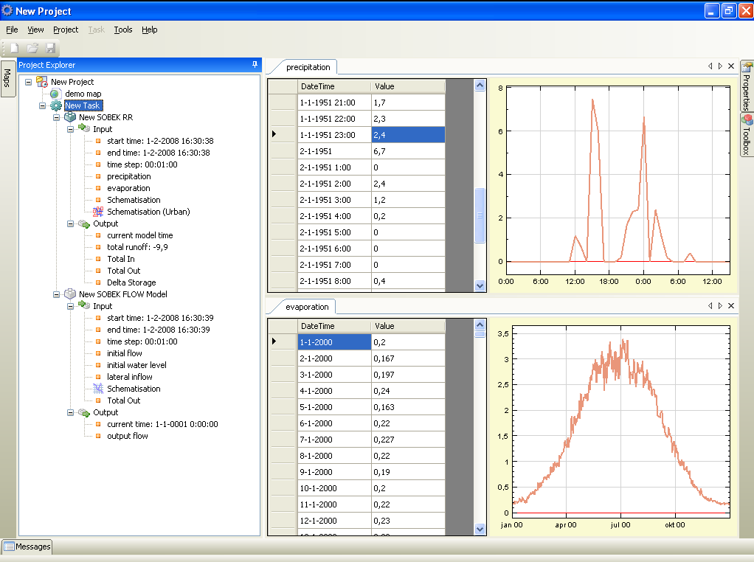

Slide 31


Slide 32
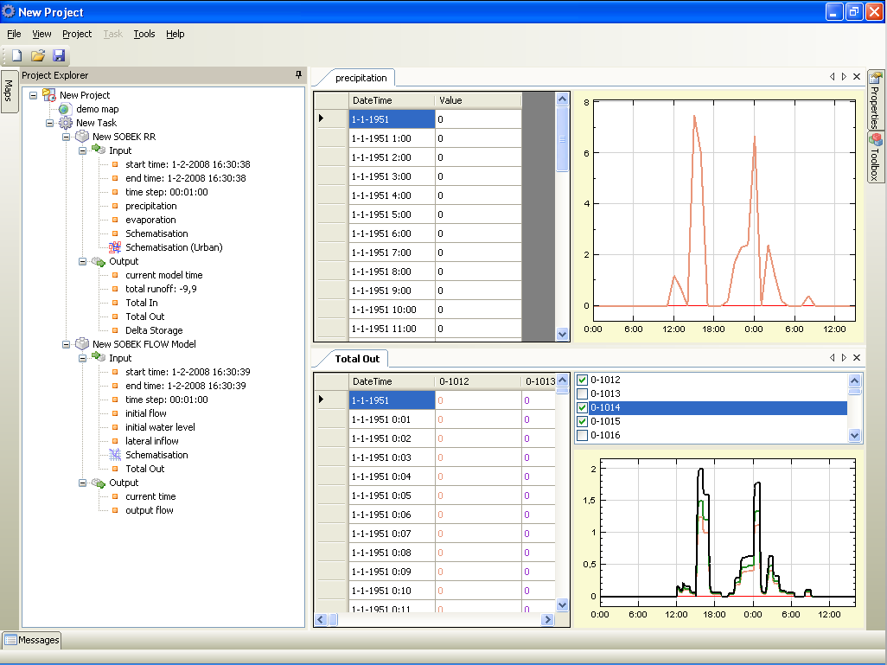

Slide 33
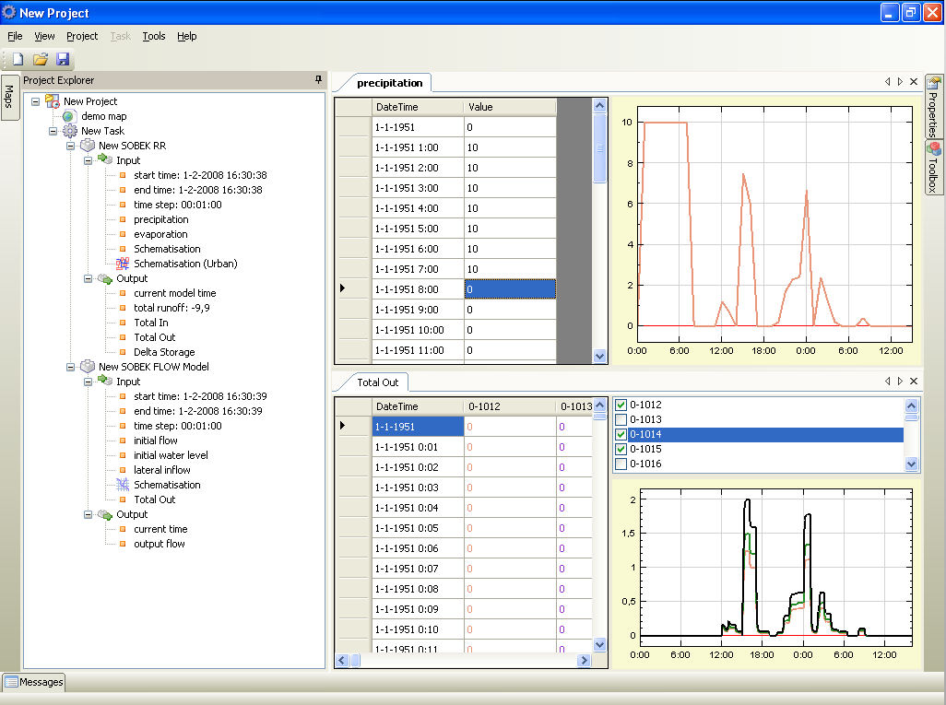

Slide 34
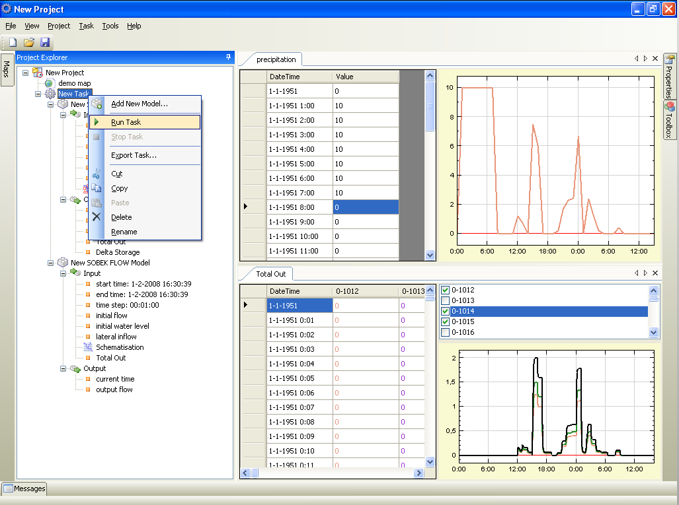

Slide 35
