Slide 1
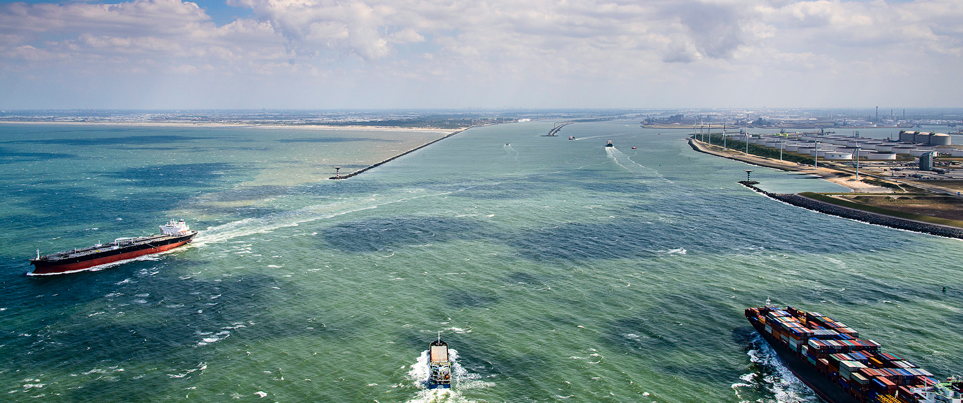

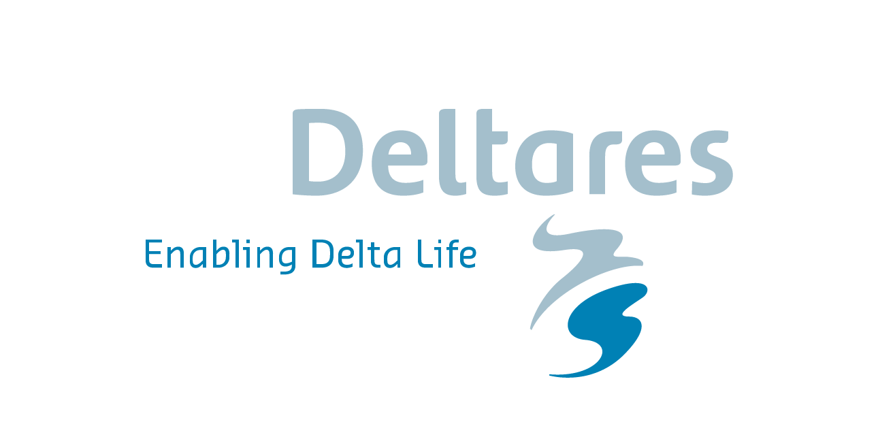
Pilot project Suricates
Situation March 2018
M. Wensveen and A. Wijdeveld
Rotterdam, 06 March 2019

Slide 2
EU project SURICATES
Objective: Managing and monitoring the dredging and reallocation of 200.000 tons of sediment within the river in Port of Rotterdam
WP T2 (implementation): Demonstrate and evaluate innovative sediment reuse solutions for flood and erosion protection
WP I1 (investment): Pilot application of sediment reallocation within the system to 'reset' a natural system for bank nourishment in Port of Rotterdam
Port of Rotterdam target: Evolution of reallocation scenario for sediment in the river, improving the system understanding of sediment transport and settlement.

Slide 3
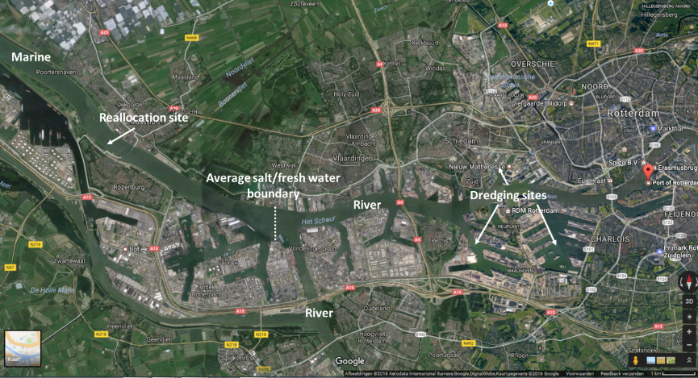
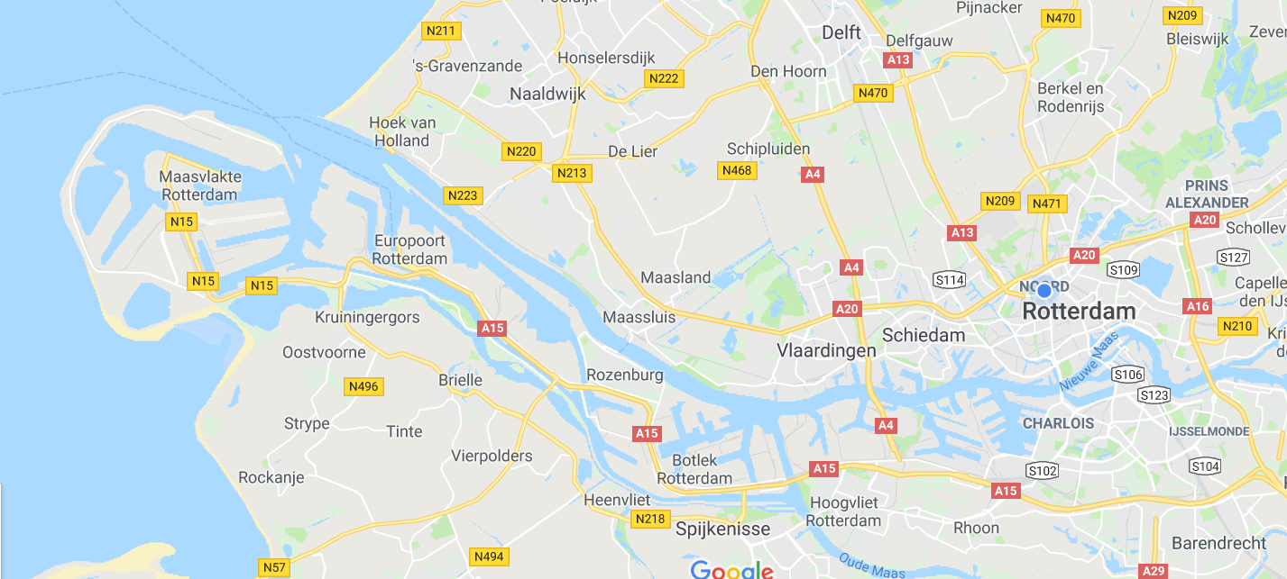
Overview of Port of Rotterdam

Slide 4
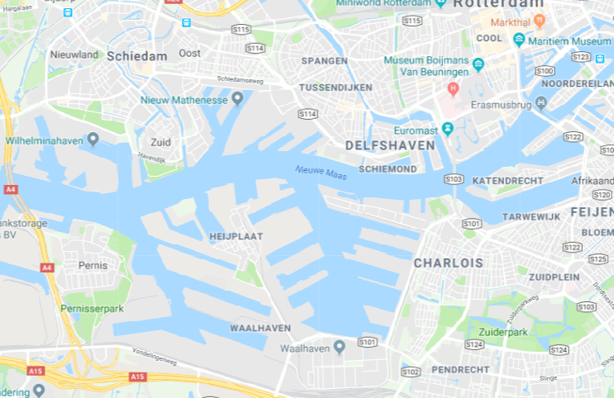
Dredging area

Slide 5
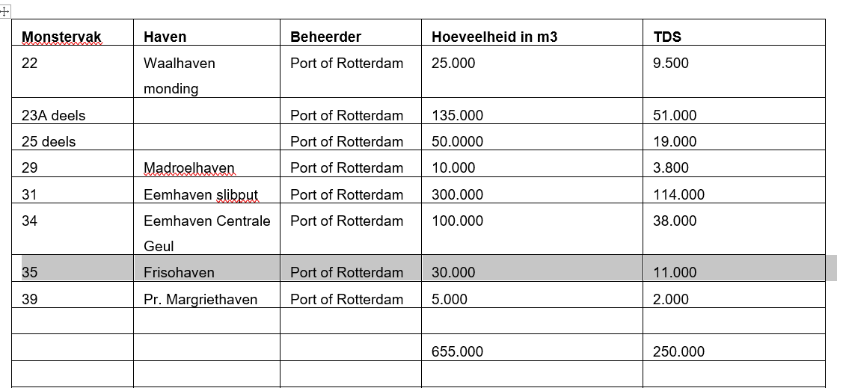
Amounts of dredged sediment

Slide 6
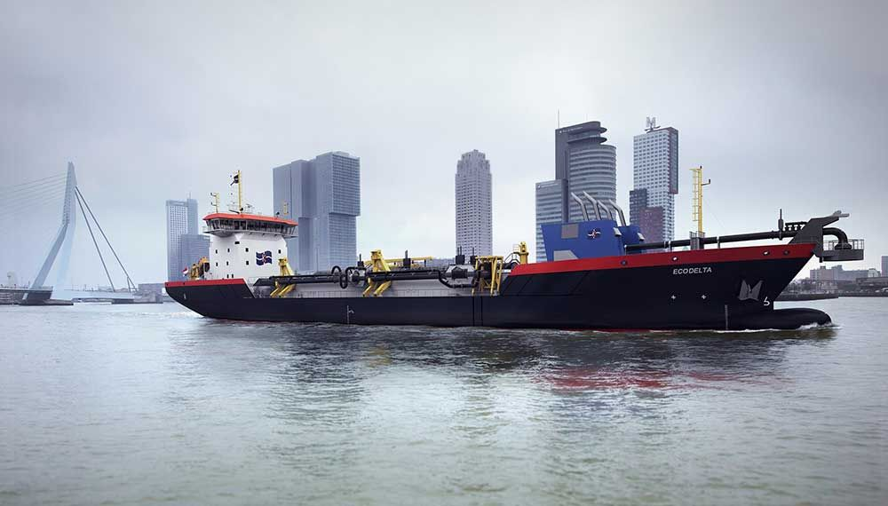
Execution
March – April 2019
TSHD Ecodelta
Capacity 5.500 m3
2 trips every tide
~100 trips

Slide 7
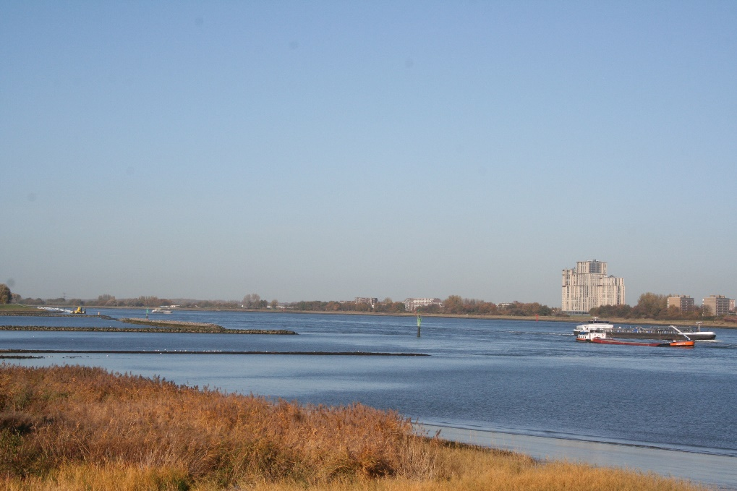
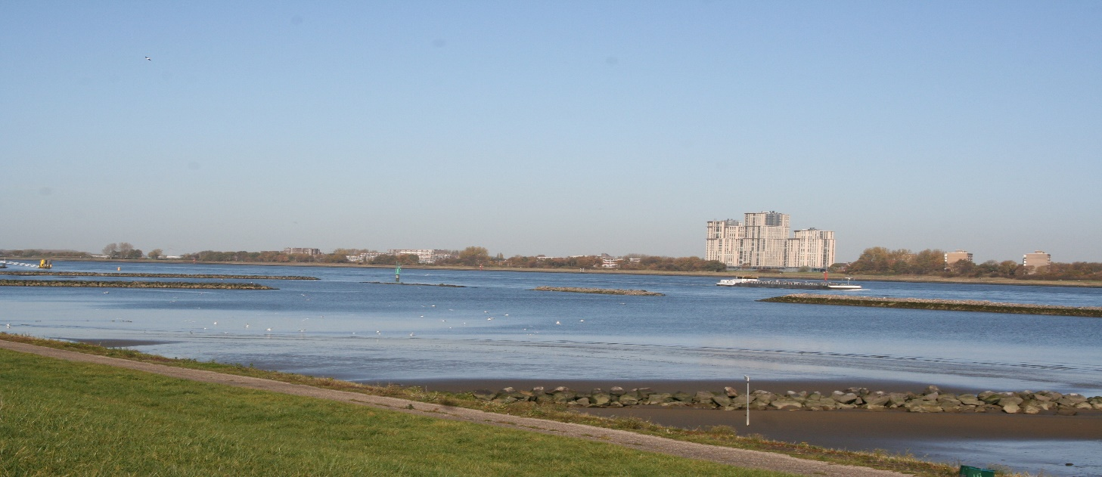
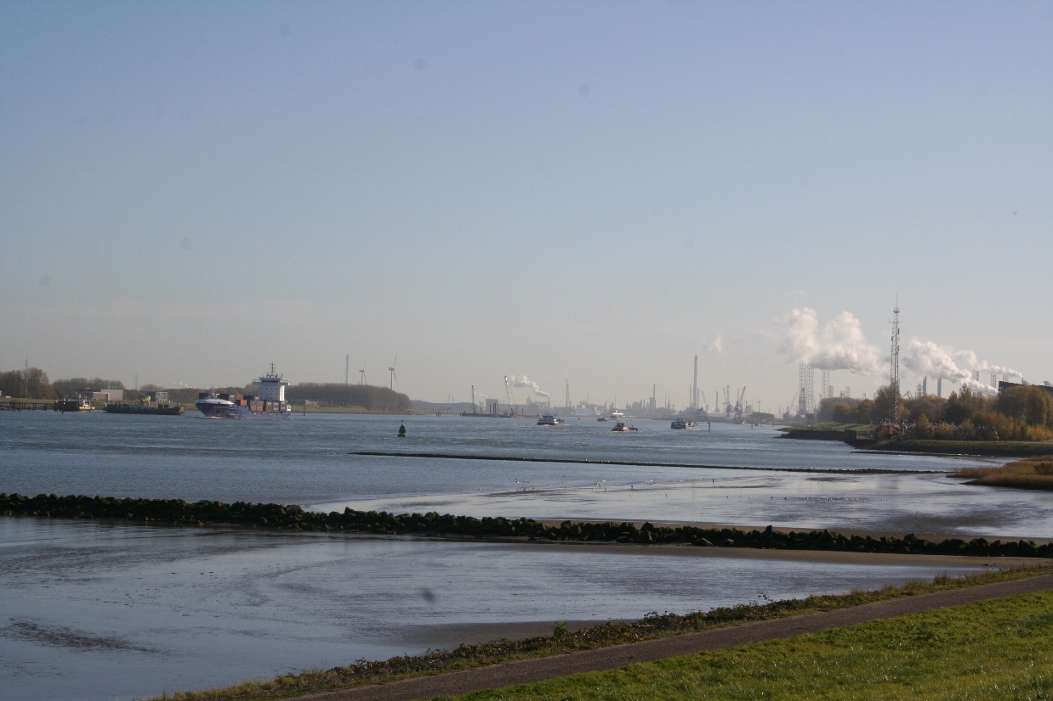
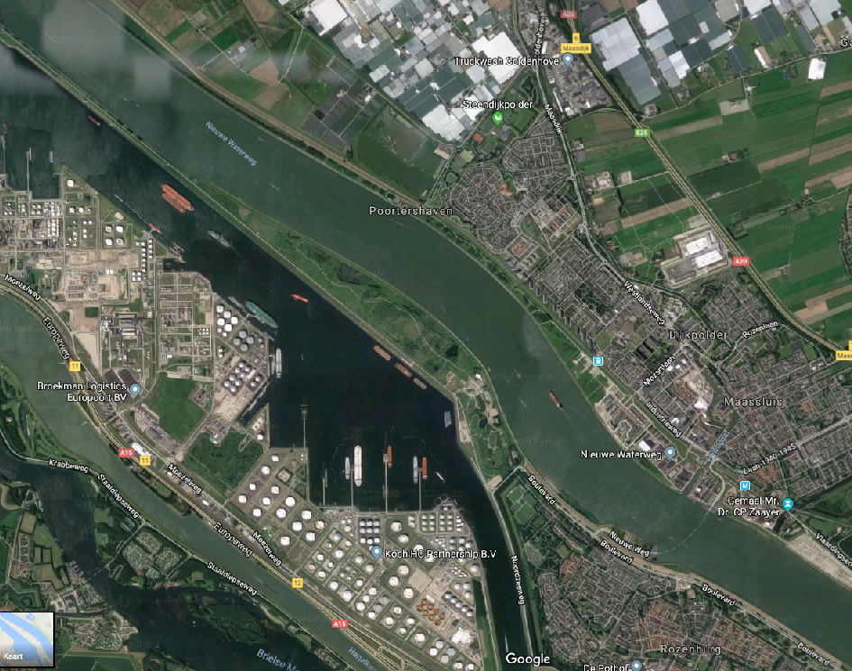
Reallocation area: Location

Slide 8
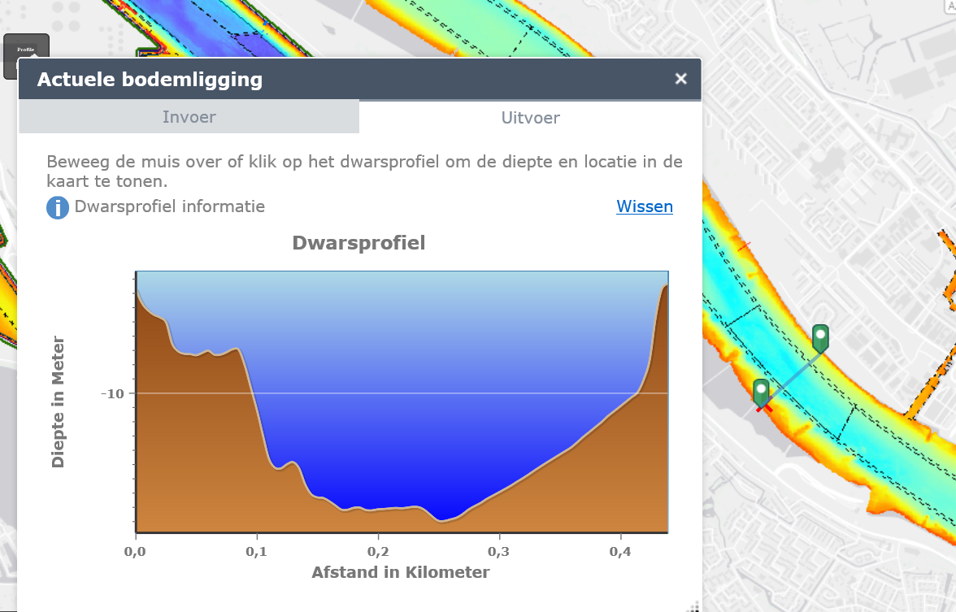
Bathmetry at reallocation site

Slide 9
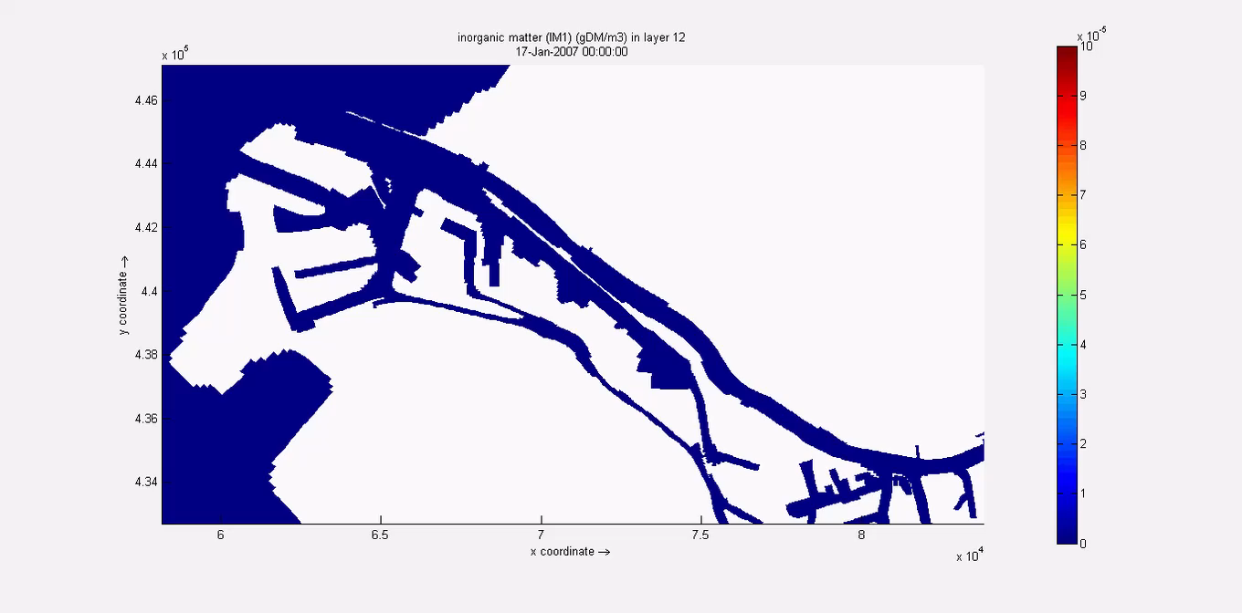
Reallocation area, simulation results transport of sediments

Slide 10
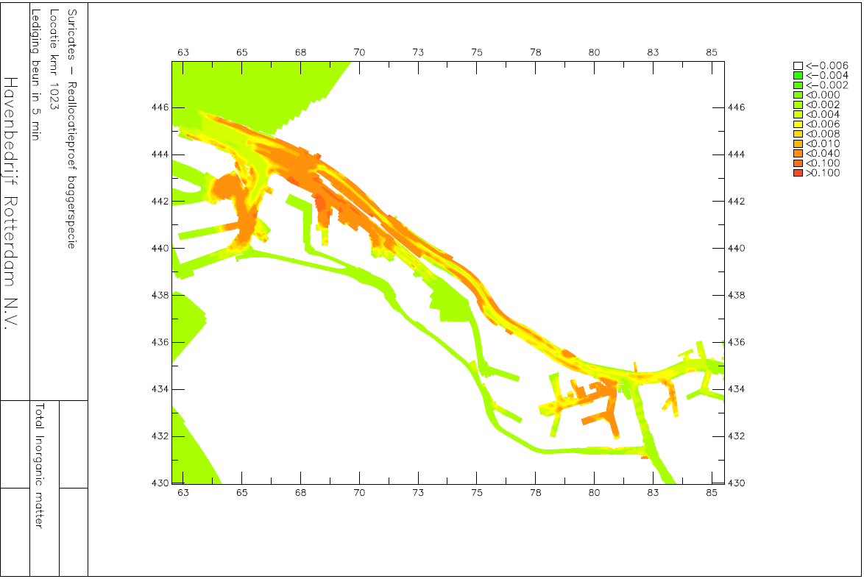
Reallocation area, simulation results transport of sediments

Slide 11
Zooming in on the monitoring
Grab samples of sediments in the port, for baseline and rare earth elements fingerprint
Optical cable for settling, erosion and sediment density
Survey’s to follow the flume
Survey’s to check the river bathymetry
(Survey’s to check the Green port bathymetry between the groins)

Slide 12
Grab samples of sediments in the port

Slide 13
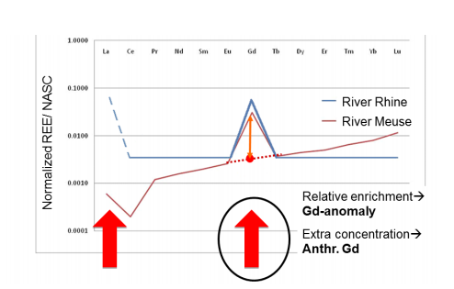
Grab samples of sediments in the port
Rare earth as tracer, background (in Dutch):
https://www.google.com/url?sa=i&source=images&cd=&ved=2ahUKEwi6l6Ty8OzgAhWSKVAKHctUC9QQjRx6BAgBEAQ&url=http%3A%2F%2Fpublications.deltares.nl%2F1230038_003.pdf&psig=AOvVaw2PeiHzkJxq3yD1eXT5prUR&ust=1551939925899538
Vanaf halverwege de jaren 80, van de 20ste eeuw, worden in toenemende mate gadolinium (Gd) houdende complexen gebruikt tijdens hoge resolutie MRI-scan in de medische wereld. Vanaf midden jaren negentig is het mogelijk om deze “extra” gadolinium uit de MRI complexen terug te meten.
Naast de extra oftewel antropogene gadolinium kan ook de rest van het zeldzame aardelementen patroon gebruikt worden om verschillende waterbronnen te onderscheiden.
Vanaf 1998 is het bijvoorbeeld mogelijk om Rijnwater te onderscheiden van Maaswater / grondwater / regenwater op basis van een extra antropogene lanthaan concentratie, en vanaf het voorjaar 2011 ook een extra antropogene samariumconcentratie.

Slide 14
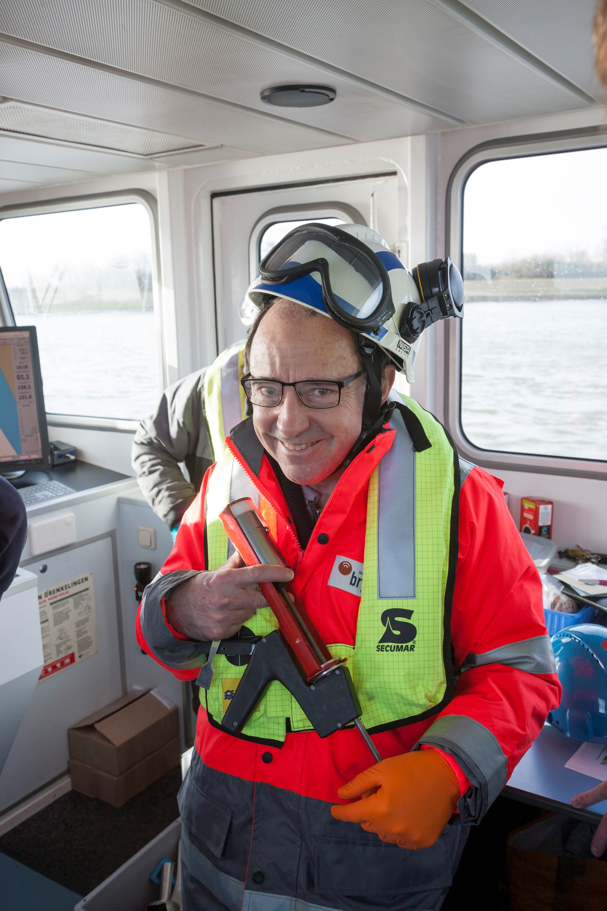
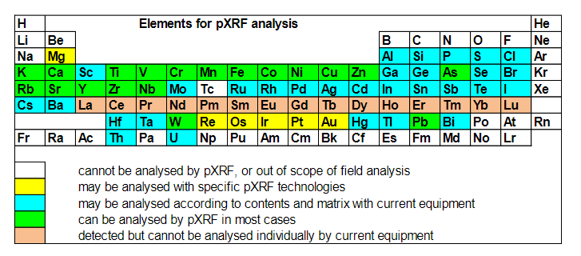
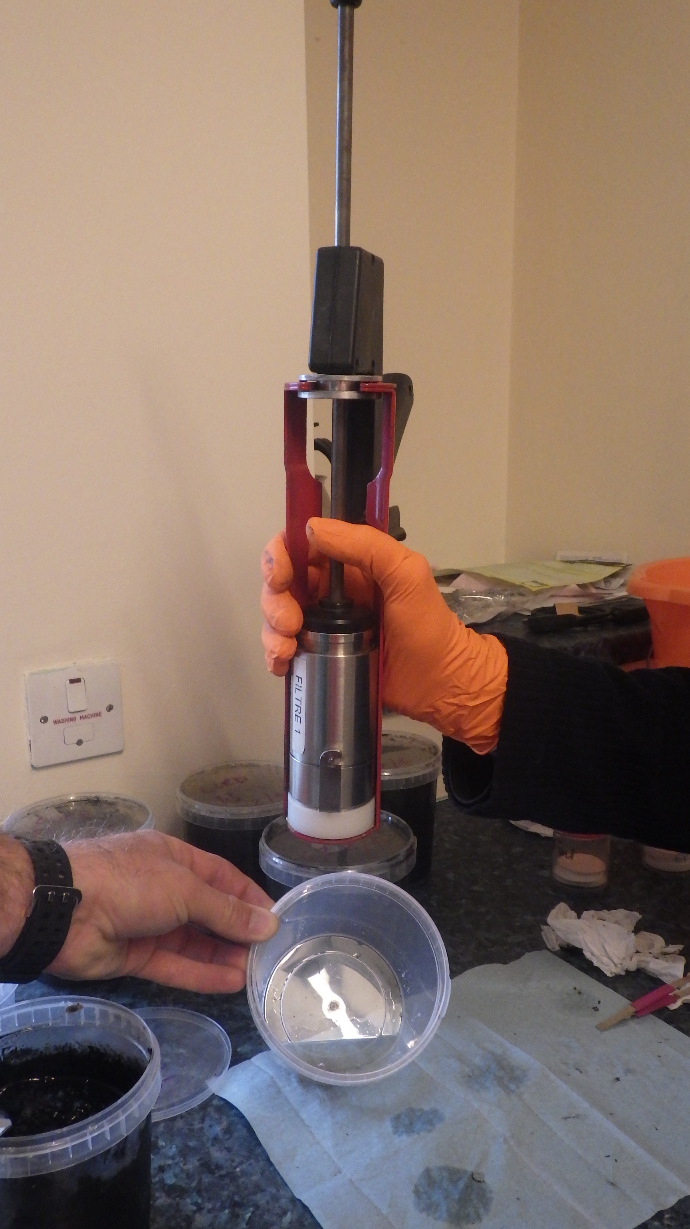
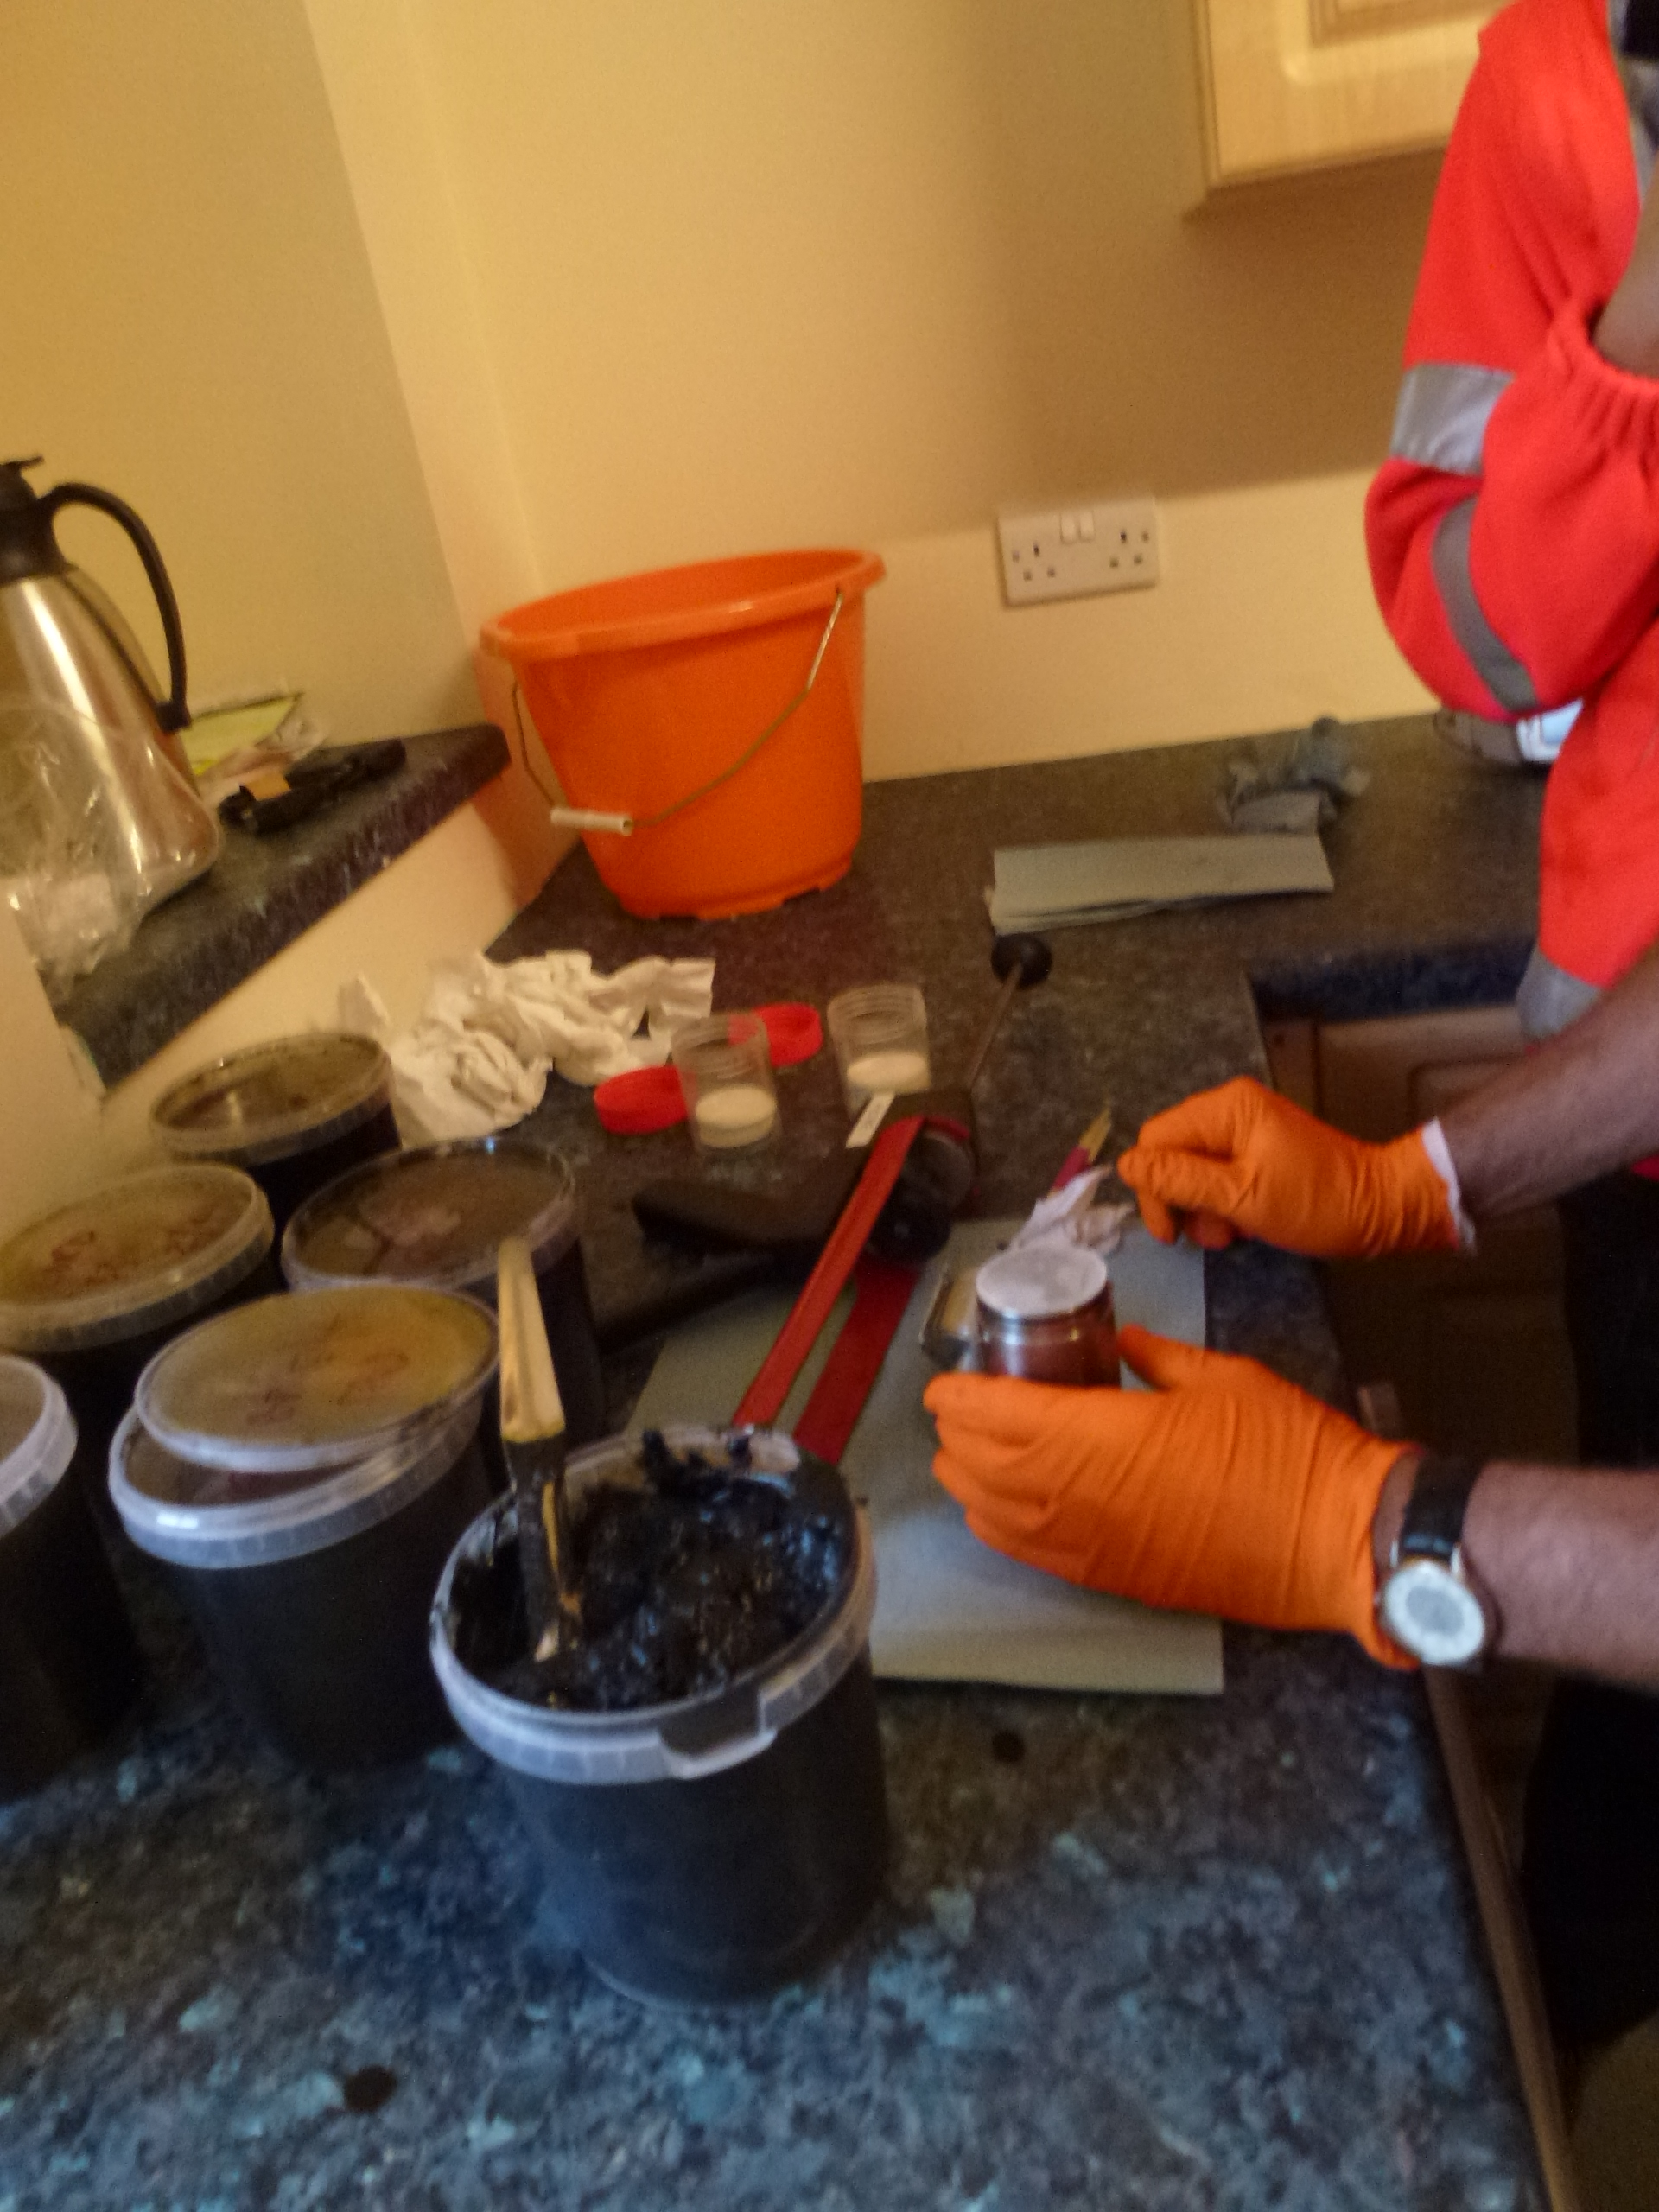
Grab samples of sediments in the port
XRF for mineralogy (BRGM): XRF assists in the classification of the
mineral fraction.

Slide 15
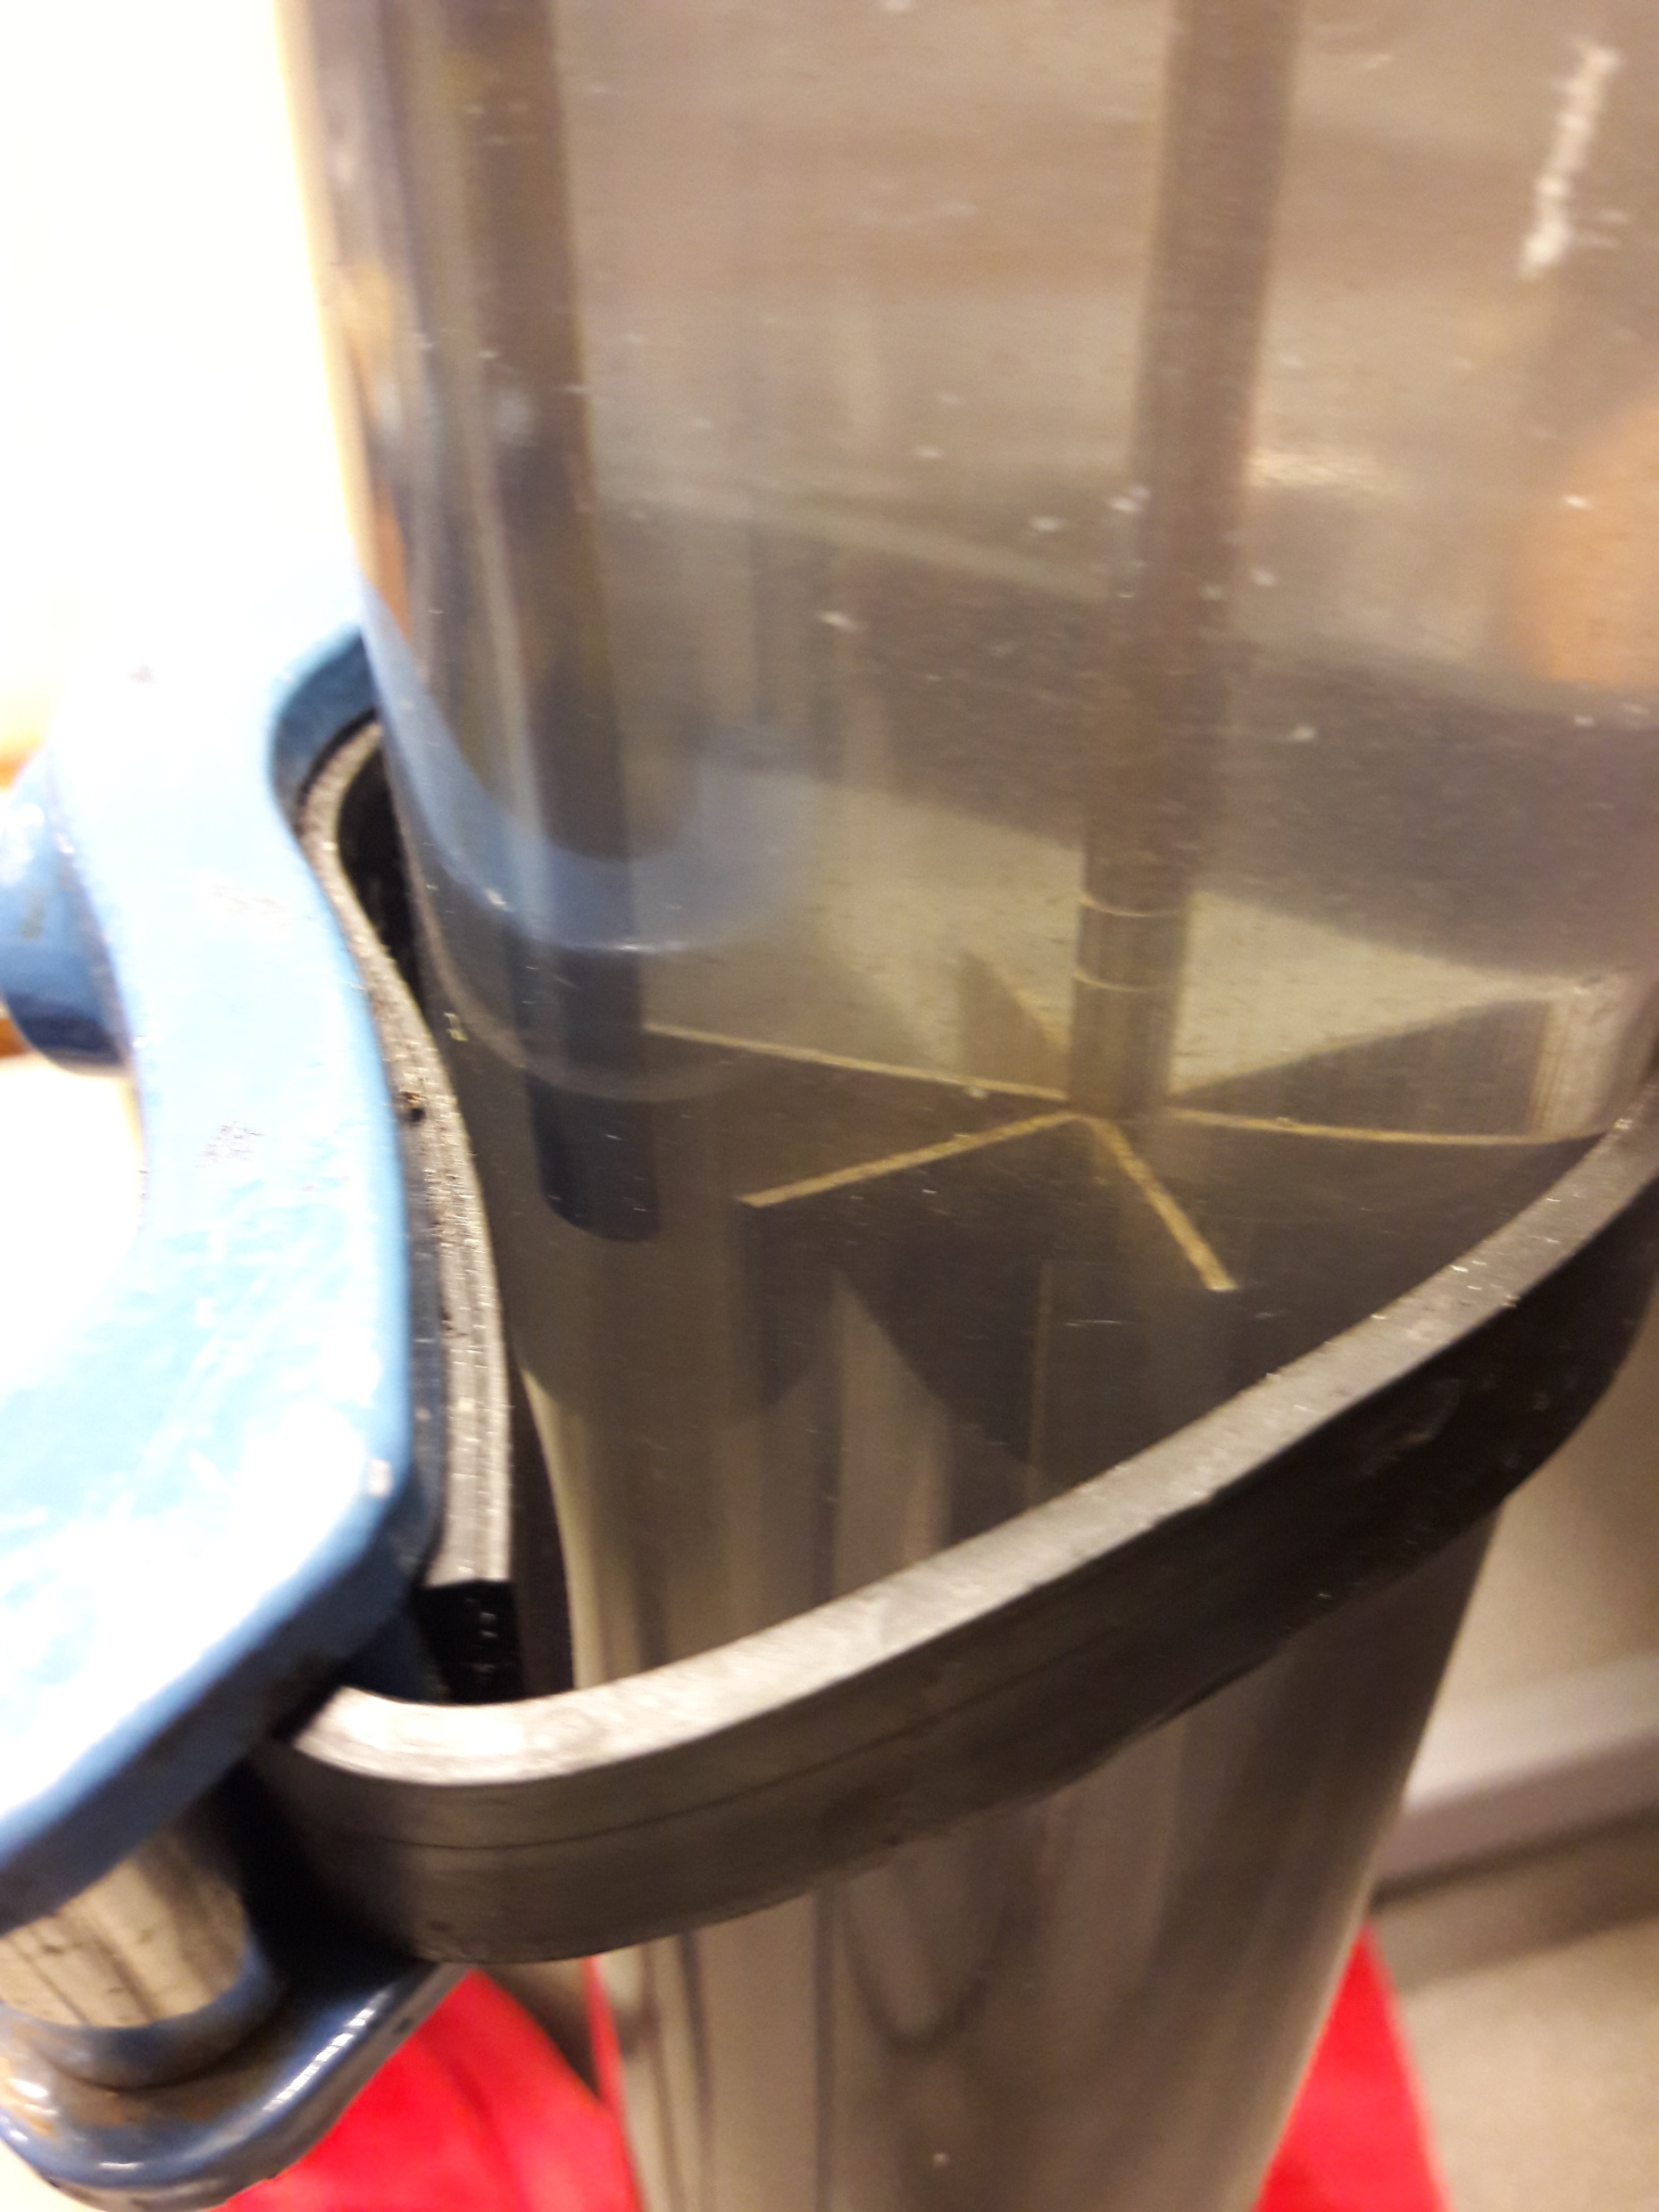
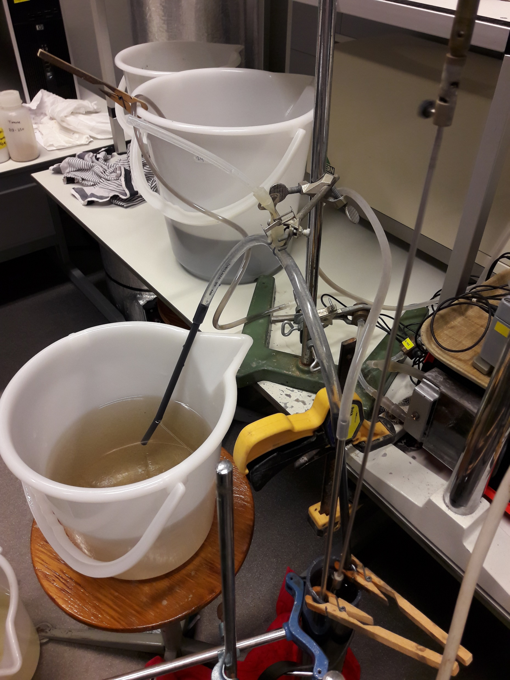
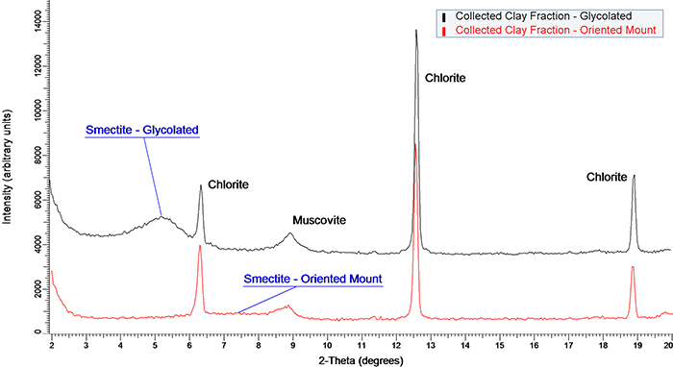
Grab samples of sediments in the port
Rheology and flocculation: To determine the settling behavior and shear stress of the sediment at different locations in the port.
Base line: XRD for clay mineral composition

Slide 16
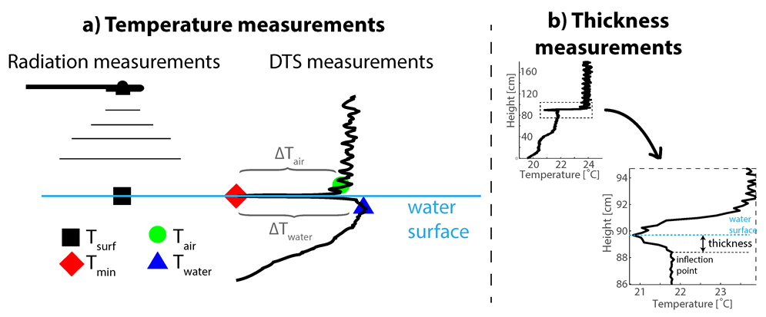
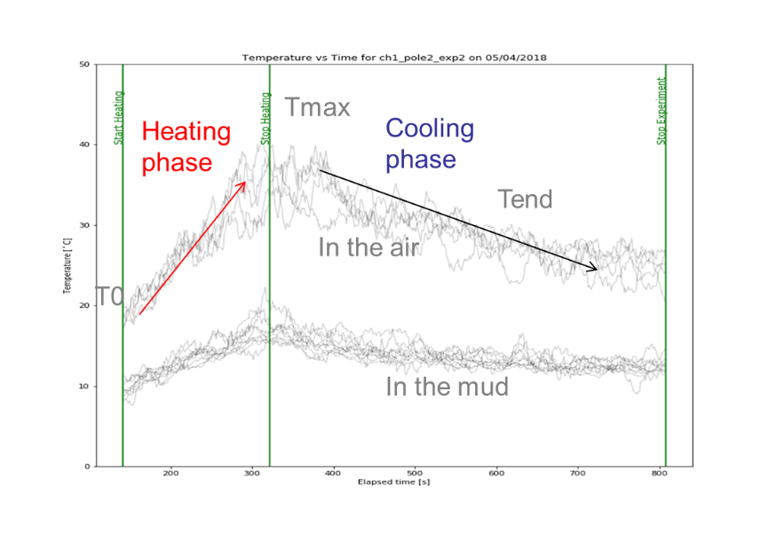
Optical cable
Long (1 km) horizontal cable: To determine the coverage with sediments based on a delayed shift in temperature when the tide change (passive)
Short (1 m) vertical poles: To determine the sediment density based on the thermal heat capacity of the sediment (active)

Slide 17
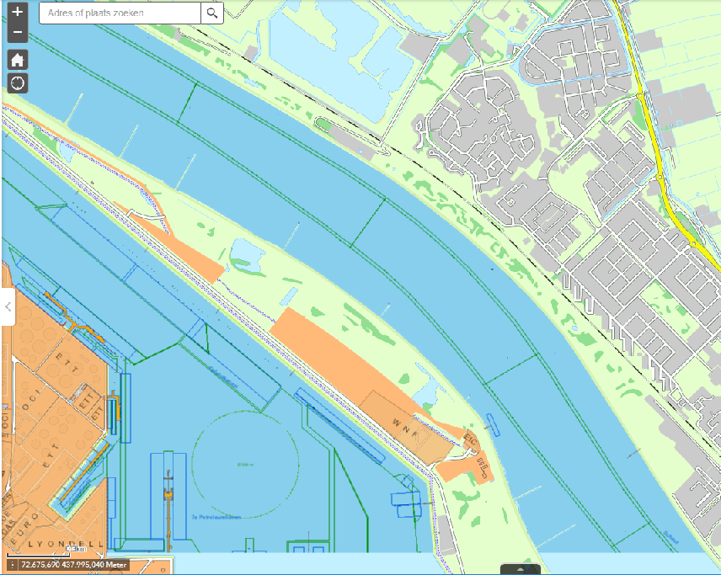
Stortvak
Long optical cable

Slide 18
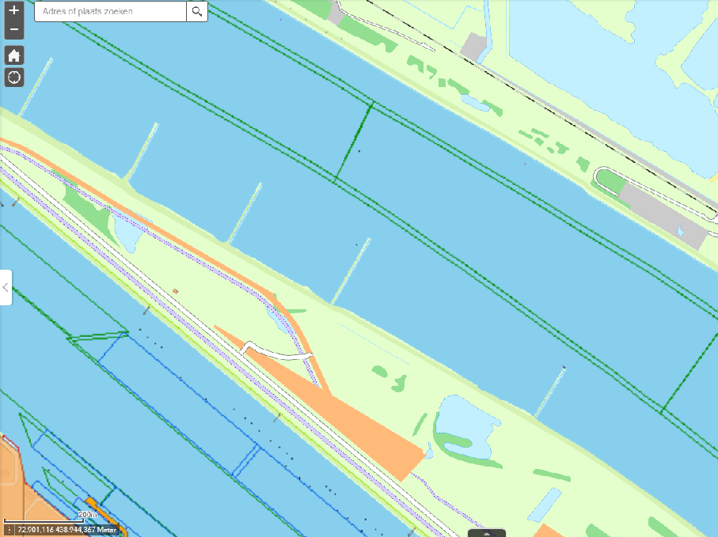
Poles for vertical profile, Vak 3

Slide 19
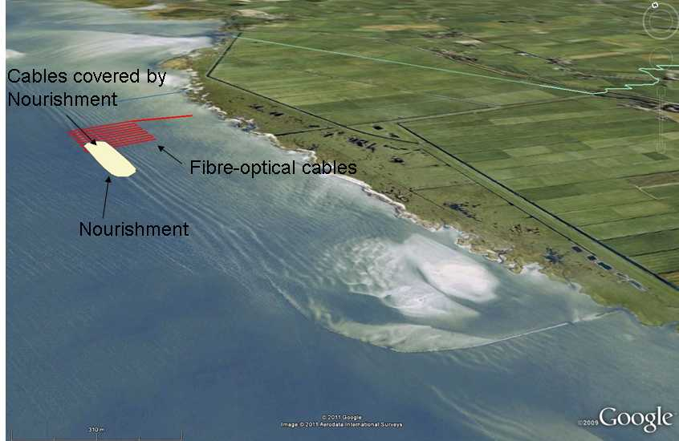
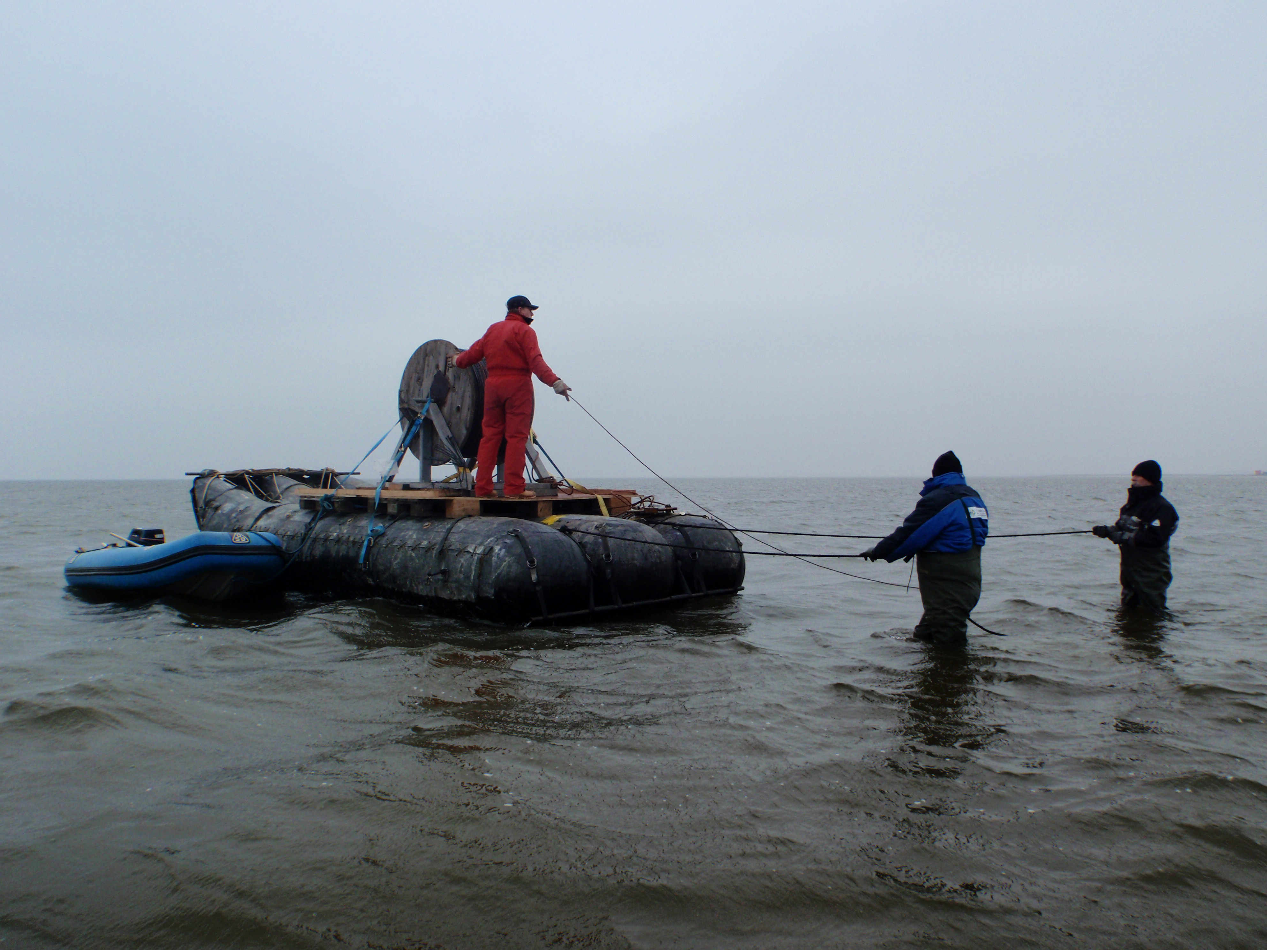
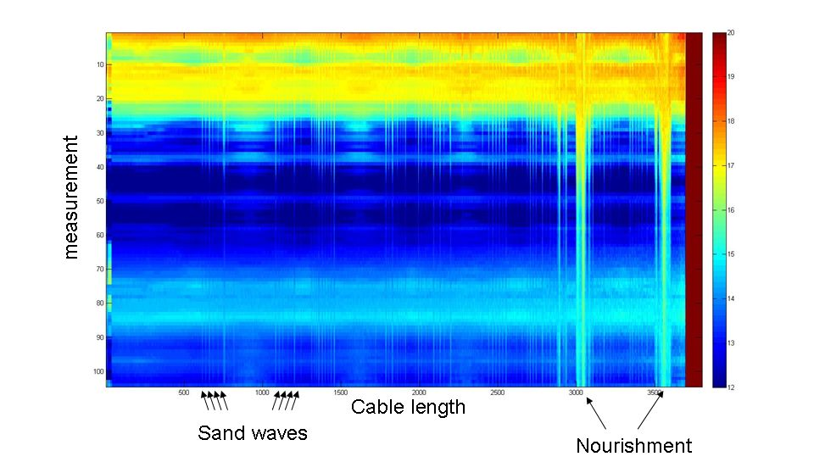
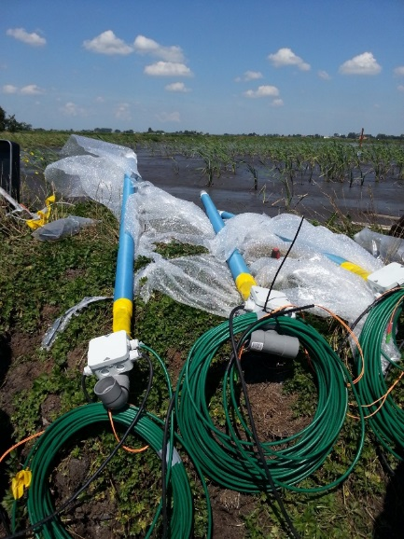
Optical cable
Long (1 km) horizontal cable:
  (details Mike van der Werf)
  To be installed on the river bed
Short (1 m) vertical poles:
Drilled in the sediment bed within vak3
Pole is 1 m from top sediment -> submerged, we can lengthen the pole with a non active part

Slide 20
Surveys
The bathymetry will be checked during the T0, T1 and T2 surveys of the impacted area (km 1013 – 1033) by Multi beam echo sounder (230 kHz).
- T0: before 16-04-2019 (routine survey Port of R’dam)
- T1: between 16-04-2019 and 21-06-2019 (planned for 23-05-2019)
- T2: 3 months after the experiment (to be planned around 21-09-2019)
The turbidity directly after a reallocation (5.500 m3) will be checked by in total six survey’s:
• Floating with the reallocation flume towards sea, three times during the reallocation period (period of 9 weeks)
23-04 / 08-05 / 22-05
• Staying at a stationary location close to the reallocation site, three times during the reallocation period
25-04 / 14-05 / 28-05

Slide 21
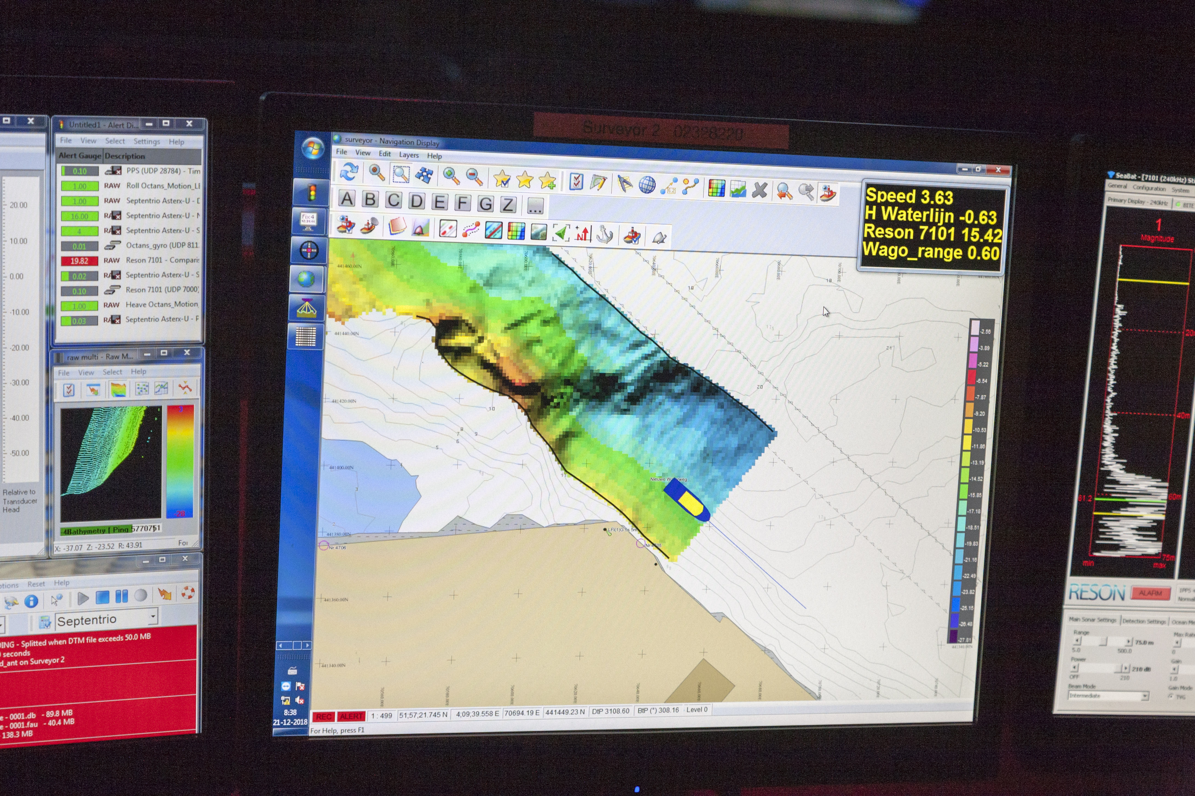
Survey Maeslantkering
The Maeslantkering bathymetry will be checked weekly during the reallocation period with a Multi beam echo sounder (230 kHz).
(Port of Rotterdam)

Slide 22
Timeline monitoring
The reallocation will start at the end of the storm season (16-04-2019), to not compromise the safety of the Maeslantkering.
In total 500.000 m3 of sediment will be reallocated, the capacity of the hopper is 5.500 m3 per trip:
91 trips
2 trips per day (tide dependent) = 11.000 m3 per day
45.5 working days
Reallocation period 9 weeks
Start: 16-04-2019 (week 16)
End: 21-06-2019 (week 25)

Slide 23
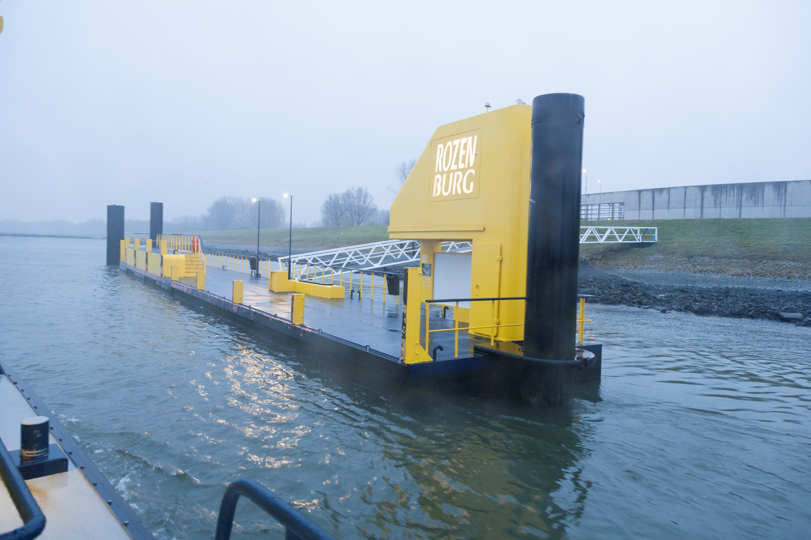
Practical issues
Grab sampling: No issues, with Hebo – Cat 12
Survey’s: No issues, test a new multi frequency echosounder and new ADCP software for turbidity
Optical cables:
Permit for placement
Power for logger
Safe place for logger
Developments impacting the pilot:
Green Port: use of soil with different origin between the groins;
  rare earth fingerprinting disturbed,
  sediment balance with the river disturbed
Blankenburg tunnel: Dredging of trench can act as extra sink
Recent deepening of NWW: uncertain if current bathymetry is in equilibrium

