Slide 1
Star2C Adaptation Catalyst tool
Overview of functionality
24 mei, 2019

Slide 2
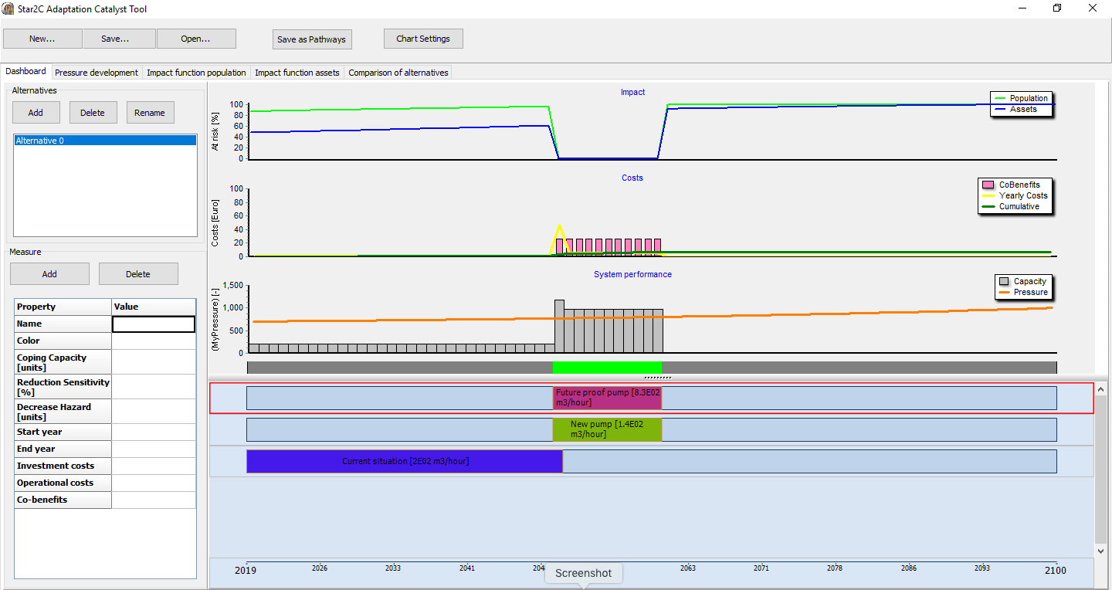
Star2C Adaptation Catalyst tool

Slide 3
Star2C Adaptation Catalyst tool

Slide 4
Star2C Adaptation Catalyst tool
Dashboard
Pressure development
Impact function population
Impact function assets
Comparison of alternatives

Slide 5
Star2C Adaptation Catalyst tool
Pressure
Climate change scenarios
Measures
Combination of measures and interventions
Excess
Overall performance
Impact
Co-Benefits
Costs

Slide 6
Star2C Adaptation Catalyst tool
Pressure
Climate change scenarios
Measures
Combination of measures and interventions
Excess
Overall performance
Impact
Co-Benefits
Costs
Costs and co-benefits

Slide 7
Star2C Adaptation Catalyst tool
Pressure
Climate change scenarios
Measures
Combination of measures and interventions
Excess
Overall performance
Impact
Co-Benefits
Costs
Impact on population and assets

Slide 8
Pressure
Measures
Excess
Impact
Co-Benefits
Costs

Slide 9
Pressure
Measures
Excess
Impact
Co-Benefits
Costs

Slide 10
Pressure
Measures
Excess
Impact
Co-Benefits
Costs

Slide 11
Pressure
Measures
Excess
Impact
Co-Benefits
Costs
Excess
Timeline of excess and sufficient capacity
Green: sufficient capacity
Gray: insufficient capacity

Slide 12
Pressure
Excess
Unsufficient capacity results in excess of the pressure
Overall performance:
Satisfactory if excess is zero
Unsatisfactory if excess larger than zero
Example:
Satisfactory:
Sufficient pumping capacity to deal with precipitation
Sufficient dike and protection
Unsatisfactory:
Unsufficient pumping capacity to deal with precipitation
Unsufficient dike and protection
Measures
Excess
Impact
Co-Benefits
Costs

Slide 13
Pressure
Measures
Excess
Impact
Co-Benefits
Costs

Slide 14
Pressure
Measures
Excess
Impact
Co-Benefits
Costs

Slide 15
Pressure
Measures
Excess
Impact
Co-Benefits
Costs

Slide 16
Pressure
Pressure
Puts stress on the system
Example:
Precipitation
Water levels
Storm surge
Water deficit
Defined as scenario:
Expected values for future conditions
Measures
Excess
Impact
Co-Benefits
Costs

Slide 17
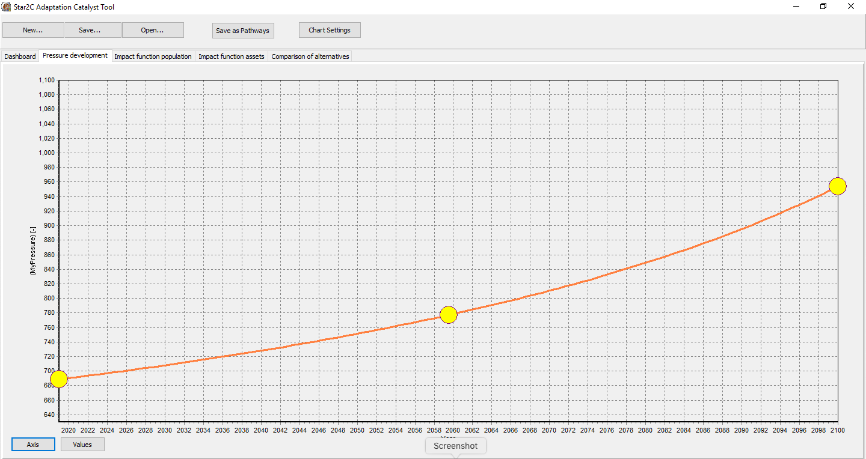
Pressure
Measures
Excess
Impact
Co-Benefits
Costs
Page: Pressure
Axis button controls the pressure axis of the chart
Drag handles for scenario definition

Slide 18
Pressure
Measure
Coping capacity of the system to deal with the pressure
Reduction of sensitivity of the system to hazards
Decrease of hazard
Example:
Pumping capacity for excess water
Dikes and protection structures
Water inlets and reservoirs
Combination of measures and interventions
Timing of the measure (first year and last year of operation)
Investment costs
Operational costs
Measures
Excess
Impact
Co-Benefits
Costs

Slide 19
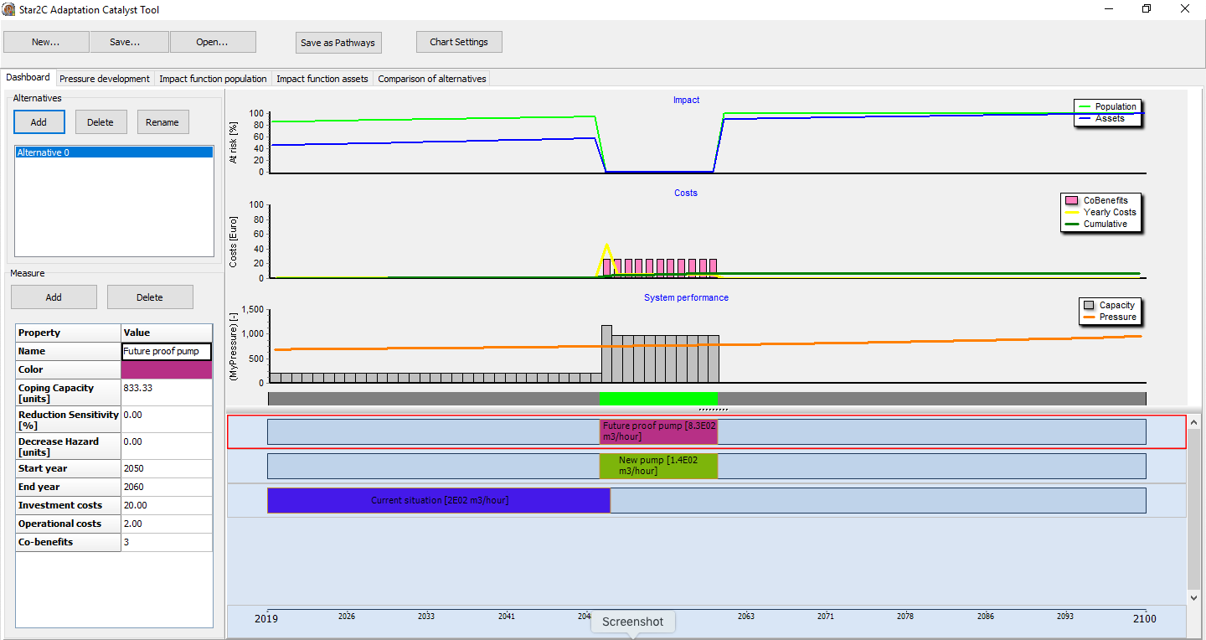
Pressure
Measures
Excess
Impact
Co-Benefits
Costs
Page: Main
Timeline of timing of defined measures
Add: Adds new measure
Delete: Deletes selected measure
Properties: lists the properties of the selected measure
Draghandles allow for changing timing of selected measure

Slide 20
Pressure
Measures
Excess
Impact
Co-Benefits
Costs
Page: Main
Timeline of timing of defined measures
Add: Adds new measure
Delete: Deletes selected measure
Properties: lists the properties of the selected measure
Draghandles allow for changing timing of selected measure

Slide 21
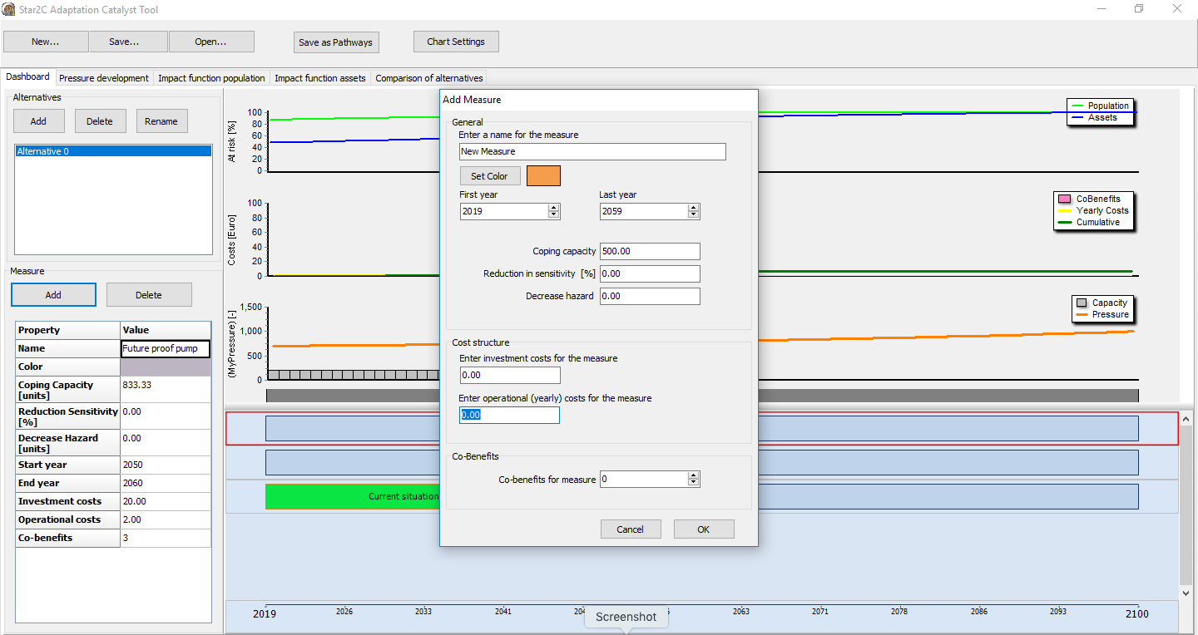
Pressure
Measures
Excess
Impact
Co-Benefits
Costs
Page: Main
Timeline of timing of defined measures
Add: Adds new measure
Delete: Deletes selected measure
Properties: lists the properties of the selected measure
Draghandles allow for changing timing of selected measure

Slide 22
Pressure
Impact
Occurs in excess of the pressure
Impact on population
Population at risk
Population exposed to excess
Population vulnerable to excess
Impact on assets
(Risk of) Damage to properties
Measures
Excess
Impact
Co-Benefits
Costs

Slide 23
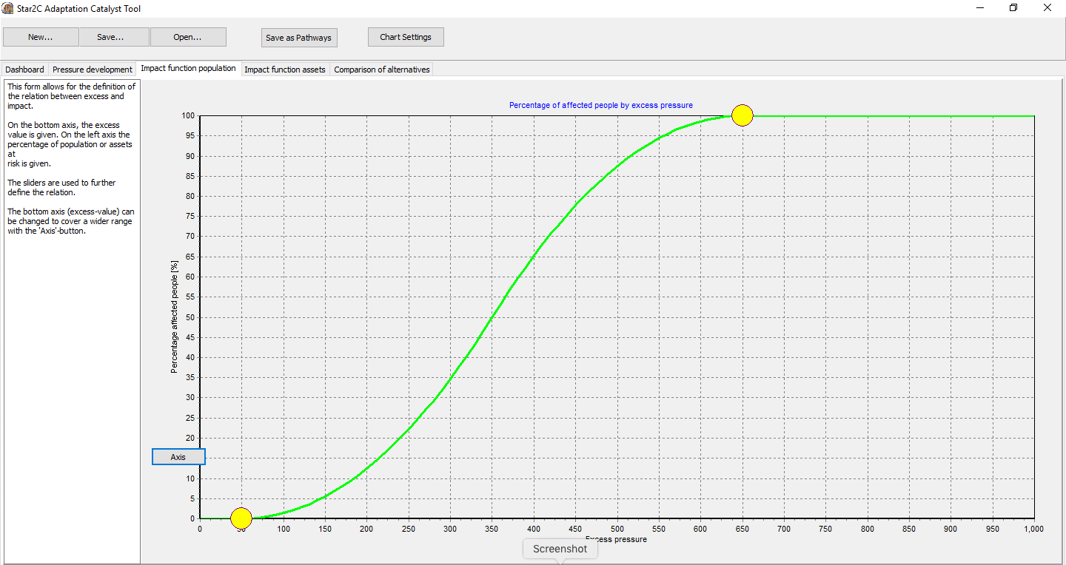
Pressure
Measures
Excess
Impact
Co-Benefits
Costs
Page: Impact function population
Draghandles for percentage affected people [%]
Curve is related to the normal distribution
Button allows to change axis

Slide 24
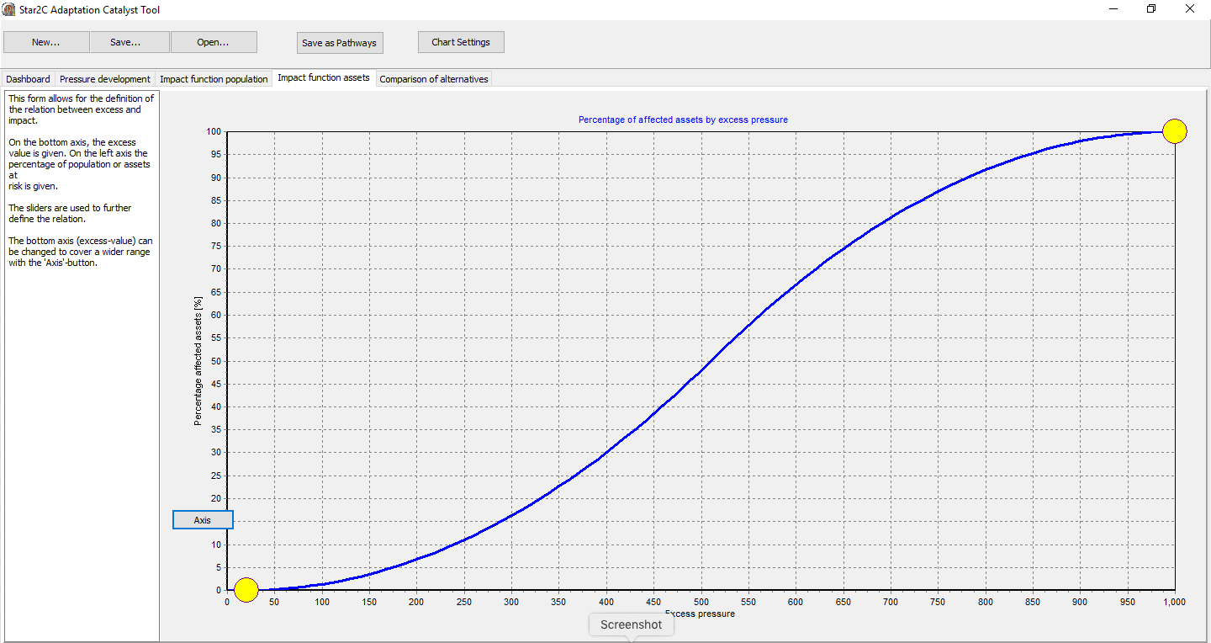
Pressure
Measures
Excess
Impact
Co-Benefits
Costs
Page: Impact function assets
Draghandles for percentage affected assets [%]
Curve is related to the normal distribution
Button allows to change axis

Slide 25
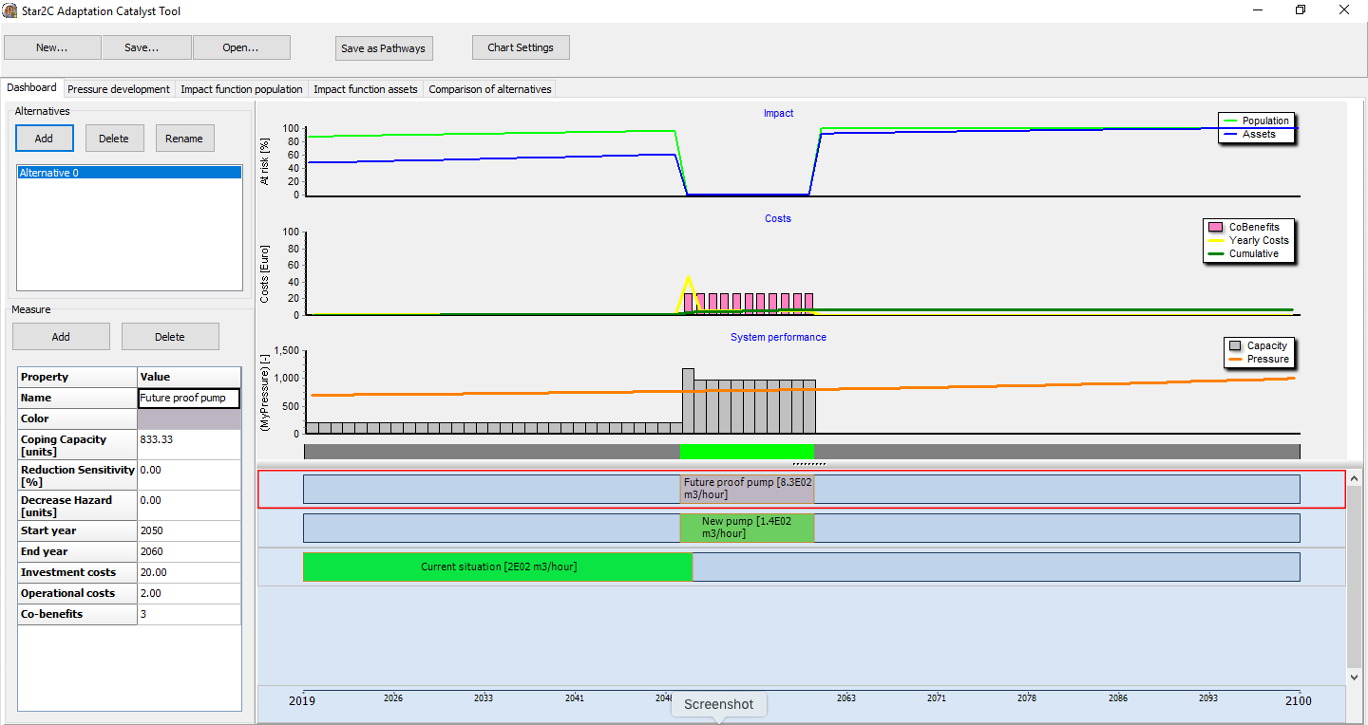
Pressure
Measures
Excess
Impact
Co-Benefits
Costs
Page: Dashboard

Slide 26
Create Alternatives: alternative solutions
for the same pressure
Pressure
Measures
Excess
Impact
Co-Benefits
Costs

Slide 27
Create Alternatives: alternative solutions
for the same pressure
Pressure
Measures
Excess
Impact
Co-Benefits
Costs
Pressure
Measures
Excess
Impact
Co-Benefits
Costs

Slide 28
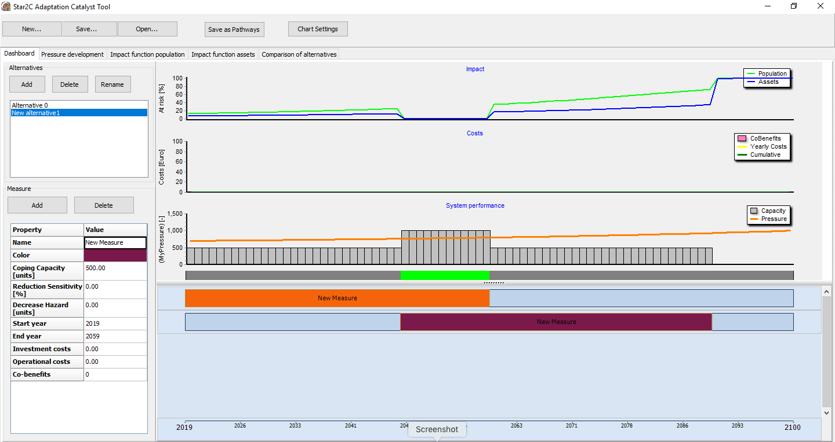
Create Alternatives: alternative solutions
for the same pressure
Pressure
Measures
Excess
Impact
Co-Benefits
Costs
Pressure
Measures
Excess
Impact
Co-Benefits
Costs

Slide 29

Create Alternatives: alternative solutions
for the same pressure
Pressure
Measures
Excess
Impact
Co-Benefits
Costs
Pressure
Measures
Excess
Impact
Co-Benefits
Costs

Slide 30
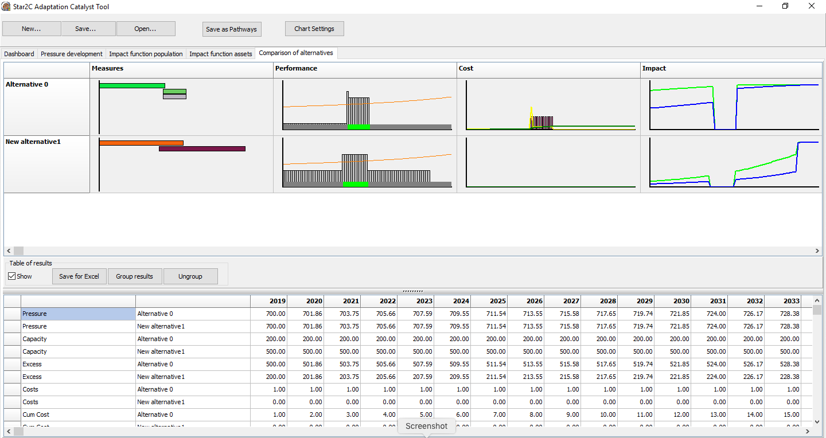
Comparisons of Alternatives
Page: comparison of alternatives
Visual in charts
Numbers in table
Pressure
Measures
Excess
Impact
Co-Benefits
Costs
Pressure
Measures
Excess
Impact
Co-Benefits
Costs

Slide 31
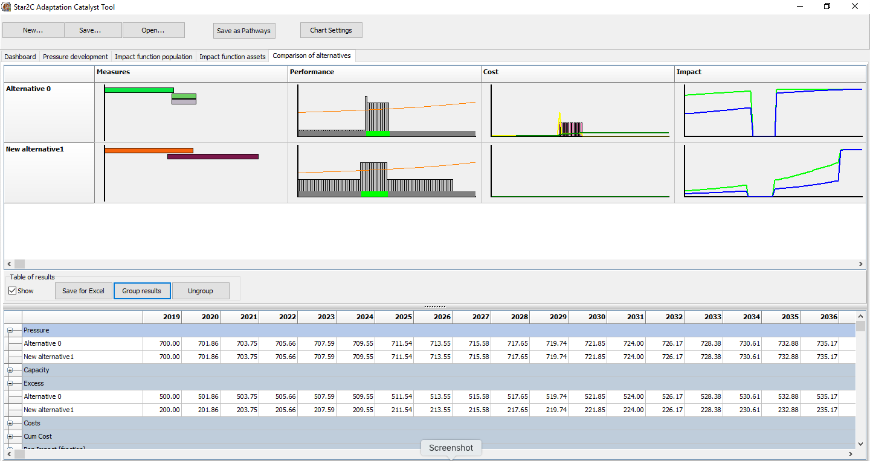
Compare Alternatives
Summary Page allows for comparison of alternatives
Groups of results in table
Pressure
Measures
Excess
Impact
Co-Benefits
Costs
Pressure
Measures
Excess
Impact
Co-Benefits
Costs

Slide 32
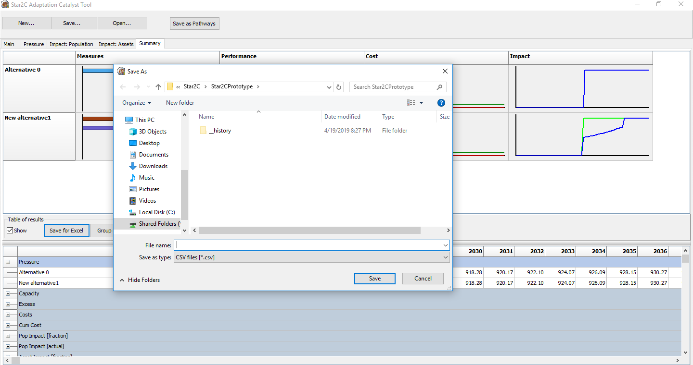
Compare Alternatives
Summary Page allows for comparison of alternatives
Export table to Excel (csv files)
Pressure
Measures
Excess
Impact
Co-Benefits
Costs
Pressure
Measures
Excess
Impact
Co-Benefits
Costs

Slide 33
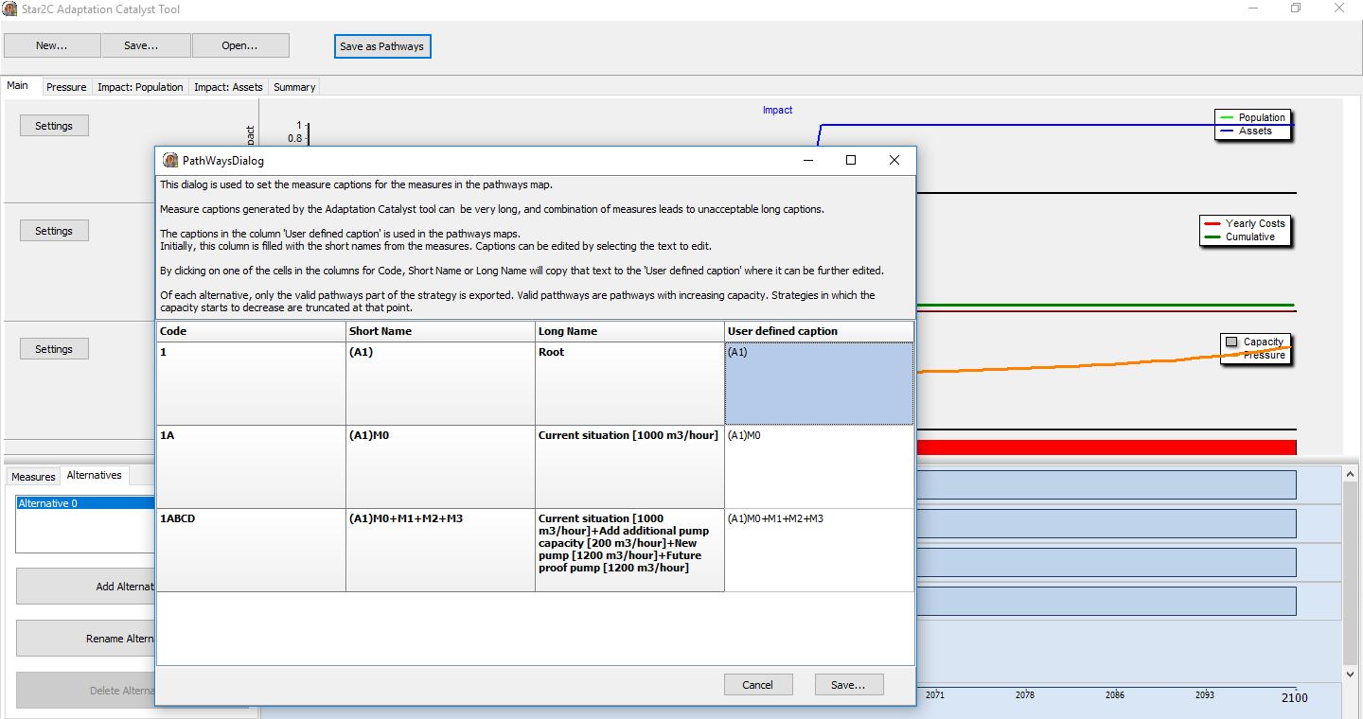
Compare Alternatives
Save strategies to pathways file
Only valid pathways
  capacity does not decrease over time
  No excess (tipping point is reached)
User defined captions for individual packages of measures
Pressure
Measures
Excess
Impact
Co-Benefits
Costs
Pressure
Measures
Excess
Impact
Co-Benefits
Costs

Slide 34
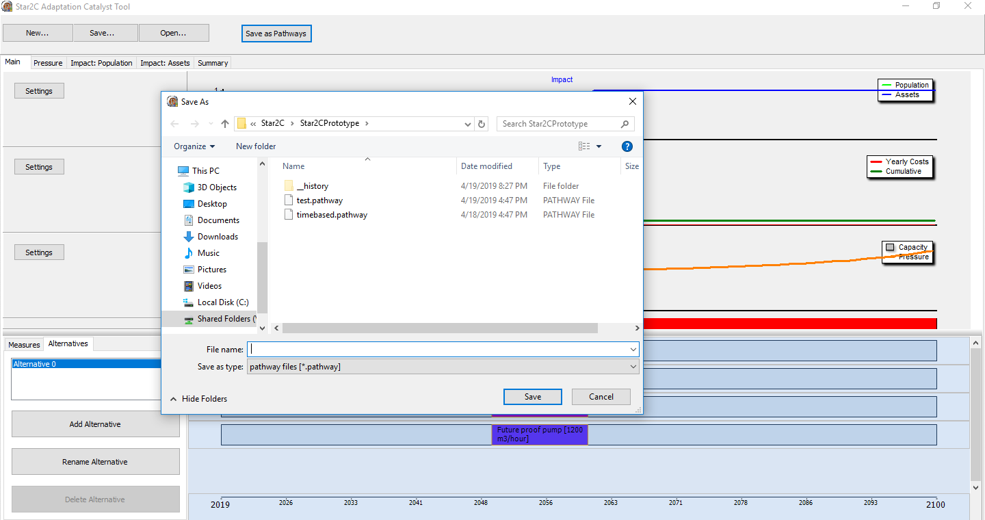
Compare Alternatives
Save strategies to pathways file
Only valid pathways
  capacity does not decrease over time
  No excess (tipping point is reached)
User defined captions for individual packages of measures
Pressure
Measures
Excess
Impact
Co-Benefits
Costs
Pressure
Measures
Excess
Impact
Co-Benefits
Costs

Slide 35
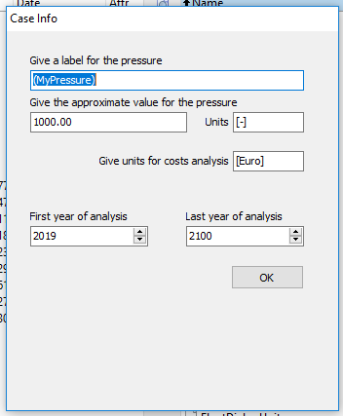
Star2C Adaptation Catalyst tool

Slide 36
