Slide 1



CoDeS Tool Tutorial
20-3-2018

Slide 2
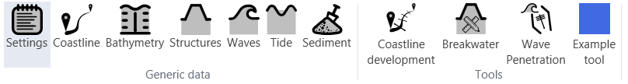
CoDeS data model
Generic data model
Available for all tools
Input can be made required for tools
Data can be accessed by tools in Python:
scenario.GenericData.name
Tool Data
Available for tool only
Input of tool specific data
Output of map features and graphs
Make use of Python Tool.py class to
Initiate Example tool

Slide 3
Elements of a new tool
Tool.py (main class)
  1.1 ToolData.py
  1.2 Main Script
  1.3 ToolPersister.py (save/load)
  1.4 ToolGUI.py
Start.py
  2.1 Initiates Tool (adds to ribon etc.)

Slide 4
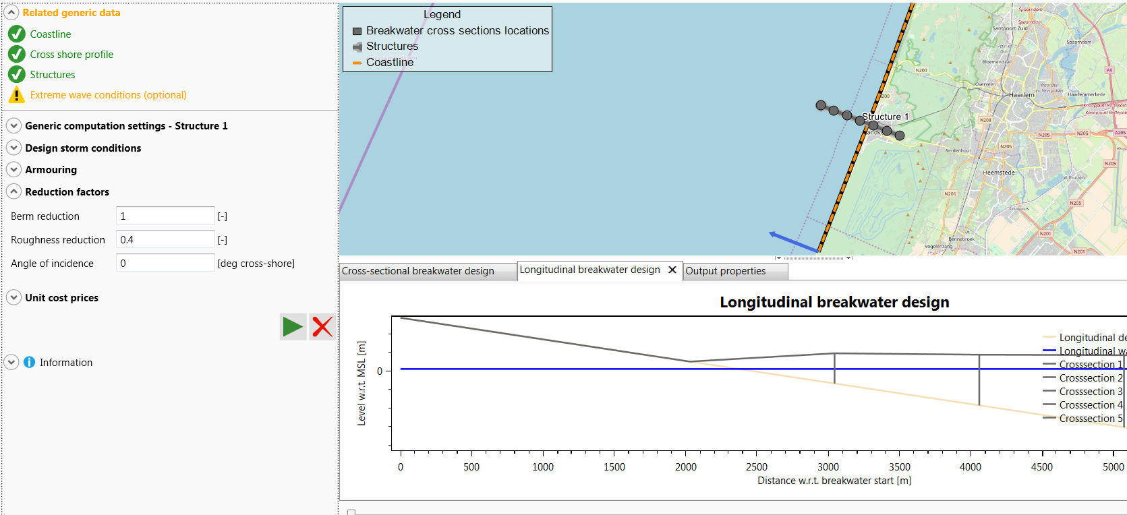
Elements of a new tool
Tool.py (main class)
Generic data
ToolGui
Map items
ToolData
CanExecute()
Execute()
ClearOutputData()
Graph items
Input
Output

Slide 5
1. Tool.py
Tool.py (main class)
  1.1 CreateToolData() → Initiate ToolData.py class
  1.2 Execute() → Run main Python script
  1.3 CanExecute() → Check if main script can be executed
  1.4 ClearOutputData() → Clear main script output (map items and graph items)

Slide 6
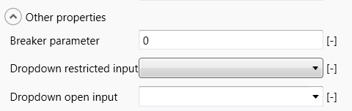
1.1 ToolData.py
ToolData.py
  1.1 initializeInputProperties ():
  - Add a ToolProperty() or custom control for each user input field
  - C# automatically adds input fields to the GUI
  - An expander will be added per unique GroupName
GroupName
BasicToolProperty
OptionToolProperty
OptionToolProperty
Name
Value
Unit

Slide 7
1.1 ToolData.py
Types of input properties
  1.1 BasicToolProperty ():
  - Label + Inputfield + unit
  - BasicToolProperty allowes min and max values
  1.2 OptionToolProperty():
  - List of choices
  - Flag true / false for restricted or open input
  1.3 Custom control:
  - Any control within Windows.Controls

Slide 8
1.1 ToolData.py
How to add a Custom Control
  1.1 ExampleToolData():
  - Add BasicToolProperty to inputProperties
  1.2 ExampleToolGui():
  - HasCustomControl:
  Flag custom toolProperty based on name
  - CreateInputParameterWpfControl:
  Define custom control properties within if statement

Slide 9
1.2 Main Script
Defines the script to be executed in the tool
Write code into a separate .py file
  Split up main script into multiple modules (functions)
  Write unit tests per function. Put unit tests scripts into someScriptName_test.py
Import main scripts into Tool.py
Check if main script can be Executed by CanExecute() function
Add main script to Execute() function in Tool.py

Slide 10
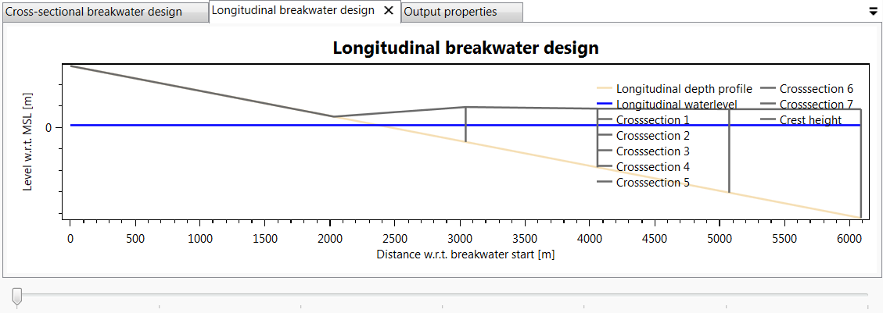
1.2 Main Script
How to output a Graph?
In MainScript add to ToolData:
  Graph canvas (SeriesToolProperty)
  Regular plot (SeriesProperty)
  Iterable plot based on slider (SeriesListProperty)
SeriesToolProperty
SeriesProperty
Slider

Slide 11
1.2 Main Script
How to output a Map layer?
  Add geometry properties to ToolData in main script
  UpdateGuiAfterExecute() (in ToolGui.py) will be executed after each script call; create new mapLayers here.
  Use ToolGui AddMapLayer() to add new mapLayer to map

Slide 12
1.3 Persister (save/load)
Defines ToolData save/load option
Adjust ToolPersister.py
  Adjust Save() function to write toolData to a file in the current scenario working directory (folderPath)
  Adjust Load() function to load toolData from a file in the current scenario working directory (folderPath)
Initiate persister by calling set_ToolPersister() and remove persister by calling remove_ToolPersister() in Tool.py

Slide 13
1.4 ToolGUI
Set required datatypes from Generic Data that are required to Execute the Main Script
UpdateGuiAfterExecute () runs after Execute() function
AddMapLayer() and RemoveMapLayer() can be used in UpdateGuiAfterExecute()

Slide 14
Start.py
Runs on CoDeS start to add new tools
Add Tool.py to appPlugin.Tools
Add ToolGui.py to guiPlugin.ToolGuis

Slide 15
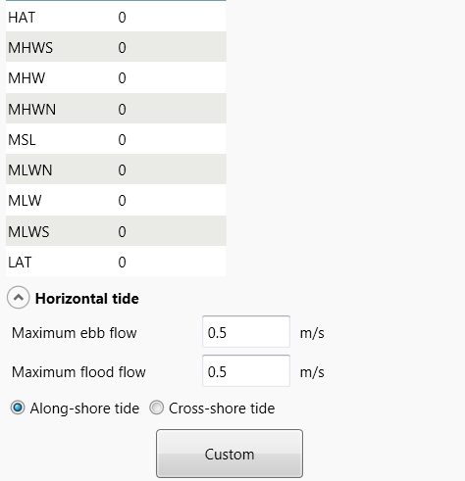
Add custom control to GenericData
Add custom control to Generic Data tools
Triggers when new window is opened
See AddCustomControlsToCSharpViews.py for example
Add this to link to Start.py to open on start up
Custom control button

