Slide 1
Proposal Jpower TKI
Ecology

Slide 2
Ideas posted in TKI proposal
2 ideas:
Connecting species (fish!) habitat to specific components of the flow requirement, trying to provide mechanistical explanation
Not species, but trait based: more generic, but also more mechanistical
With a more thorough literature scan, those two ideas are closely linked
In line with environmental flow developments in literature

Slide 3
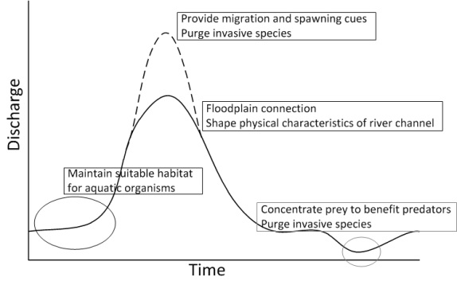
Environmental flows
Natural flow regimes have shaped their biotic community
Aspects of a river’s flow regime are meaningful to species
Artificial changes in a river’s flow regime can impact a species success in that river
‘Normal’ e-flow approach used to be to use historical flow regime records to construct/advise a specific e-flow
In recent literature warnings are posted that climate change can also have impacts on a river’s flow regime, which has consequences for e-flow advise: look at how dynamics of flows impact habitats of species in consecutive years

Slide 4
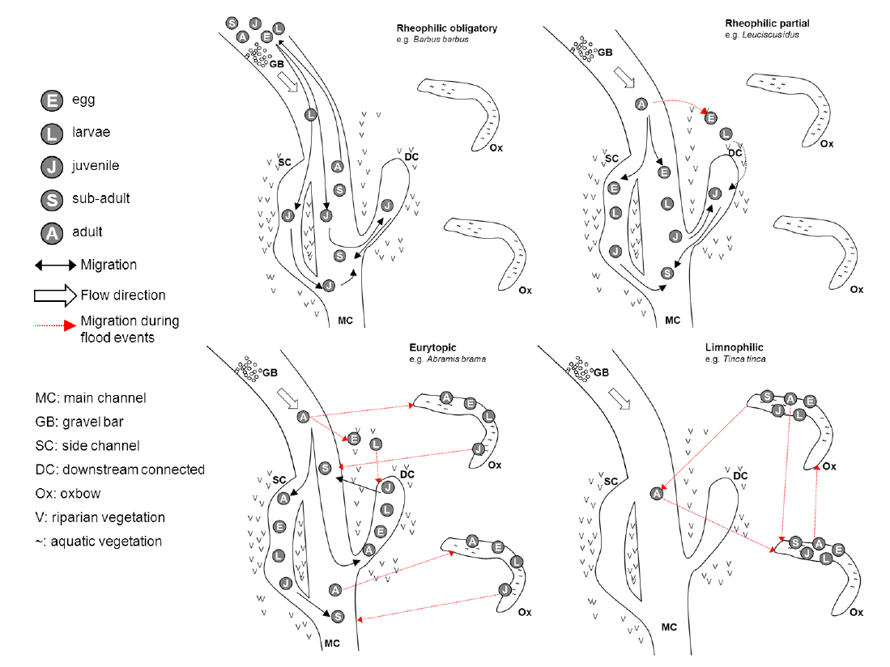
Year to year flows
Changes between years in regard to available habitats
Changes in connection between available habitats
Depends on the species

Slide 5
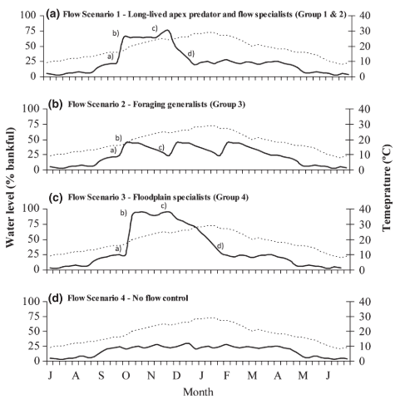
Guilds of fish species
Several different species arrangements possible, for example
Long-lived apex predators
  No spawning cue
  Increased flow could contribute to more spawning habitat
  Because of longevity, annual spawning and recruiting not required
Flow dependent specialists
  Flood pulses are required for a spawning response
  Migration may be flow dependent
Foraging generalists
  Generally resilient to prolonged low flow conditions
  Relative flexible spawning and recruitment strategies (seems temperature dependent)
  Spawning more than once each year: small-scale watering events may be beneficial
Floodplain specialists
  Mostly short-lived (up to ten years), so regular connection to floodplains required (2 to 3 times per decade)
  Dispersal between floodplain habitats (and thus along channel habitats) is an essential life history strategy.

Slide 6
How does JPower fit in?
Applying the ‘guild’ approach to whole of the lower stretch, for several years
  Gives insight in the usability of this approach for habitat modelling in general
  Gives insight how year-to-year changes may facilitate the different guilds
Translating the Ayu fish knowledge rules into environmental flow aspects: adding time component explicitly
  Finding out how this works
  Can we fit Ayu fish into guilds generally described in literature?

Slide 7
Parts of the project
Identification which species are to be expected in the Tenryuu river (IUCN database)
What guild approach seems best suitable (literature scan)
Translation of guilds to knowledge rules
Run several scenario’s within Habitat
Translate Ayu fish knowledge rules to e-flow aspects
Run several scenario’s and compare with previous work
Compare guild results and Ayu fish results to come up with findings of suitability of using guilds and e-flow explicitly

