Slide 1


Projecting Saltwater Intrusion in Southeastern Louisiana and New Orleans based on Groundwater Modelling
MSc Thesis Presentation by:
Lennart Brokx
22-04-2019
Supervisors:
Dr. Ir. G.H.P. Oude Essink
Prof. Dr. Ir. M.F.P. Bierkens

Slide 2
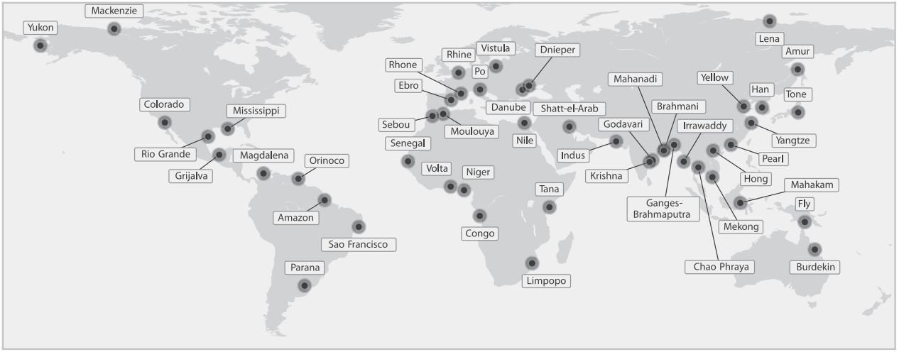
Introduction | Groundwater Use
River Delta Areas
Attractive environment for humankind
Densely populated
Large freshwater demands
Source: Tessler et al. (2015)
Introduction | Objectives | Saltwater Intrusion | Study Area | Model Setup | Scenarios | Conclusions
Notes:
Demands for freshwater: groundwater cleaner, available in larger abundances, less seasonal variability:
Large amounts of groundwater extraction:
Groundwater depletion:
Enhancing factors: Climate Change + Increased population + economic activities
Subsidence + Saltwater Intrusion
Saltwater intrusion: main subject for study

Slide 3
Introduction | Groundwater Use
River Delta Areas
Attractive environment for humankind
Densely populated
Large freshwater demands
Why Groundwater?
Clean
Large volumes
Reliable
Subsidence
Extensive Groundwater Use
Groundwater Depletion
Saltwater Intrusion
Population Increase
Economic Growth
Climate Change
Introduction | Objectives | Saltwater Intrusion | Study Area | Model Setup | Scenarios | Conclusions
Notes:
Demands for freshwater: groundwater cleaner, available in larger abundances, less seasonal variability:
Large amounts of groundwater extraction:
Groundwater depletion:
Enhancing factors: Climate Change + Increased population + economic activities
Subsidence + Saltwater Intrusion
Saltwater intrusion: main subject for study

Slide 4
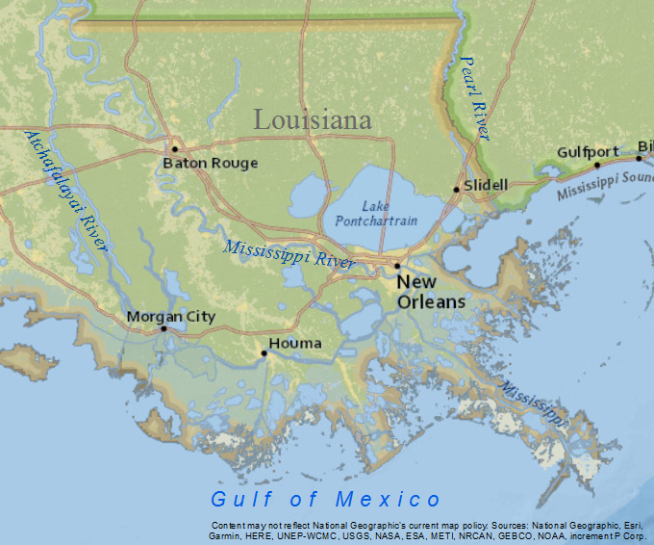
Introduction | Southeastern Louisiana
Mississippi River Delta
Largest port of the USA
Baton Rouge & New Orleans
Groundwater Resources
Southern Hills regional aquifer system
Large abundances of fresh groundwater in northern part
Introduction | Objectives | Saltwater Intrusion | Study Area | Model Setup | Scenarios | Conclusions
Notes:
Mississippi River Delta
Largest Port by Cargo volume
Two Major urban centers: Baton Rouge and New Orleans: both approximately a million inhabitants
Groundwater present in large volumes: especially in northern part: large extractions in the Baton Rouge area

Slide 5
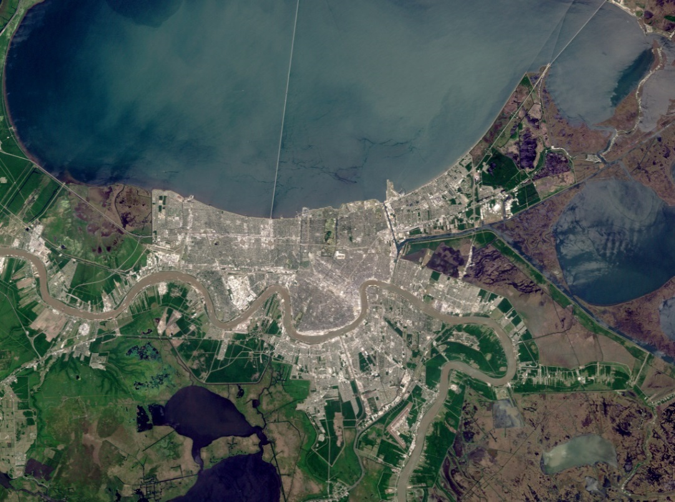
Introduction | New Orleans
Dependent on Surface Water
98.6% of total freshwater use
Unreliable source
Source: Simmon (2002)
Groundwater
Alternative or emergency source
Currently hardly used
Past extraction led to SWI
Further Research Needed
Introduction | Objectives | Saltwater Intrusion | Study Area | Model Setup | Scenarios | Conclusions
Notes:
Mainly dependent on freshwater from the Mississippi River currently: 98,6%
Dependency on river water has been proven to dangerous: upstream spillages and saltwater encroachment during low tide, after Katrina facilities damaged
Therefore, groundwater proposed as alternative freshwater source or emergency source
Currently hardly any freshwater produced in New Orleans: four major extraction wells for industry only produce saline water
In the past, however, freshwater extraction occurred and led to salinization of the aquifers
Further research is therefore needed to reestablish the groundwater as a sources of freshwater in the area.

Slide 6
Objectives
Study the effects of saltwater intrusion on the freshwater resources of southeastern Louisiana in the coming century (2019-2119), creating and using a 3D variable density groundwater model, as a result of the following processes:
Southeastern Louisiana (regional scale)
Sea level rise
Subsidence
Flooding
Groundwater extraction
New Orleans (local scale)
Groundwater extraction
Mitigation methods
  Artificial recharge
  Saltwater extraction
Introduction | Objectives | Saltwater Intrusion | Study Area | Model Setup | Scenarios | Conclusions

Slide 7
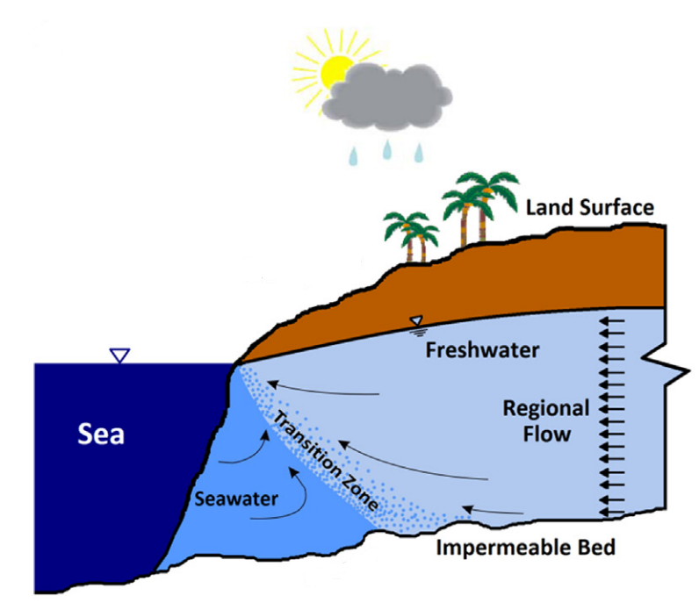
Saltwater Intrusion | General
Inflow of saline water into areas previously containing fresher water
 | C (kg/m³) | ρ (kg/m³)
Seawater | 35 | 1025
Freshwater | ≤ 0.5 (or ≤ 1) | ≈1000
Transition Zone | >0.5/1 & <35 | >1000 & <1025
Source: Ketabchi et al. (2016)
Introduction | Objectives | Saltwater Intrusion | Study Area | Model Setup | Scenarios | Conclusions
Notes:
Defined as inflow of saline water into areas previously containing fresher water
Amount of seawater intrusion and therefore location of the interface determined by head differences: sea level at seaward boundary vs freshwater flux from landward boundary.
Concentrations and densities of seawater and freshwater: conc in terms of Total dissolved solids concentration
Variable density flow due to density differences: causes ‘toe’ of saline water beneath freshwater
Solute transport of dissolved particles formation of transition zone with C and ro between fresh and seawater.
Due to solute transport:
Transition zone

Slide 8
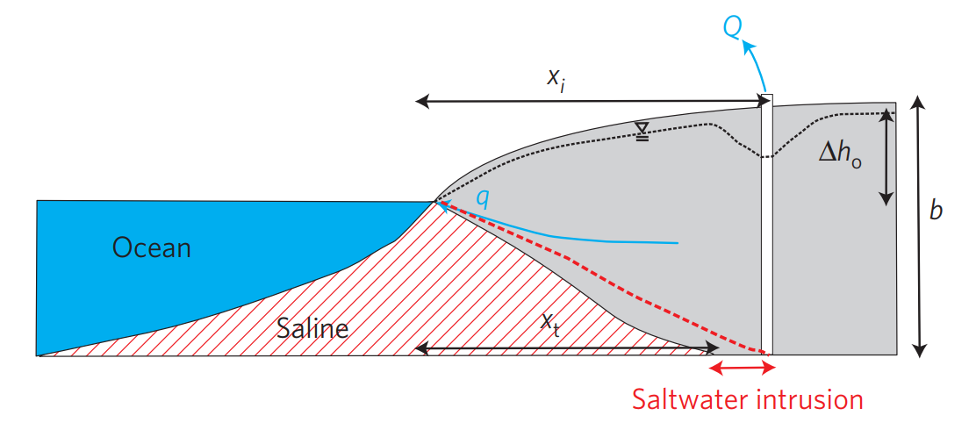
Saltwater Intrusion | Drivers
Enhancing factors:
Groundwater extraction
Source: Ferguson & Gleeson (2012)
Introduction | Objectives | Saltwater Intrusion | Study Area | Model Setup | Scenarios | Conclusions
Notes:
Higher seaward head and lower landward head lead to enhanced saltwater intrusion
-groundwater extraction leads to lower heads on land, therefore intrusion
-Groundwater extraction leads to subsidence, which causes lowering of the water table: also lower heads on land
-Sea level rise causes higher head at sea: enhances seawater intrusion:
Other effect of sea level rise and subsidence: inundation: landward shift of interface between the sea and aquifer
Also higher risk of flooding: can lead to direct infiltration of saline water into freshwater resources
Effects of subsidence and sea level rise on saltwater intrusion strongly dependent on aquifer properties: larger effects found in unconfined systems than in confined systems
Sea level rise leads to a higher hydraulic head at the seaward side
Subsidence leads to lowering of water table

Slide 9
Saltwater Intrusion | Drivers
Enhancing factors:
Groundwater extraction
Subsidence
Source: Ferguson & Gleeson (2012)
Introduction | Objectives | Saltwater Intrusion | Study Area | Model Setup | Scenarios | Conclusions
Notes:
Higher seaward head and lower landward head lead to enhanced saltwater intrusion
-groundwater extraction leads to lower heads on land, therefore intrusion
-Groundwater extraction leads to subsidence, which causes lowering of the water table: also lower heads on land
-Sea level rise causes higher head at sea: enhances seawater intrusion:
Other effect of sea level rise and subsidence: inundation: landward shift of interface between the sea and aquifer
Also higher risk of flooding: can lead to direct infiltration of saline water into freshwater resources
Effects of subsidence and sea level rise on saltwater intrusion strongly dependent on aquifer properties: larger effects found in unconfined systems than in confined systems
Sea level rise leads to a higher hydraulic head at the seaward side
Subsidence leads to lowering of water table

Slide 10
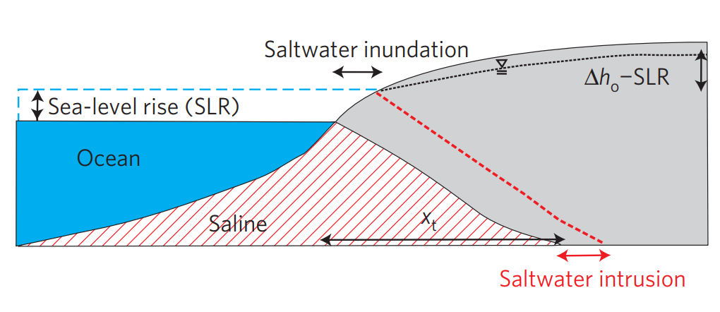
Saltwater Intrusion | Drivers
Enhancing factors:
Groundwater extraction
Subsidence
Sea level rise
Inundation
Flooding
Source: Ferguson & Gleeson (2012)
Introduction | Objectives | Saltwater Intrusion | Study Area | Model Setup | Scenarios | Conclusions
Notes:
Higher seaward head and lower landward head lead to enhanced saltwater intrusion
-groundwater extraction leads to lower heads on land, therefore intrusion
-Groundwater extraction leads to subsidence, which causes lowering of the water table: also lower heads on land
-Sea level rise causes higher head at sea: enhances seawater intrusion:
Other effect of sea level rise and subsidence: inundation: landward shift of interface between the sea and aquifer
Also higher risk of flooding: can lead to direct infiltration of saline water into freshwater resources
Effects of subsidence and sea level rise on saltwater intrusion strongly dependent on aquifer properties: larger effects found in unconfined systems than in confined systems
Sea level rise leads to a higher hydraulic head at the seaward side
Subsidence leads to lowering of water table

Slide 11
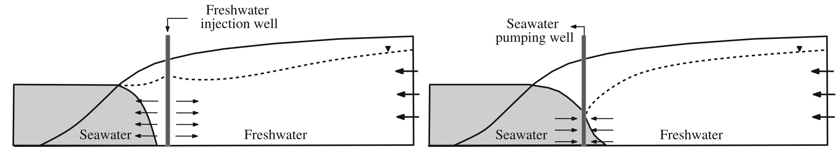
Saltwater Intrusion | Mitigation
Potential measures:
Artificial recharge
Source: Pool & Carrera (2009)
Introduction | Objectives | Saltwater Intrusion | Study Area | Model Setup | Scenarios | Conclusions
Notes:
Different measures possible
Proposed here: Artificial Recharge and Saltwater Extraction
Artificial recharge by ponding and direct infiltration: Enlarges head of freshwater. Sources of freshwater: Rivers/lakes, desalinated water, treated wastewater
Seawater extraction: opposite effect: lower head of saltwater front
Other measures: physical flow barriers to halt groundwater flow and land reclamation

Slide 12
Saltwater Intrusion | Mitigation
Potential measures:
Artificial recharge
Saltwater extraction
Physical flow barriers
Land reclamation
Source: Pool & Carrera (2009)
Introduction | Objectives | Saltwater Intrusion | Study Area | Model Setup | Scenarios | Conclusions
Notes:
Different measures possible
Proposed here: Artificial Recharge and Saltwater Extraction
Artificial recharge by ponding and direct infiltration: Enlarges head of freshwater. Sources of freshwater: Rivers/lakes, desalinated water, treated wastewater
Seawater extraction: opposite effect: lower head of saltwater front
Other measures: physical flow barriers to halt groundwater flow and land reclamation

Slide 13
Study Area | Extent
- Southeastern Louisiana
Introduction | Objectives | Saltwater Intrusion | Study Area | Model Setup | Scenarios | Conclusions
Notes:
The study area used to fulfill the regional study areas was equal to the model extent and encompasses most of southeastern Louisiana and a small part of Mississippi in the northeast

Slide 14
Study Area | Extent
- Southeastern Louisiana
- New Orleans Area
Introduction | Objectives | Saltwater Intrusion | Study Area | Model Setup | Scenarios | Conclusions
Notes:
The study area used to fulfill the regional study areas was equal to the model extent and encompasses most of southeastern Louisiana and a small part of Mississippi in the northeast

Slide 15
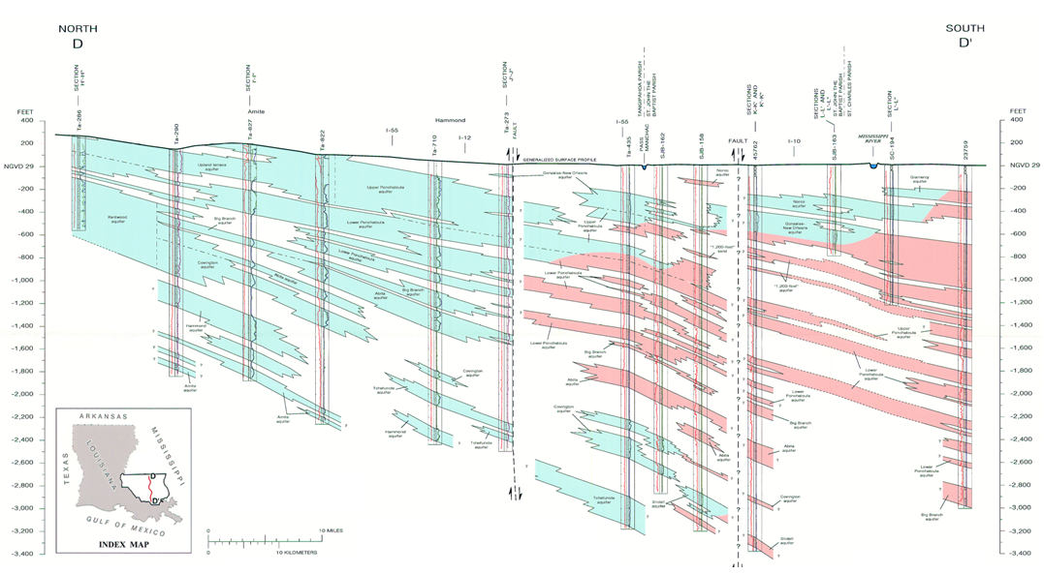
Study Area | Hydrogeology
Southern Hills Regional Aquifer System
Source: Griffith (2003)
Introduction | Objectives | Saltwater Intrusion | Study Area | Model Setup | Scenarios | Conclusions
Notes:
Hydrogeology dominated by the southern hills regional aquifer system
Consist of a set of southward dipping aquifers separated by confining layers of Miocene to Pleistocene Age
Groundwater flow is generally southward
Freshwater present in the northern parts, south of the latitude of New Orleans only brackish to saline water

Slide 16
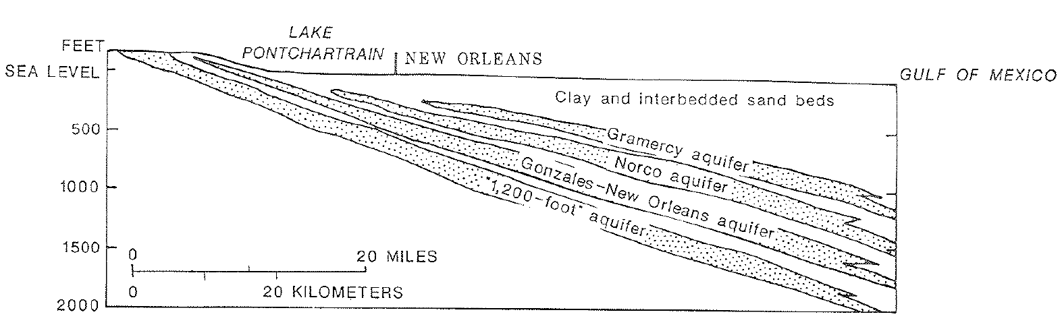
Study Area | Hydrogeology
New Orleans Area
Four freshwater containing aquifers
Source: Dial & Sumner (1989)
Introduction | Objectives | Saltwater Intrusion | Study Area | Model Setup | Scenarios | Conclusions
Notes:
Only the top four aquifers of the southern hills regional aquifer system contain freshwater to some extent in the New Orleans area, therefore these are the only relevant aquifers in the study area
All four aquifers are also containing saline water in the New Orleans area, making them prone to SI

Slide 17
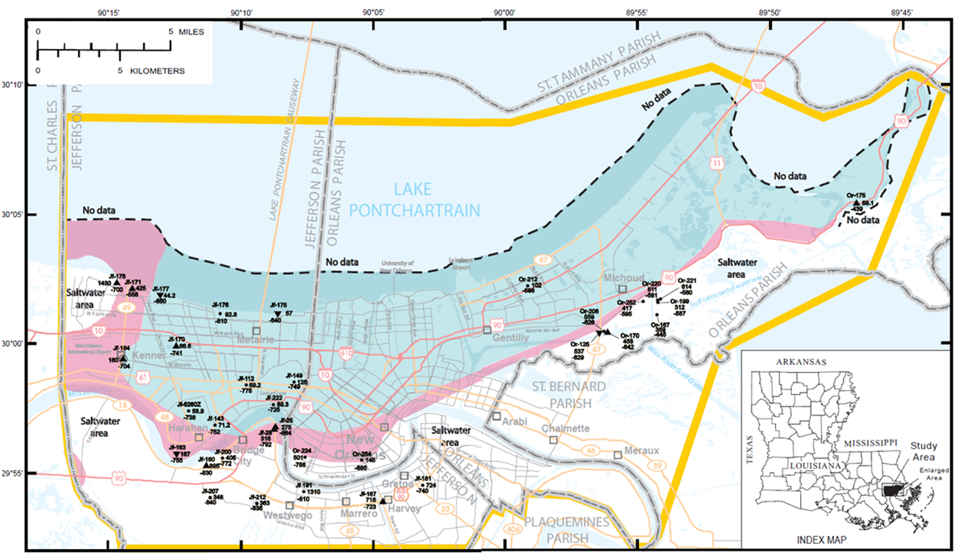
Study Area | Hydrogeology
Gonzales-New Orleans Aquifer
Largest freshwater volume
Source: Prakken (2009)
Introduction | Objectives | Saltwater Intrusion | Study Area | Model Setup | Scenarios | Conclusions
Notes:
Only the top four aquifers of the southern hills regional aquifer system contain freshwater to some extent in the New Orleans area, therefore these are the only relevant aquifers in the study area
The main aquifer is the Gonzales-New Orleans aquifer, which contains the largest volumes of freshwater, and therefore nearly all groundwater extraction occurs in this aquifer. The aquifer generally contains freshwater in the northern part of the study area and is surrounded by more saline water to the west and south

Slide 18
Study Area | Hydrogeology
Gonzales-New Orleans Aquifer
Largest freshwater volume
Four major withdrawal centers
Michoud closed in 2016
Plans for reopening
Introduction | Objectives | Saltwater Intrusion | Study Area | Model Setup | Scenarios | Conclusions
Notes:
Only the top four aquifers of the southern hills regional aquifer system contain freshwater to some extent in the New Orleans area, therefore these are the only relevant aquifers in the study area
The main aquifer is the Gonzales-New Orleans aquifer, which contains the largest volumes of freshwater, and therefore nearly all groundwater extraction occurs in this aquifer. The aquifer generally contains freshwater in the northern part of the study area and is surrounded by more saline water to the west and south
In the past decades, four major withdrawal centers were present in the New Orleans area, pumping from the Gonzales-New Orleans aquifer
Largest one: power plant facility at Michoud. Closed in 2016
Plans for reopening at 10% of initial rate
The four withdrawal centers pump brackish to saline water: virtually no freshwater

Slide 19
Model Setup | General
Used Modelling Software: iMOD-SEAWAT
Input Data Derived From:
Global data bases (DEM, river width and depth)
USGS data (ground- and surface water salinity)
Literature of local case-studies (hydraulic conductivity, extractions)
General literature (dispersivity, diffusion coefficient)
Introduction | Objectives | Saltwater Intrusion | Study Area | Model Setup | Scenarios | Conclusions
Notes:
iMOD-SEAWAT: Deltares made version of SEAWAT, accounting both for variable density flow and solute transport
Explain more about model geology and initial groundwater salinity

Slide 20
Model Setup | Geology
Simplified geological framework
Main assumption: layers constant in east-west direction
Based on transects provided by Griffith (2003)
Introduction | Objectives | Saltwater Intrusion | Study Area | Model Setup | Scenarios | Conclusions
Notes:
Both in Baton Rouge and NO: geology was found to be extremely complex
Therefore, simplified geology used

Slide 21
Model Setup | Geology
Source: Griffith (2003)
Introduction | Objectives | Saltwater Intrusion | Study Area | Model Setup | Scenarios | Conclusions
Notes:
Both in Baton Rouge and NO: geology was found to be extremely complex
Therefore, simplified geology used

Slide 22
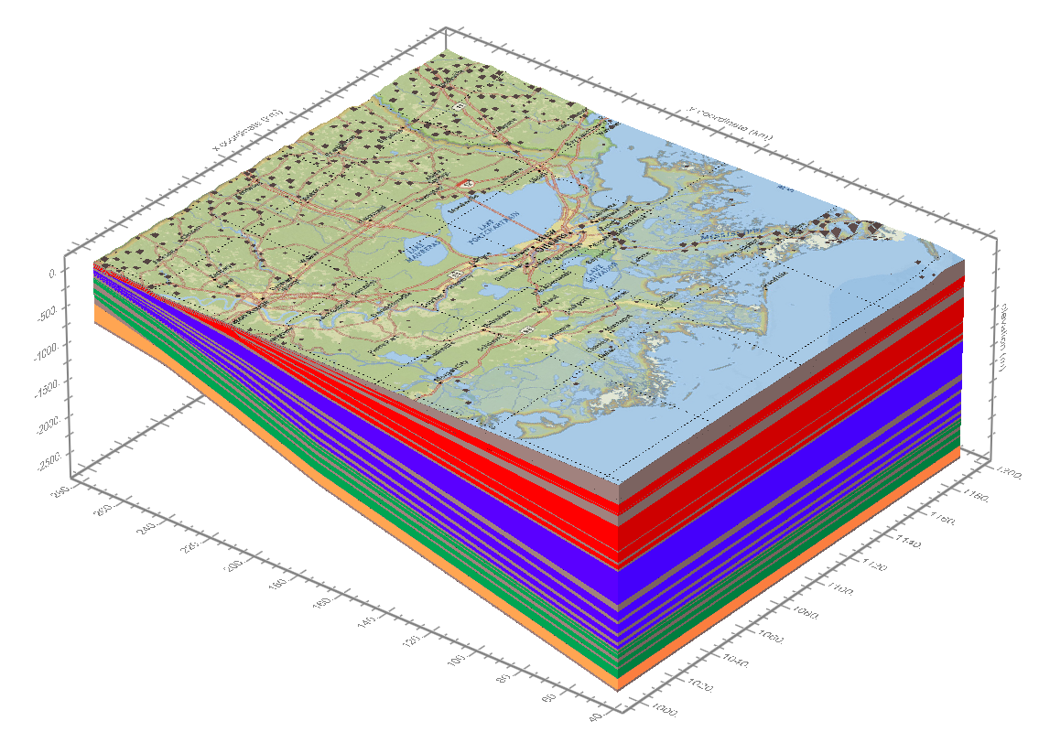
Model Setup | Geology
Simplified geological framework
Main assumption: layers constant in east-west direction
Based on transects provided by Griffith (2003)
Main focus: longitude of New Orleans
34 model layers used (15 aquifers)
Introduction | Objectives | Saltwater Intrusion | Study Area | Model Setup | Scenarios | Conclusions
Notes:
Both in Baton Rouge and NO: geology was found to be extremely complex
Therefore, simplified geology used

Slide 23
Model Setup | Salinity Distribution
Initial Distribution of Fresh and Saline Water
Salinity measurements available in some areas, but lacking in others.
Best estimate determined by 3-step approach
Introduction | Objectives | Saltwater Intrusion | Study Area | Model Setup | Scenarios | Conclusions
Notes:
Initial distribution or current state important to properly model seawater intrusion
Measurements available, but not fully covering study area. Especially lacking in southern saline parts of study area
Therefore: 3 step approach used

Slide 24
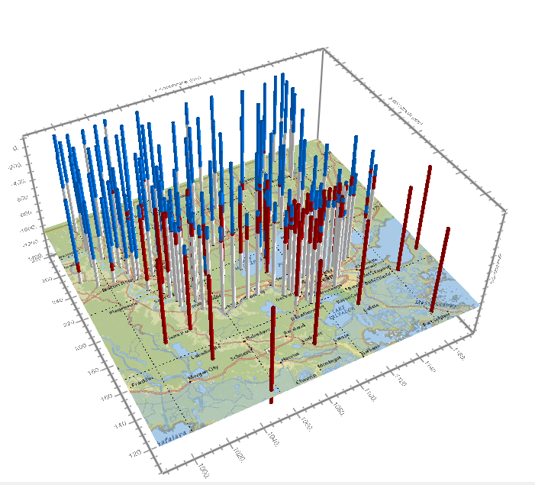
Model Setup | Salinity Distribution
1) Interpolation of Aquifers Transects
Literature based
Water assumed to be either fully fresh or saline
  C_{fresh} = 0.1 kg/m³
  C_{salt} = 35.0 kg/m³
3D interpolation by ordinary kriging in iMOD
Introduction | Objectives | Saltwater Intrusion | Study Area | Model Setup | Scenarios | Conclusions
Notes:
Based on Griffith and Tomaszewski, interpretated interfaces between fresh and saline water from transects and digitized them

Slide 25
Model Setup | Salinity Distribution
2) Interpolation of Groundwater Quality Data
Specific conductance values from the USGS
8320 observations for the 15 aquifers
2D interpolation by ordinary kriging in iMOD
Results superimposed on transect distribution
Introduction | Objectives | Saltwater Intrusion | Study Area | Model Setup | Scenarios | Conclusions

Slide 26
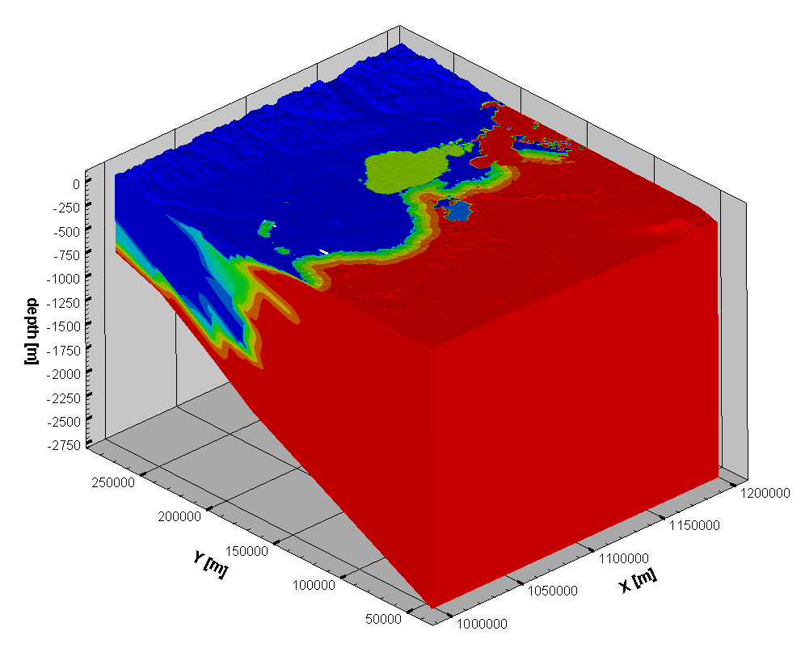
Model Setup | Salinity Distribution
3) Mixing Zone and Salinity of Confining Units
Sharp interfaces due to transect interpolation not desired
15 km mixing zone created
Confining units: averaging surrounding aquifers
Introduction | Objectives | Saltwater Intrusion | Study Area | Model Setup | Scenarios | Conclusions

Slide 27
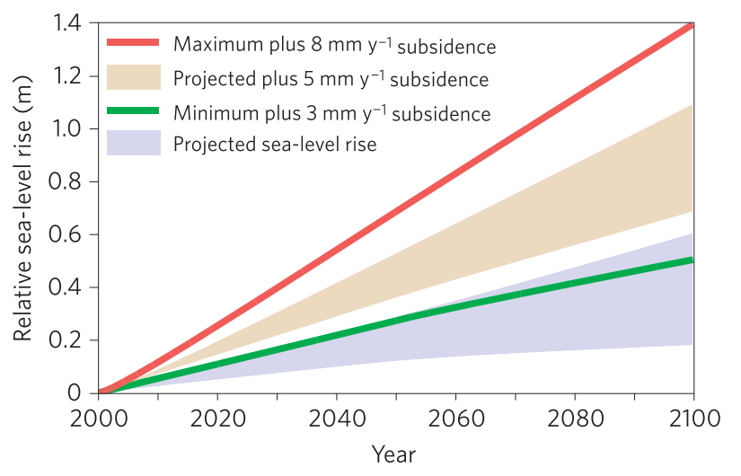
Scenarios | Regional
Sea Level Rise + Subsidence
Rates: 6.0 mm y⁻¹ + 8.0 mm y⁻¹
No inundation
Source: Blum & Roberts (2009)
Introduction | Objectives | Saltwater Intrusion | Study Area | Model Setup | Scenarios | Conclusions
Notes:
Slr and subs rates based on the study by Blum and Roberts
Created by adjusting the level of seaward boundary condition every ten years by 6 cm as model timesteps were per 10 yr
Subs by manually lowering the drains every 10 years
No inundation assumed
Both effects separately and combined

Slide 28
Scenarios | Regional
Sea Level Rise + Subsidence
Rates: 6.0 mm y⁻¹ + 8.0 mm y⁻¹
No inundation
10-day Flooding
Land flooded if below 2.0 MASL
Starting from present (2019)
Introduction | Objectives | Saltwater Intrusion | Study Area | Model Setup | Scenarios | Conclusions
Notes:
10-day flooding created starting from present
All land relatively close to the sea at 2,0 m a.s.l.
Adjusting the general head boundary conditions of the top layer
Salinity at flooded areas set at half full seawater concentration, as assumed to be not fully penetrating the first layer
Comparing scenario with groundwater extraction to full natural flow

Slide 29
Scenarios | Regional
Sea Level Rise + Subsidence
Rates: 6.0 mm y⁻¹ + 8.0 mm y⁻¹
No inundation
10-day Flooding
Land flooded if below 2.0 MASL
Starting from present (2019)
Groundwater Extraction
Single well per parish
Literature based
Introduction | Objectives | Saltwater Intrusion | Study Area | Model Setup | Scenarios | Conclusions
Notes:
10-day flooding created starting from present
All land relatively close to the sea at 2,0 m a.s.l.
Adjusting the general head boundary conditions of the top layer
Salinity at flooded areas set at half full seawater concentration, as assumed to be not fully penetrating the first layer
Comparing scenario with groundwater extraction to full natural flow

Slide 30
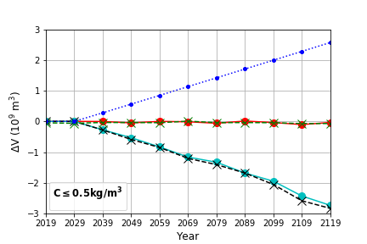
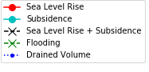
Scenarios | Regional
Sea Level Rise & 10-day Flooding
Virtually no effect (< 0.005%)
Subsidence
Larger impact (≈ 0.08%)
> 90% due to drainage
Little effect on SWI
Introduction | Objectives | Saltwater Intrusion | Study Area | Model Setup | Scenarios | Conclusions
Notes:
Note: C<0.5 kg/m³
Volume differences relative to base case
Upcoming century
Numbers given maximum change

Slide 31
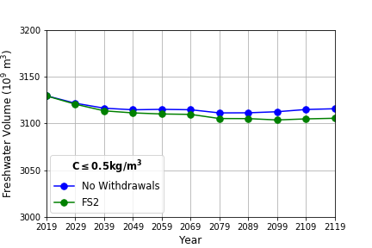
Scenarios | Regional
Sea Level Rise & 10-day Flooding
Virtually no effect (< 0.005%)
Subsidence
Larger impact (≈ 0.08%)
> 90% due to drainage
Little effect on SWI
Groundwater Extraction
Expected volume decrease ≈ 0.3%
Introduction | Objectives | Saltwater Intrusion | Study Area | Model Setup | Scenarios | Conclusions
Notes:
Explain Graph

Slide 32
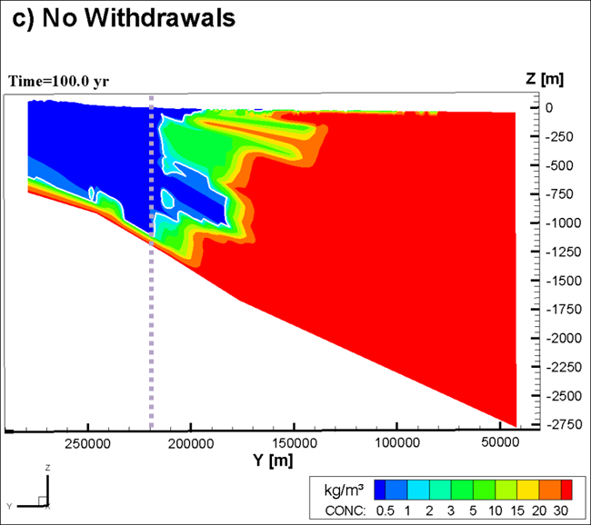
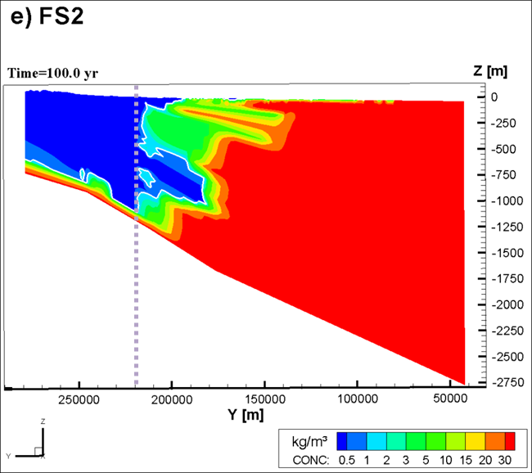
Scenarios | Regional
Natural Flow
Groundwater Extraction
Local effects more severe!
Introduction | Objectives | Saltwater Intrusion | Study Area | Model Setup | Scenarios | Conclusions
Notes:
Explain Graph

Slide 33
Scenarios | New Orleans
4 Future Extraction Scenarios
Mainly based on the extraction rate at Michoud
  FS1: Michoud at pre-closure value
  FS2: Michoud at 10% (proposed)
  FS3: Michoud closed
  FS4: No extractions in New Orleans
Introduction | Objectives | Saltwater Intrusion | Study Area | Model Setup | Scenarios | Conclusions
Notes:
Based on the extraction Rate

Slide 34
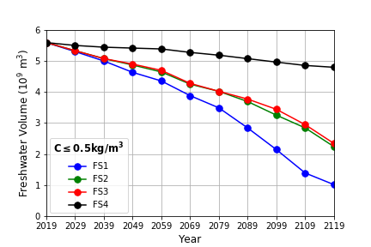
Scenarios | New Orleans
4 Future Extraction Scenarios
Mainly based on the extraction rate at Michoud
  FS1: Michoud at pre-closure value
  FS2: Michoud at 10% (proposed)
  FS3: Michoud closed
  FS4: No extractions in New Orleans
Ongoing Extractions SWI
Freshwater volume decreases:
  FS1: 81.8%
  FS2: 59.9%
  FS3: 58.1%
  FS4: 14.2%
Introduction | Objectives | Saltwater Intrusion | Study Area | Model Setup | Scenarios | Conclusions
Notes:
Based on the extraction Rate

Slide 35
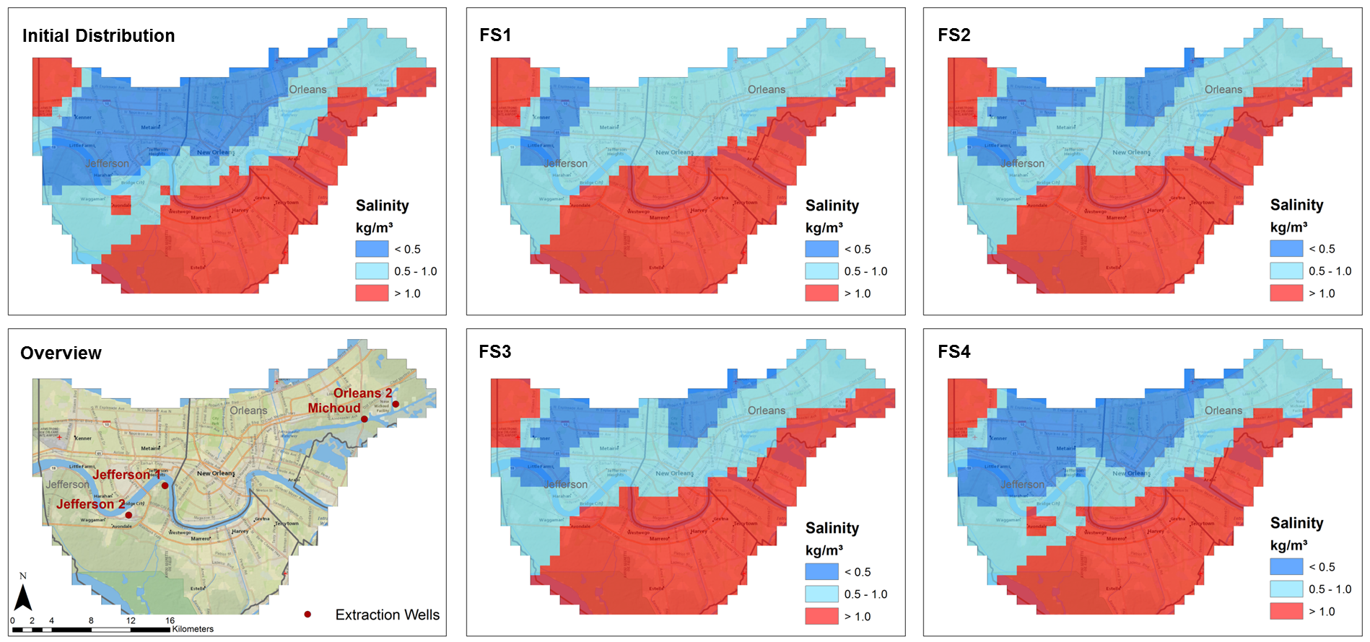
Scenarios | New Orleans
Introduction | Objectives | Saltwater Intrusion | Study Area | Model Setup | Scenarios | Conclusions
Notes:
Largest intrusion near the wells at Jefferson Parish

Slide 36
Scenarios | New Orleans
Artificial Recharge and Saltwater Extraction
23 infiltration & extractions wells
Total rate: 10/50 million m³ y⁻¹
Freshwater from Mississippi River
Introduction | Objectives | Saltwater Intrusion | Study Area | Model Setup | Scenarios | Conclusions
Notes:
Mississippi

Slide 37
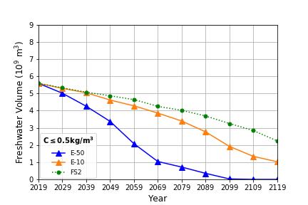
Scenarios | New Orleans
Saltwater Extraction
Adverse effects
Introduction | Objectives | Saltwater Intrusion | Study Area | Model Setup | Scenarios | Conclusions
Notes:
Leg cijfers uit

Slide 38
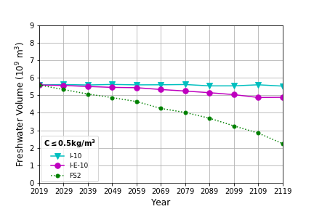
Scenarios | New Orleans
Saltwater Extraction
Adverse effects
Infiltration: 10 million m³ y⁻¹
Freshwater volume stabilizes
Slight adverse effects of saltwater extraction
Introduction | Objectives | Saltwater Intrusion | Study Area | Model Setup | Scenarios | Conclusions
Notes:
Leg cijfers uit

Slide 39
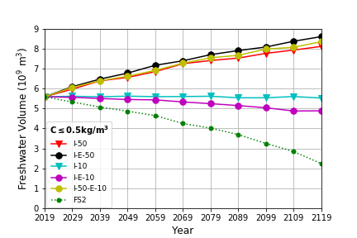
Scenarios | New Orleans
Saltwater Extraction
Adverse effects
Infiltration: 10 million m³ y⁻¹
Freshwater volume stabilizes
Slight adverse effects of saltwater extraction
Infiltration: 50 million m³ y⁻¹
Volume increase of 45% - 54%
Larger increase due to saltwater extraction
Introduction | Objectives | Saltwater Intrusion | Study Area | Model Setup | Scenarios | Conclusions
Notes:
Leg cijfers uit

Slide 40
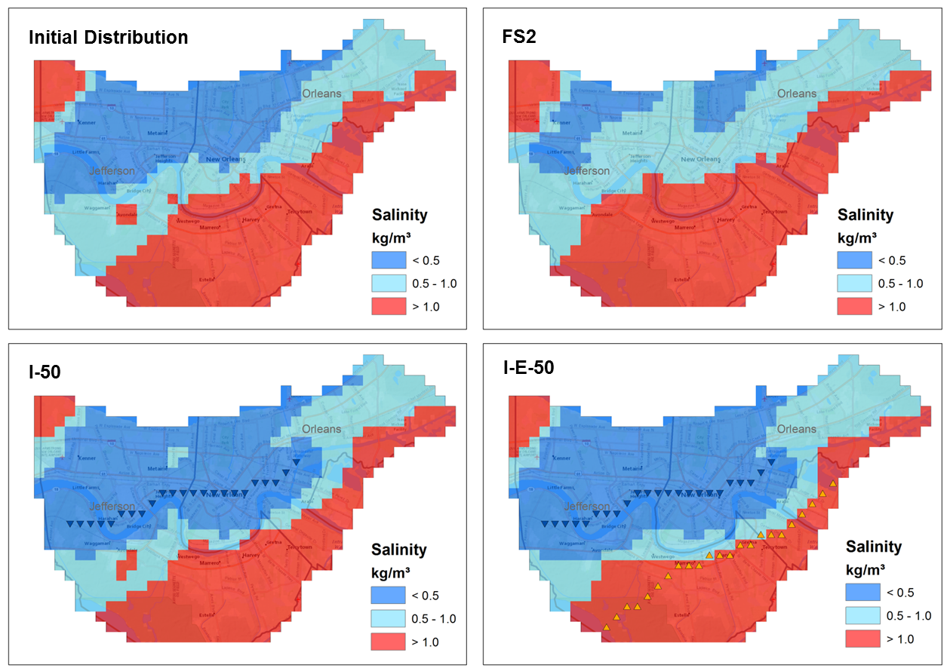
Scenarios | New Orleans
Introduction | Objectives | Saltwater Intrusion | Study Area | Model Setup | Scenarios | Conclusions
Notes:
Further intrusion at I-E-50 in western part

Slide 41
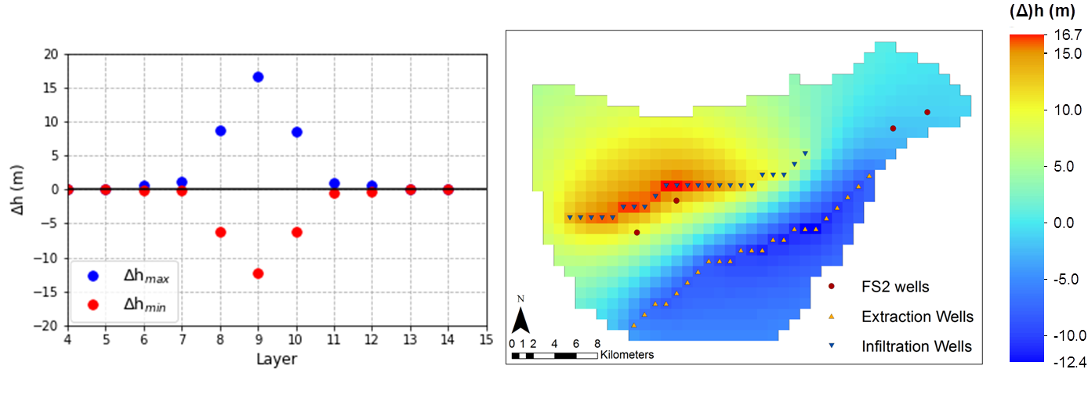
Scenarios | New Orleans
Artificial Recharge + Saltwater Extraction at 50 million m³ y⁻¹ leads to the largest increase of freshwater volume in the New Orleans area.
However:
Subsidence due to decreasing hydraulic heads
Introduction | Objectives | Saltwater Intrusion | Study Area | Model Setup | Scenarios | Conclusions
Notes:
Leg cijfers uit

Slide 42
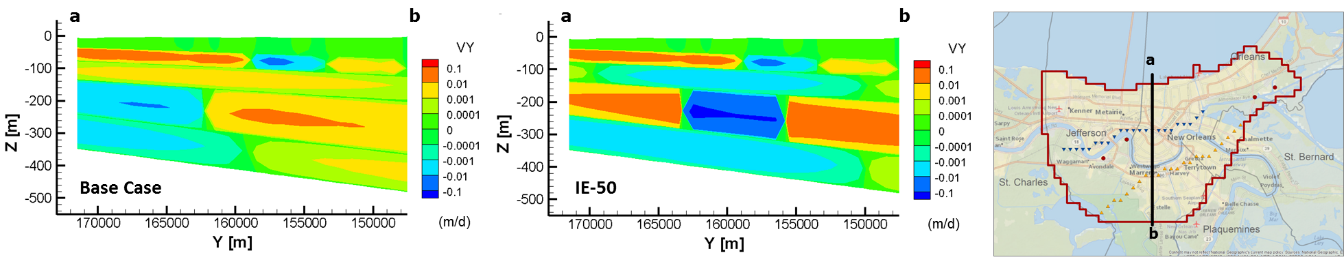
Scenarios | New Orleans
Artificial Recharge + Saltwater Extraction at 50 million m³ y⁻¹ leads to the largest increase of freshwater volume in the New Orleans area.
However:
Subsidence due to decreasing hydraulic heads
Increased influx of highly saline water
Introduction | Objectives | Saltwater Intrusion | Study Area | Model Setup | Scenarios | Conclusions
Notes:
Leg cijfers uit

Slide 43
Scenarios | New Orleans
Artificial Recharge + Saltwater Extraction at 50 million m³ y⁻¹ leads to the largest increase of freshwater volume in the New Orleans area.
However, due to saltwater extraction:
Subsidence due to decreasing hydraulic heads
Increased influx of highly saline water
Larger costs
+
Artificial Recharge only the most viable solution
Introduction | Objectives | Saltwater Intrusion | Study Area | Model Setup | Scenarios | Conclusions
Notes:
Larger costs for implementation of well system and treatment or discharge of saline water

Slide 44
Conclusions
Sea level rise, subsidence and flooding are expected to have a negligible effect on the groundwater resources and saltwater intrusion in Southeastern Louisiana
Groundwater extractions have little effect on the total freshwater volumes for the regional aquifer system, but can lead to large amounts of saltwater intrusion locally (e.g. Baton Rouge, New Orleans)
The availability of freshwater during the upcoming century in the New Orleans area is highly dependent on the amount of groundwater extracted
Large scale artificial recharge can significantly increase the future availability of freshwater in the New Orleans area
Introduction | Objectives | Saltwater Intrusion | Study Area | Model Setup | Scenarios | Conclusions

Slide 45
Recommendations
Using a finer model resolution to include transport process within aquifers such as upward movement of saline water due to groundwater extraction
Conducting extended research on the hydrogeology of the Southern Hills aquifer system to gain more insight in the distribution of aquifers and confining layers, and better estimates of the hydraulic conductivity
Verifying and calibrating the groundwater model based on known extraction rates and salinity changes in the past
Introduction | Objectives | Saltwater Intrusion | Study Area | Model Setup | Scenarios | Conclusions

Slide 46
References
Blum, M. D., & Roberts, H. H. (2009). Drowning of the Mississippi Delta due to insufficient sediment supply and global sea-level rise. Nature Geoscience, 2, 488–491. https://doi.org/10.1038/ngeo553
Dial, D. C., & Sumner, D. M. (1989). Geohydrology and simulated effects of pumpage on the New Orleans aquifer system at New Orleans, Louisiana. Louisiana Department of Transportation and Development Water Resources Technical Report No. 46, 54 P. Retrieved from https://la.water.usgs.gov/publications/pdfs/TR46.pdf
Ferguson, G., & Gleeson, T. (2012). Vulnerability of coastal aquifers to groundwater use and climate change. Nature Climate Change, 2(5), 342-345.
Griffith, J. M. (2003). Hydrogeologic Framework of Southeastern Louisiana. Water Resources Technical Report 72, Louisiana Department of Transportation and Development, Baton Rouge, LA.
Ketabchi, H., Mahmoodzadeh, D., Ataie-Ashtiani, B., & Simmons, C. T. (2016). Sea-level rise impacts on seawater intrusion in coastal aquifers: Review and integration. Journal of Hydrology, 535, 235–255. https://doi.org/10.1016/j.jhydrol.2016.01.083
Pool, M., & Carrera, J. (2010). Dynamics of negative hydraulic barriers to prevent seawater intrusion. Hydrogeology Journal, 18, 95–105. https://doi.org/10.1007/s10040-009-0516-1
Prakken, L. B. (2009). Groundwater Resources in the New Orleans Area, 2008. Water Resources Technical Report No.80. Retrieved from https://la.water.usgs.gov/publications/pdfs/TR80.pdf
Simmon, R. (2002). New Orleans, Louisiana. NASA earth observatory. Retrieved from https://earthobservatory.nasa.gov/images/2158/new-orleans-louisiana.
Tessler, Z. D., Vörösmarty, C. J., Grossberg, M., Gladkova, I., Aizenman, H., Syvitski, J. P. M., & Foufoula-Georgiou, E. (2015). Profiling risk and sustainability in coastal deltas of the world. Science, 349(6248), 638-643.
Introduction | Objectives | Saltwater Intrusion | Study Area | Model Setup | Scenarios | Conclusions

Slide 47
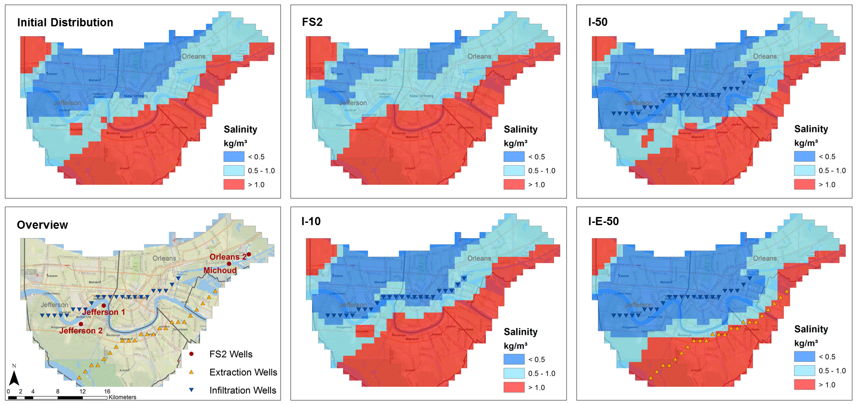
Scenarios | New Orleans
Introduction | Objectives | Saltwater Intrusion | Study Area | Model Setup | Scenarios | Conclusions
Notes:
Further intrusion at I-E-50 in western part

Slide 48
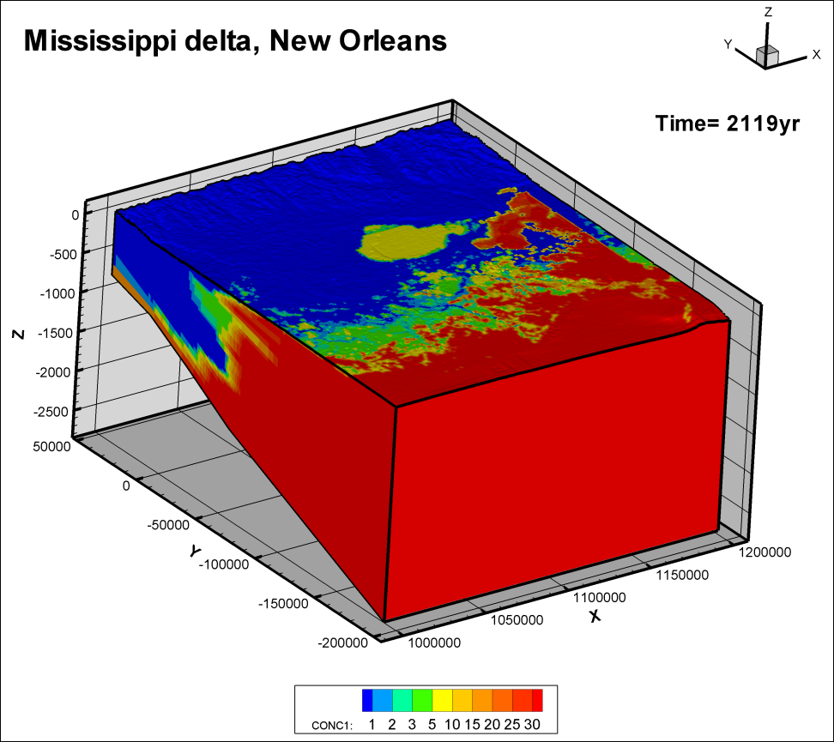
Scenarios | New Orleans
Introduction | Objectives | Saltwater Intrusion | Study Area | Model Setup | Scenarios | Conclusions
Notes:
Further intrusion at I-E-50 in western part

Slide 49
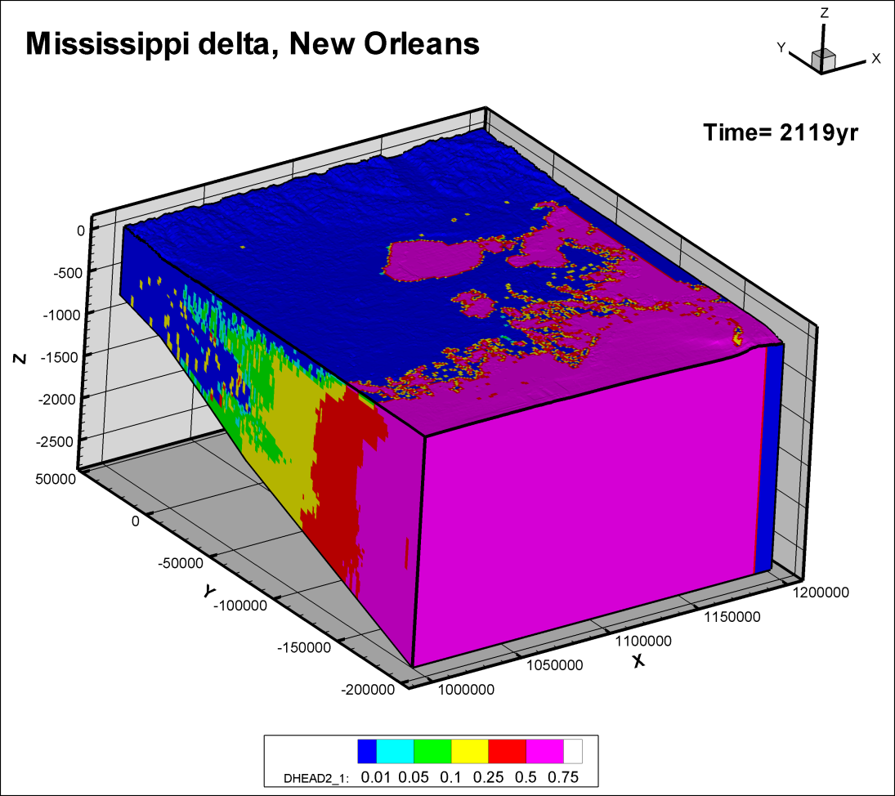
Scenarios | New Orleans
Introduction | Objectives | Saltwater Intrusion | Study Area | Model Setup | Scenarios | Conclusions
Notes:
Further intrusion at I-E-50 in western part

Slide 50
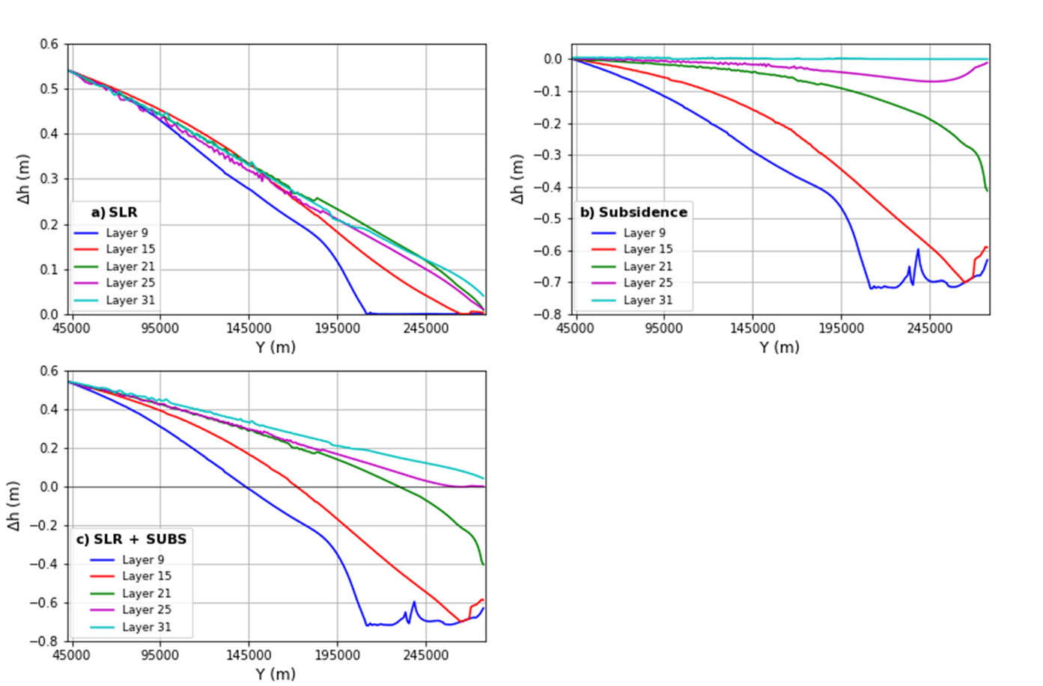
Scenarios | New Orleans
Fig. 4.8. Head changes due to (a) sea level rise, (b) subsidence and (c) both sea level rise and subsidence in 2119 vs. latitude for several model layers. Head changes are defined as the 2119 head difference between the sea level rise or subsidence scenario and FS2. The head changes were given for X = 1085000 m, at the same location as the transects depicted in Fig. 4.7.
Introduction | Objectives | Saltwater Intrusion | Study Area | Model Setup | Scenarios | Conclusions
Notes:
Further intrusion at I-E-50 in western part

