Slide 1



OpenMI 2.0 Design
Gennadii Donchyts
Deltares, The Netherlands

Slide 2
OpenMI 2.0 Design
UML Class Diagram
Linking components
Exchanging values
Workflow Management
Event-driven programming
Decorating Exchange Items
Saving / Loading Component State
OGC-like geometries
Improved time interfaces
Arguments
Notes:
Since we have very little time – only topics till red line will be covered

Slide 3
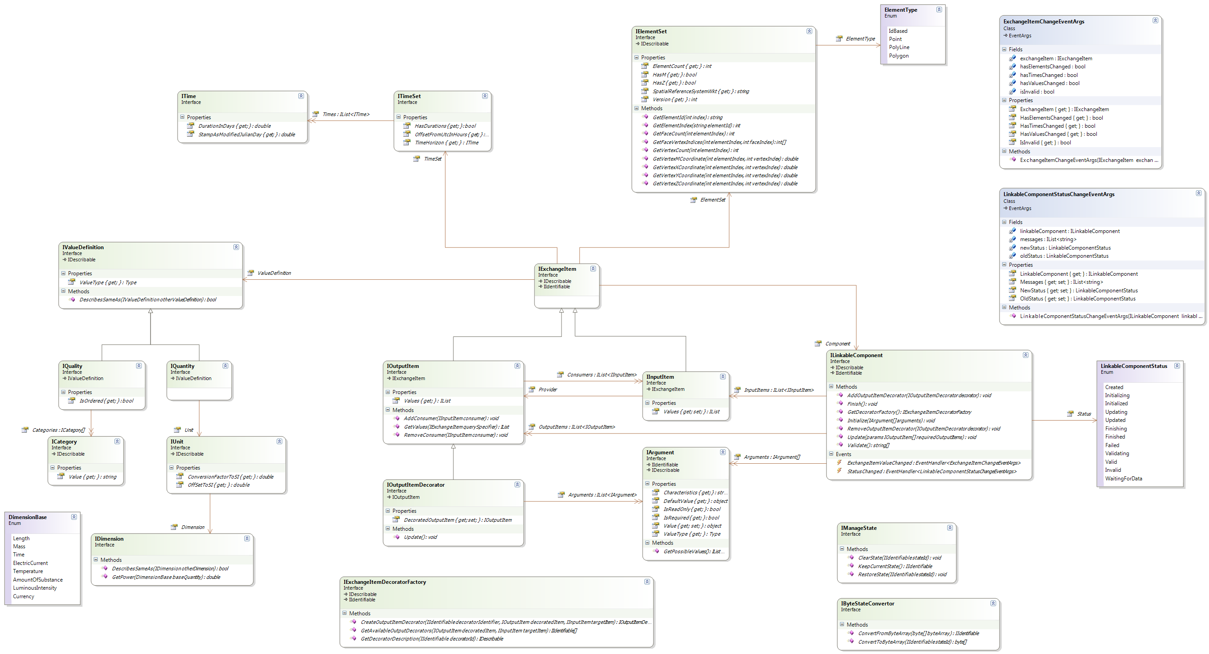
UML Class Diagram
Notes:
Trying to present the whole UML on one page is too complicated
We will try to analyze it by examples later in the presentation

Slide 4
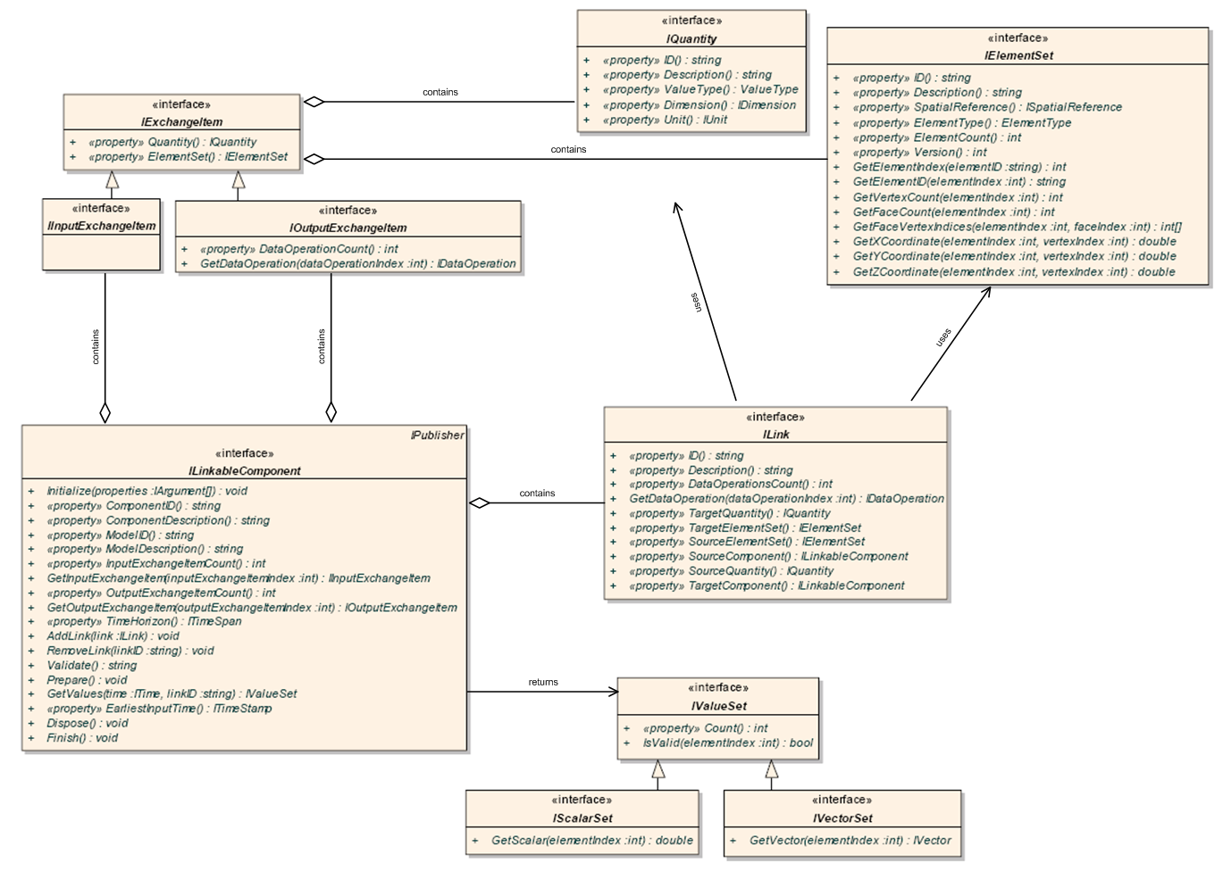
Linking Components, Version 1
Notes:
Analyzing UML of version 1 on one page is not so informative either

Slide 5
Linking Components, Version 1
Using their exchange items
Quantity
What?
Element Set
Where?
Exchange Items
Q^{in}
C^{out}
Component
Link
Time
When?
Notes:
Visually present items shown on UML diagram

Slide 6
Linking Components
Component1
Component2
Notes:
But in reality it is not that intuitive, ILink has too many things which are hard to use

Slide 7
Linking Components
Component1
Component2
Notes:
This was solved in OpenMI 2.0 (see UML on the next page)

Slide 8
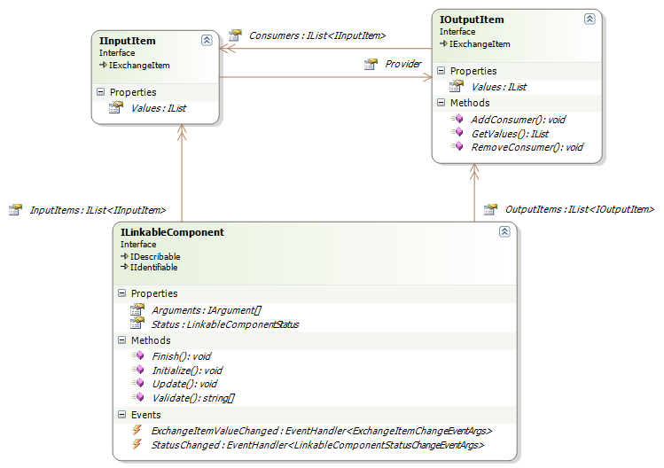
Linking Components
Notes:
Link disappeared, Provider and Consumers are used instead
Many Input Items (Consumers) can use data available in one Output Item (Provider)
Values are available directly in input / output Exchange Item

Slide 9
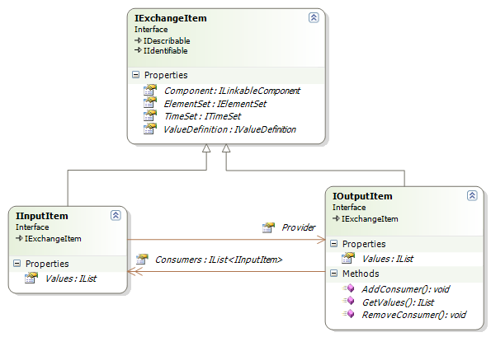
Linking Components
Notes:
Both input and output exchange item interfaces extend base IExchangeItem interface

Slide 10
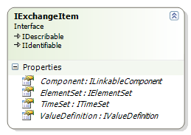
Linking Components

Slide 11
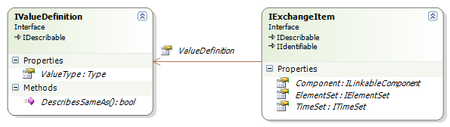
Linking Components
Notes:
Value definition is a base interface for IQuanaity and IQuality plus it defines ValueType of real values being exchanged

Slide 12
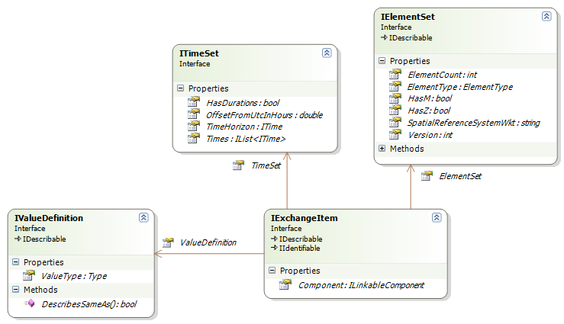
Linking Components
Where?
When?
What?

Slide 13
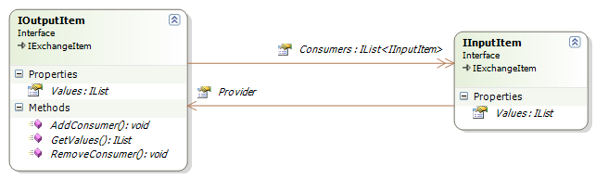
Linking Components
Component1
Component2

Slide 14
Exchanging Values
Using Linked Exchange Items
Notes:
Component developer may decide if values are passed automatically into the next component or if they should be pulled by another component

Slide 15
Exchanging Values
Using Linked Exchange Items

Slide 16
Part of the Class Diagram Covered

Slide 17
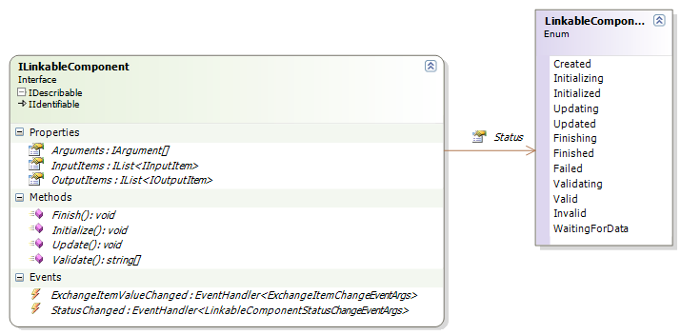
Linkable Component
Notes:
ILinkableComponent interface became much cleaner (2x less methods / properties allowing more functionality)
Decorator-related methods are hidden (in order to concentrate on most important things here)
Status property was added to the component so that component state can be monitored at run time

Slide 18
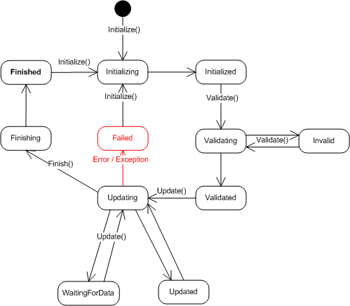
Workflow
Component States

Slide 19
Linkable Component
Notes:
ILinkableComponent interface became much cleaner (2x less methods / properties allowing more functionality)
Decorator-related methods are hidden (in order to concentrate on most important things here)
Status property was added to the component so that component state can be monitored at run time

Slide 20
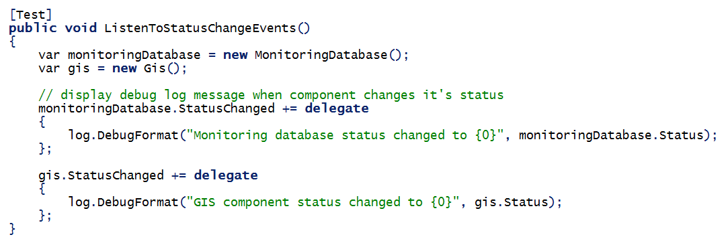
Events
Component1
Component2

Slide 21

The End

