Slide 1

Migration from 1.4 to 2.0
Wrapping a 1.4 IEngine in 2.0
Jesper Grooss, DHI

Slide 2
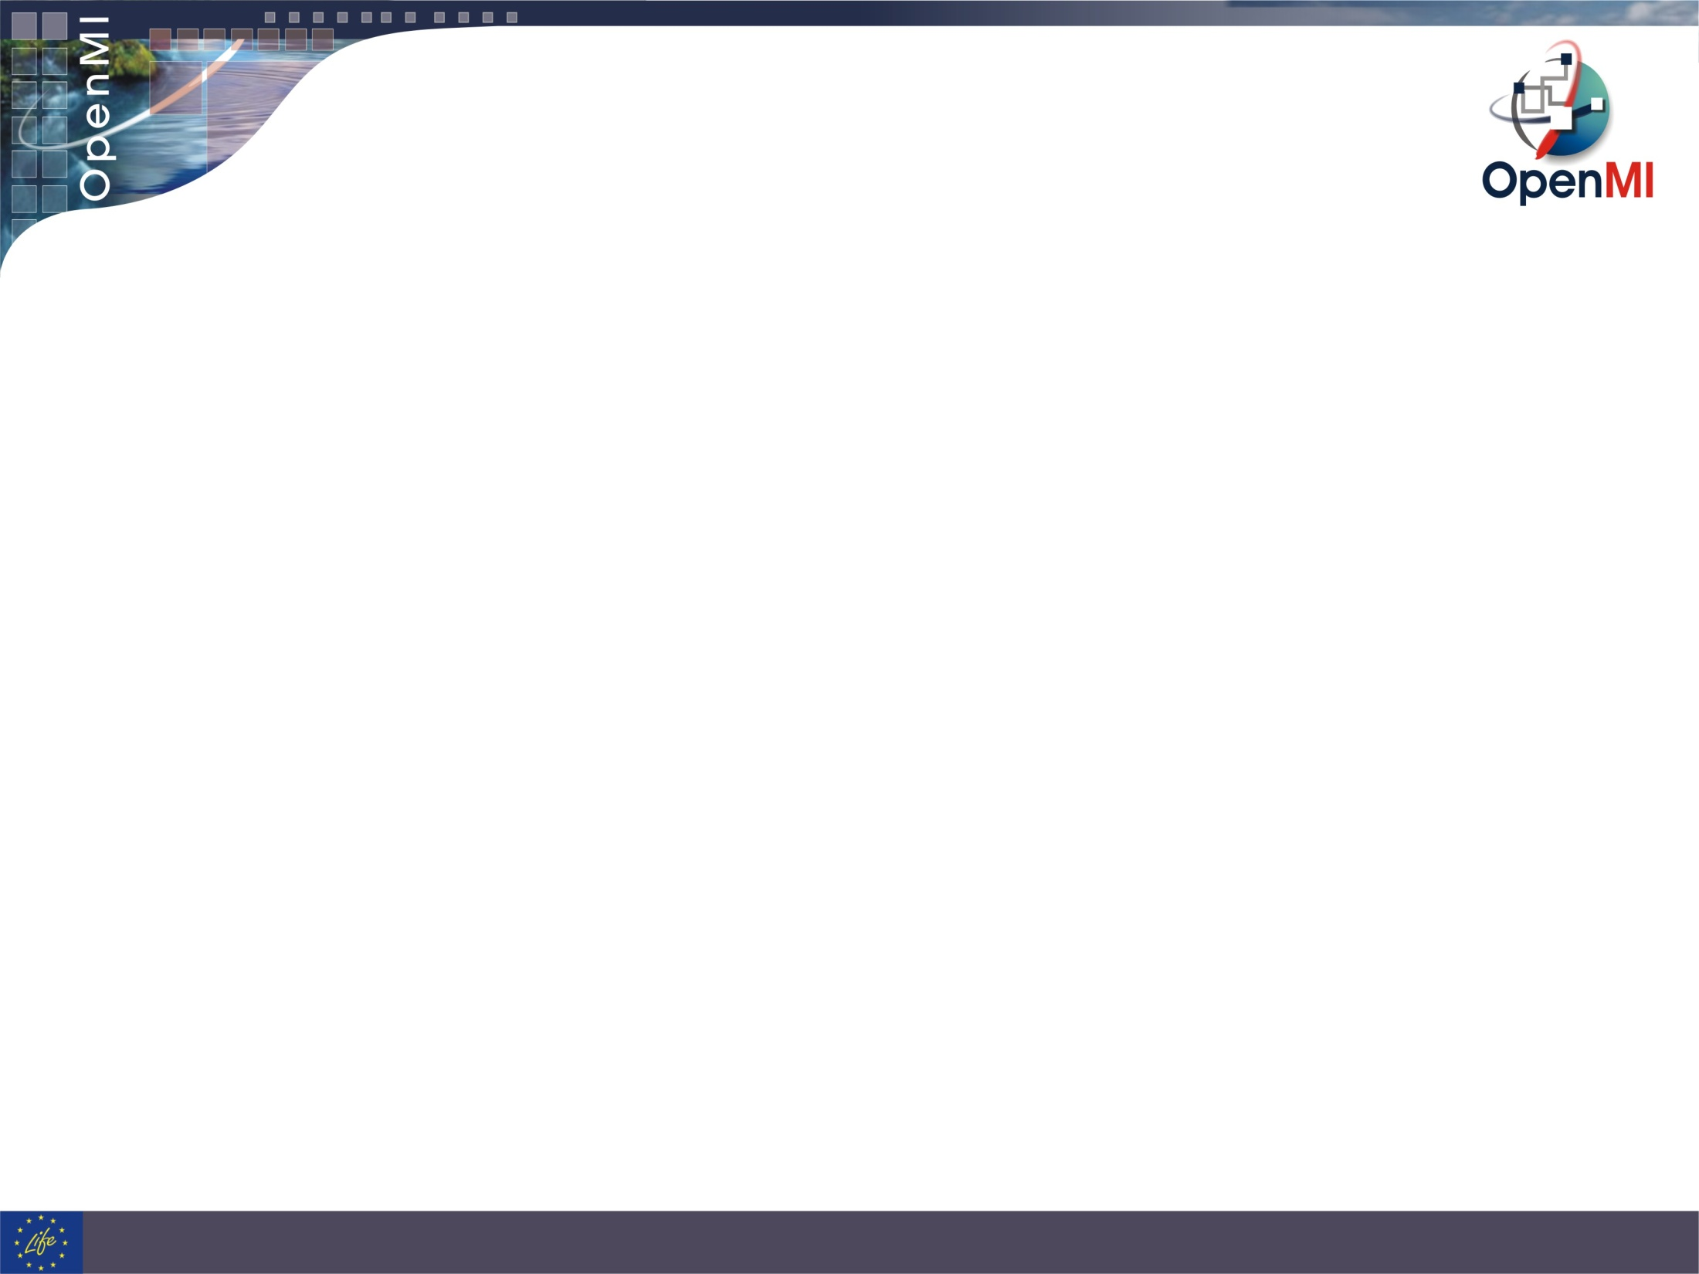
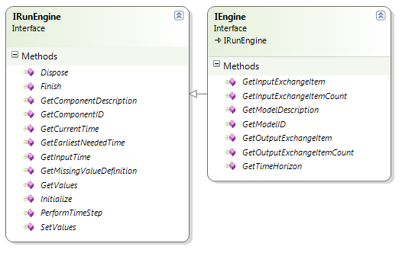
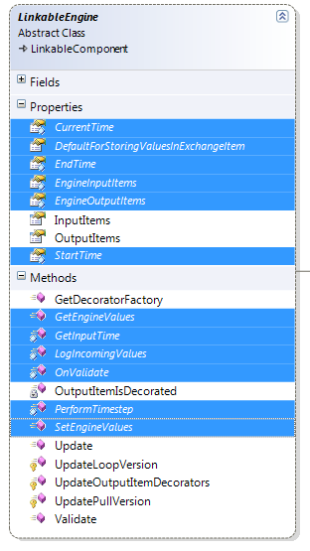

Migrating an IEngine
1.4 IEngine
2.0 LinkableEngine
My model
1.4:
GetValues(string QuantityID, string ElementSetID);
2.0:
GetEngineValues(EngineExchangeItem exchangeItem);
ExchangeItem contains QuantityId and ElementSetID. Can contain a deep pointer into the engine.
Notes:
In 1.4 an engine implemented the IEngine interface. In 2.0 an engine interface extends the LinkableEngine (abstract) and needs to implement the abstract methods (those in blue).

Slide 3
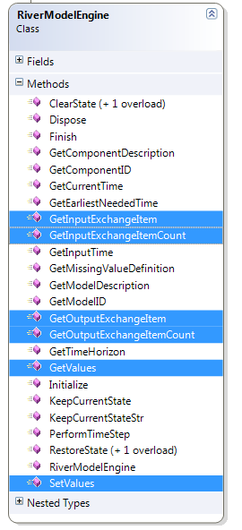
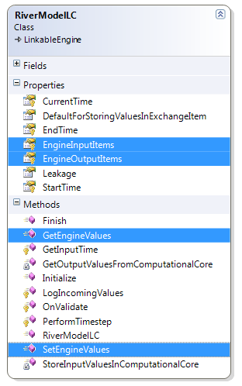
1.4 RiverModelEngine
2.0 RiverModelLC
Notes:
The differences between the 1.4
RiverModelEngine : IEngine
and the 2.0
RiverModelLC : LinkableEngine
is very small.

Slide 4
UpwardsCompatible wrapper containing
IEngine interface alike in 1.4
OpenMI 2.0
OpenMI.Standard
Sdk.Backbone
OpenMI 1.4
Sdk.Wrapper
OpenMI.Standard
Sdk.Backbone
≈
UpwardsCompatible
Sdk.Wrapper
UpComp.Standard
UpComp.Backbone
UpComp.Wrapper
My1_4Engine
Notes:
To ease migration an UpwardsCompatible namespace has been implemented, which also has an IEngine interface, and where you with very small changes to the original code can make a 1.4 engine into a 2.0 engine.

Slide 5
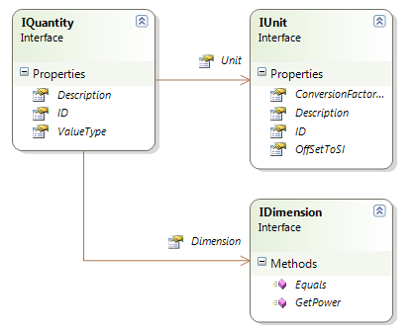
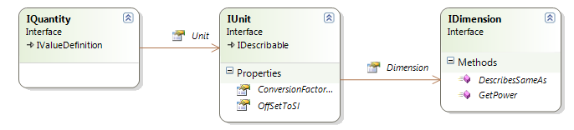
Worse code change when using the upwards compatible wrapper
1.4 quantity
2.0 quantity

Slide 6
Quantity – 1.4 vs. 2.0
1.4
Dimension flowDimension = new Dimension();
Unit literPrSecUnit = new Unit("LiterPrSecond",0.001,0,"Liters pr Second”)
Quantity flowQuantity = new Quantity(literPrSecUnit, "Flow", "Flow", global::OpenMI.Standard.ValueType.Scalar, flowDimension);
Dimension flowDimension = new Dimension();
Unit literPrSecUnit = new Unit("LiterPrSecond", 0.001, 0, "Liters pr Second");
literPrSecUnit.Dimension = flowDimension;
Quantity flowQuantity = new Quantity(literPrSecUnit, "Flow", "Flow");
flowQuantity.ValueType = typeof(double);
2.0

Slide 7
Tricky part:
References for the upwards compatible wrapper
using OpenMI.Standard;
using Oatc.OpenMI.Sdk.Backbone;
using Oatc.OpenMI.Sdk.Wrapper;
1.4
using OpenMI.Standard;
using Oatc.OpenMI.Sdk.Backbone;
using Oatc.UpwardsComp.Standard;
using Oatc.UpwardsComp.Backbone;
using Oatc.UpwardsComp.EngineWrapper;
using ITime = Oatc.UpwardsComp.Standard.ITime;
2.0

Slide 8
Changes in Time
1.4
TimeStamp startTime = new TimeStamp(Oatc.OpenMI.Sdk.DevelopmentSupport.CalendarConverter.Gregorian2ModifiedJulian(_simulationStart));
2.0
TimeStamp startTime = new TimeStamp(Time.ToModifiedJulianDay(_simulationStart));

