Slide 1
Waterberging Koopmanspolder
Digitaal terrein model

Slide 2
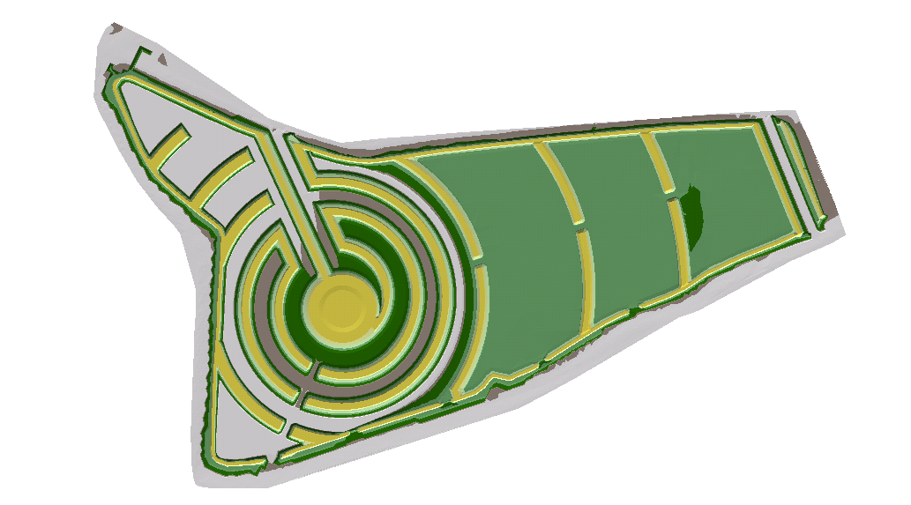
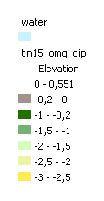
DTM (geen water)

Slide 3

NAP -3.0 m

Slide 4
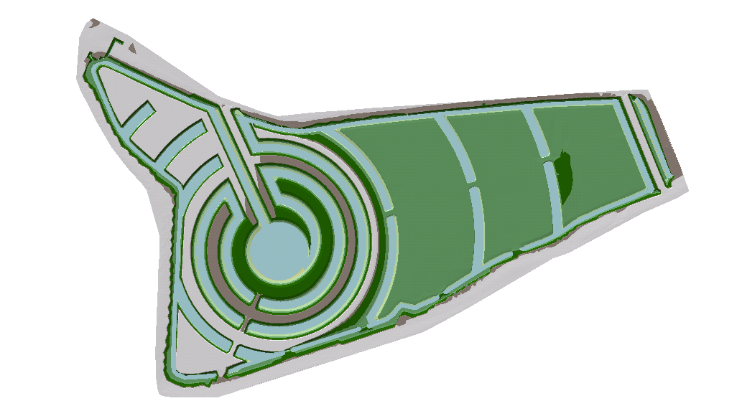
NAP -2.5 m

Slide 5

NAP -2.0 m

Slide 6

NAP -1.5 m

Slide 7
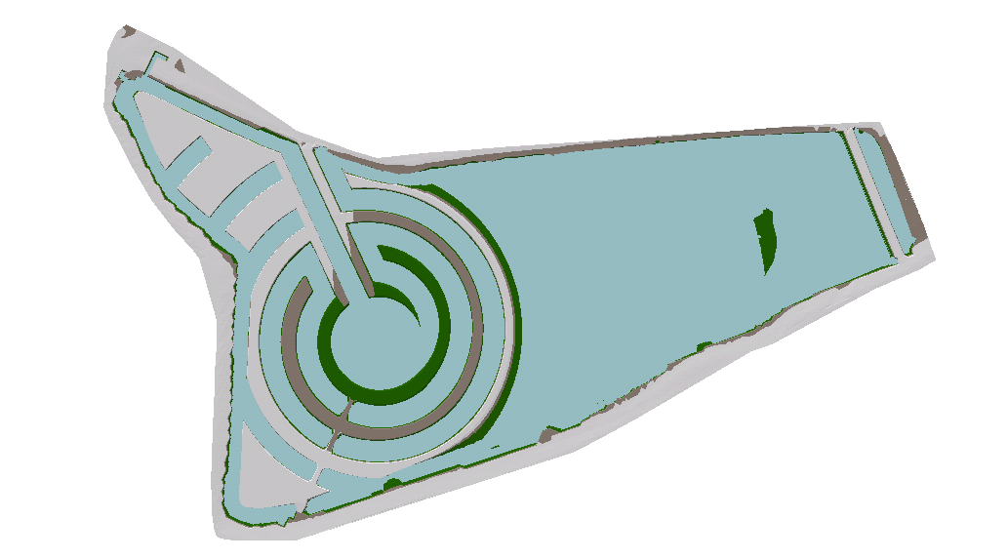
NAP -1.0 m

Slide 8
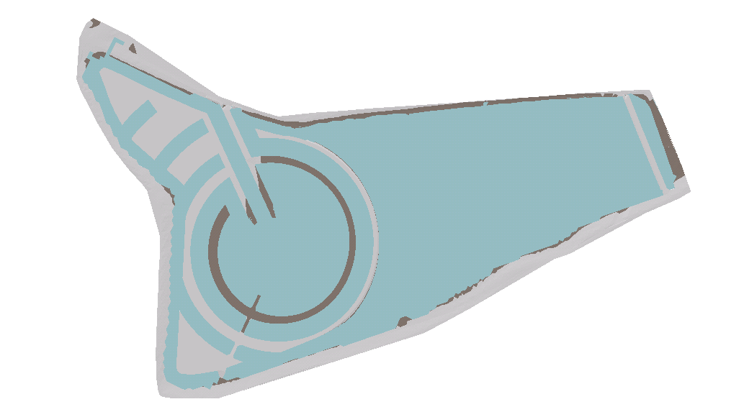
NAP -0.2 m

Slide 9
Overzicht
Volume [m3]
Waterpeil [NAP m]
Max. berging ~180.000 m3, Reguliere berging ~ 41.000 m3

