Slide 1
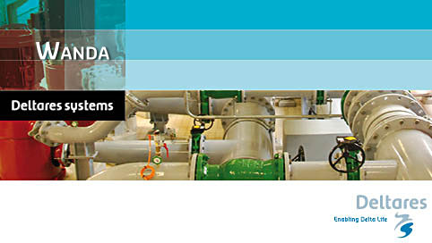
Modelling pipeline hydraulics in WANDA
What is new in Wanda 4.2

Slide 2
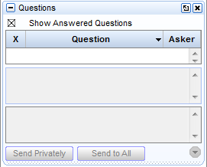
Questions?
Raise hand
Ask questions

Slide 3
Contents
Igrafix 2013
Vent with automated level effect and weir functionality
Fast filling pipe
Parameter script
Heat components
  4-way heat exchanger
  Gas boiler
  Solar collector
  Rigid column pipe with grid for temperature
QandA

Slide 4
Igrafix 2013
Improved compatibility with Windows 7 and 8
Updated look and feel to modern user interface
Inclusion of extended recent files list

Slide 5
Vent with automated level effect and weir
Q

Slide 6
Fast filling pipe

Slide 7
Parameterscript
Purpose:
Determine effect of parameter variation, e.g. wall roughness, surge vessel size, ect.
Parameterscript available in Wanda 3 and Wanda 4.1
Wanda 4.2 gets excel tool to make use more easy

Slide 8



Parameterscript
Excel tool
WPS file
Wanda
Mother case
Child case
Output csv-file

Slide 9
4-way heat exchanger

Slide 10
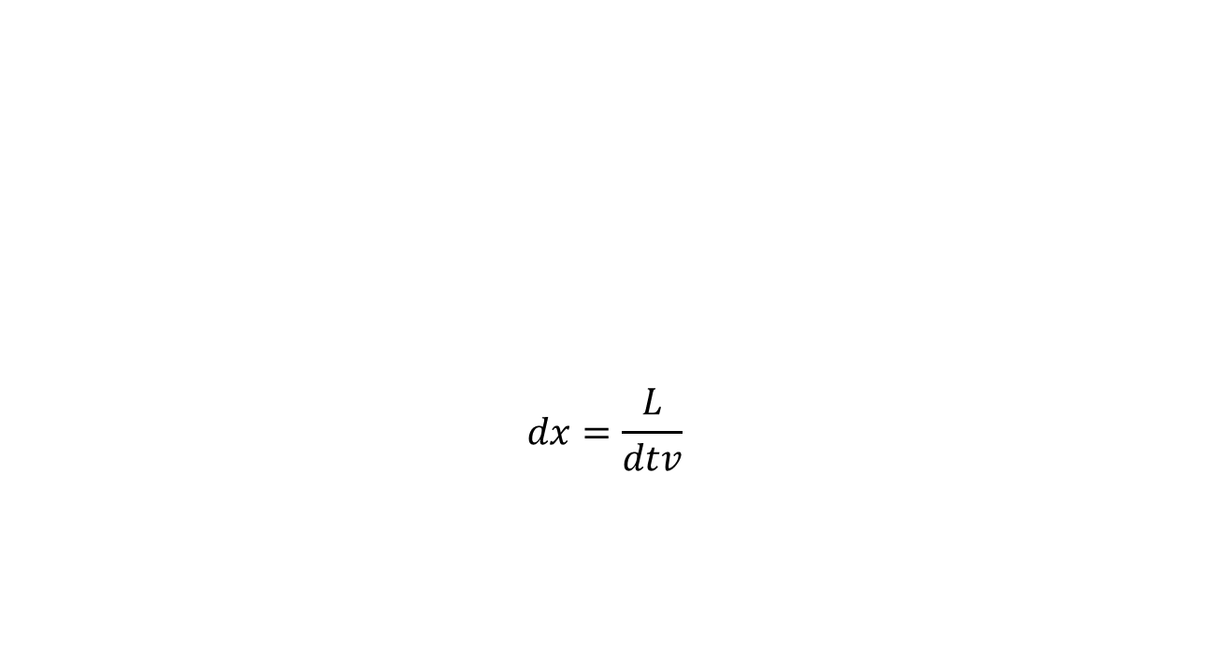
Rigid column pipe with grid for temperature

Slide 11
QandA

