Slide 1
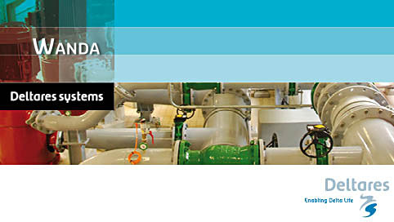
Modelling pipeline hydraulics in WANDA
Basic Wanda usage

Slide 2
Questions?
During Webinar you can ask question via chat.

Slide 3
Contents
User interface a quick introduction
Building of a simple model
Running simulations and viewing results
Setting up multiple runs via the parameter script
Viewing results and using the selection builder functionality

Slide 4
QandA
Next Webinar
17th of October 2013
System characteristic and pump energy
Delft Software days 28 October - 8 November 2013
http://www.delftsoftwaredays.nl/
Wanda basic course 5 and 6 November
Wanda advance course 7 and 8 November

