Slide 1
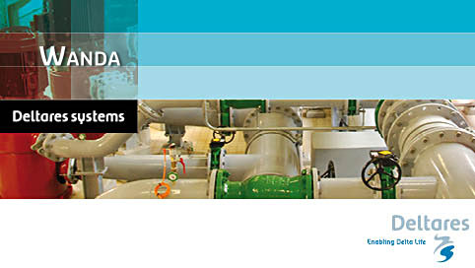
Modelling pipeline hydraulics in WANDA
System characteristic module and pump energy module

Slide 2
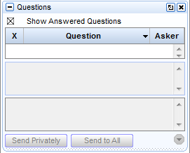
Questions?
Ask questions

Slide 3
Contents
System characteristic module
Pump curves
Pump energy module
QandA

Slide 4
System characteristic module
Purpose:
  Determine system characteristic for multiple modes of operation
  Determine working range of pumps

Slide 5
Pump energy module
Purpose: Determine optimum pump operating ranges
Application area: pumping stations with different types of pumps

Slide 6
Example case
Brabant water: Drinking water company in the province of Brabant
33 production sites
Pump schedule optimized for minimum energy based on:
  Frequency data of demands
  System characteristic of the downstream system
A saving for four pumping stations of 520 MWh (8.2%) is realized

Slide 7

Delft Software days 2014
Goal: Improve your Wanda scales
Basic course: 4th and 5th of November
Modeling & Analysis 6th of November
Control 7th of November
More info and registration on http://dsd-int.nl/

Slide 8
Questions

