Slide 1
DeltaShell 64bit
Considerations for developers

Slide 2
32 vs 64
A 32 bit process can:
  Run on a 64bit OS
  Load only 32bit native dlls
  Allocate about 2 to 3GB
  Throw OutOfMemoryException > 800mb
A 64 bit process can:
  Not run on a 32bit OS
  Load only 64bit native dlls
  Allocate enough (16TB)
  Slow down (swapping) > a few GB

Slide 3
Pros / cons
Why 64 bit?
  More memory!
  Managed code doesn’t care, mostly (AnyCPU)
  Machines sold today are 64bit
Why not 64 bit (yet)?
  32bit support still required
  Requires 64bit native dlls
  Slightly slower (caching blah blah)

Slide 4
64bit Status March 2014
Component | 64bit status
DeltaShell | full
- Gui | AnyCPU: two copies
- Console | AnyCPU: two copies
- Gdal | 2x native dlls
- NetCdf | 2x native dlls
- Sqlite | 2x native dlls
Sobek (Flow, RR, RTC, Waq) | 32bit remote instance
FM | full
Wave | 32bit wave/swan
Morphan / Xbeach / Habitat / WFD etc | not implemented
FewsAdapter / OpenMI | not implemented

Slide 5
How does it work?
Types of binaries / projects:
  Managed dlls [50%]
  Test dlls [45%]
  Native dll(s) [4%]
  Exe [1%]

Slide 6
Managed dll projects
Create one configuration: AnyCPU
Set platform to AnyCPU
Refer only AnyCPU references

Slide 7
Test projects
Create x86 and x64 configuration
Set platforms accordingly
If you want to test x86/x64 simultaneously, see tricks in Exe projects

Slide 8
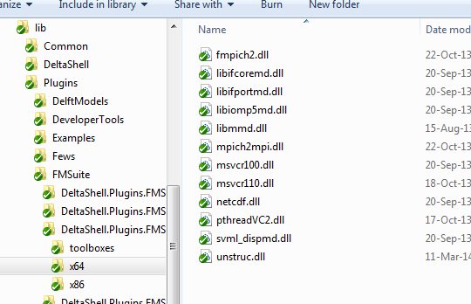
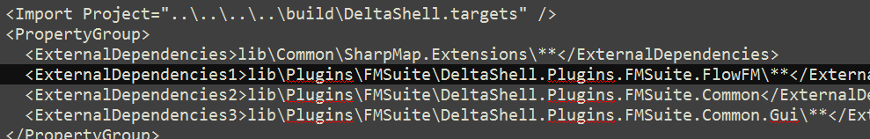
Native dlls - files
  Get both 32bit and 64bit versions, including their dependencies!
  Place them in x86 and x64 directories accordingly (in lib)
  Note: copying to test projects (ExternalDependencies) requires recursive copy now!
  Adjust wix for MSI ;-)

Slide 9
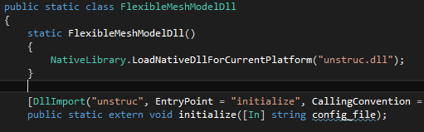
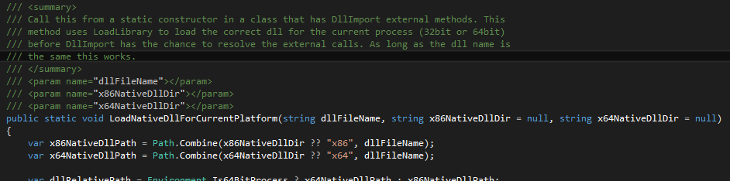
Native dlls - code
  Add static constructor to DllImport class (see image)
  (Or otherwise make sure that correct LoadLibrary is done before any DllImports can be resolved)

Slide 10
Native dlls – no 64bit?!
What if you don’t have a 64bit version (yet)?
  -> Remote instance container

Slide 11
Native exe
Nothing changes… you can continue to use the 32bit version

Slide 12
(Managed) exe projects
How it’s done for DeltaShell.Gui.exe (and others):
Create two configuration: x86 & x64
Set x64 to x64
Set x86 to AnyCPU (!)
x86/32bit build:
  DeltaShell.Gui.exe is build as AnyCPU
  Copy DeltaShell.Gui.exe to DeltaShell.Gui.x64.exe
  Force DeltaShell.Gui.exe to run 32bit (x86), using ‘corflags’ tool in postbuild
  VS run/debug: starts 32 bit
  FOR DEPLOYMENT (builds 32 & 64 bit)!!
x64/64bit build:
  DeltaShell.Gui.exe is AnyCPU (thus 64bit)
  VS run/debug: starts 64 bit
  FOR LOCAL TESTING ONLY!!

Slide 13
32+64 in single build
Why??
No double compilation time to build both 32bit & 64bit
AnyCPU for 95% of the binaries anyway
Match deployment situation closely
64bit configuration exists for testing purposes

Slide 14
Discussion…
Think about test-coverage.. Duplicate all tests?
Start working on 64bit dlls for Sobek
Same for other projects…

