Slide 1
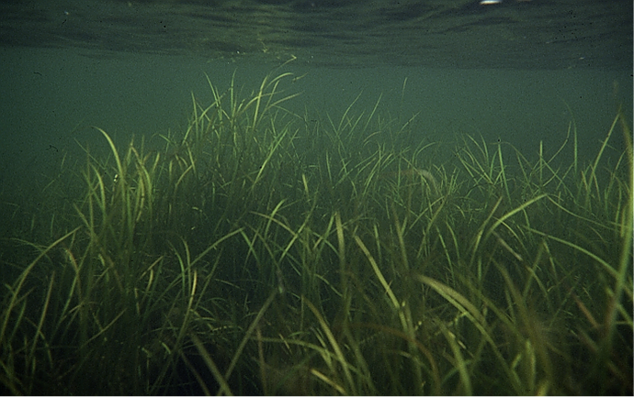
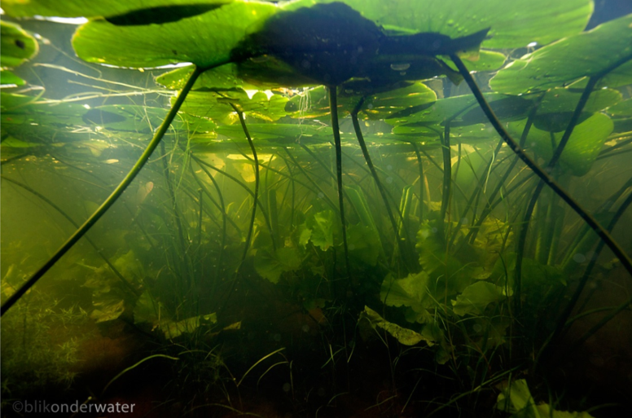
Linking water quantity and water quality via aquatic vegetation processes
Ellis Penning, Jasper Dijkstra

Slide 2
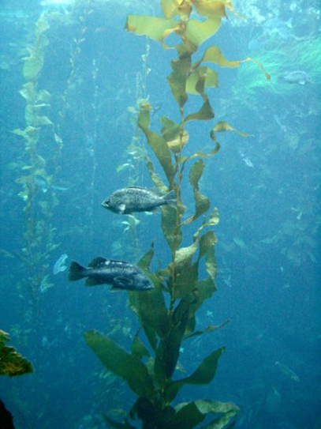
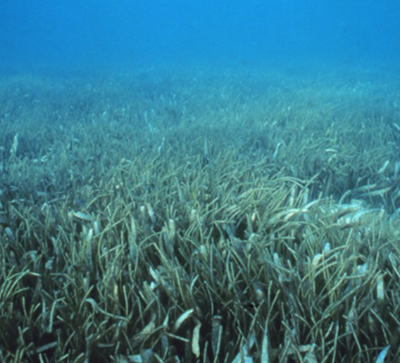
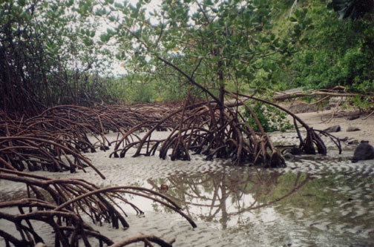
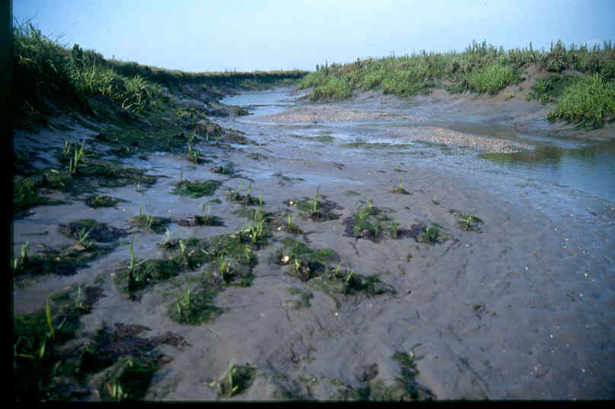
Why vegetation modelling?
Vegetation is important: Ecosystem services
  Primary production
  Erosion prevention
  Habitat for many animals
  Water management
  Wave attenuation
  Water quality
  Legislation
Transparent tools to answer quantitative questions
Notes:
Terminology ecologists/modellers

Slide 3
Goal of this presentation
To give you a flavour of various recent developments in the Deltares software:
  Vegetation and Water quantity: Dynveg, D3D-flow, Xbeach, SWAN
  Vegetation and Water quality: Delwaq, Habitat
To give some examples of recent applications
  Paulina schor (water quantity)
  Veluwemeer (water quality)
To invite you to work with us in the further development of our knowledge on quantifying the effect of macrophytes

Slide 4
Process based modelling
  Vegetation and Water quantity
Model | Scale | Process
Dynveg | individual plant – patch scale | flow
Delft3D-Flow | meadows in rivers, estuaries, coasts | flow and transport
Xbeach | nearshore meadows | (long) waves
SWAN | nearshore meadows | (short) waves
Development model

Slide 5
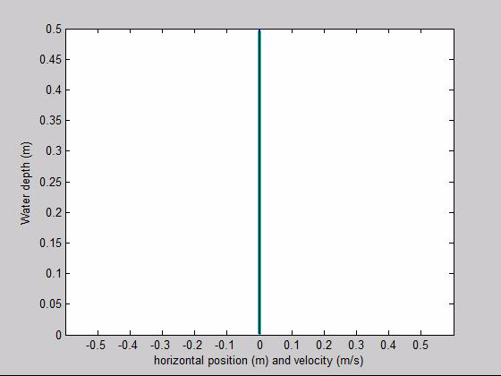
Dynveg
1DV flow interaction between flow and flexible vegetation
  plant drag depends on orientation in flow; dynamic feedback
  k-epsilon turbulence model
  real plant properties (buoyancy, elasticity)
  can be coupled to Delft3D for 2/3D
Notes:
Explain colors: status

Slide 6
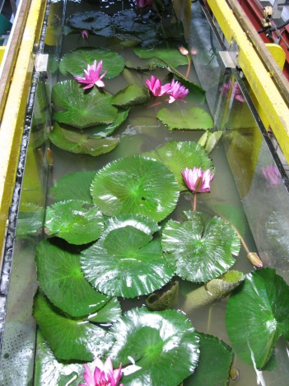
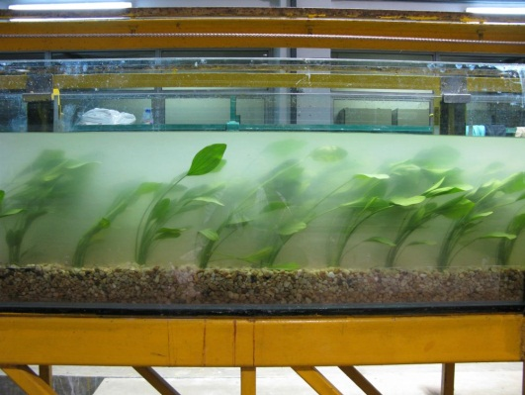
Delft3D
Spatial effect of vegetation on flow:
  k-epsilon turbulence model: ‘rigid rods’
  Trachytopes
Notes:
Jasper, beide voorbeelden zijn in 1DV!

Slide 7
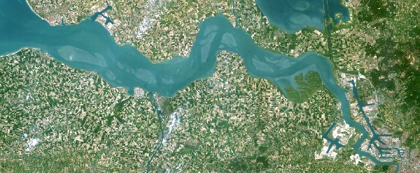
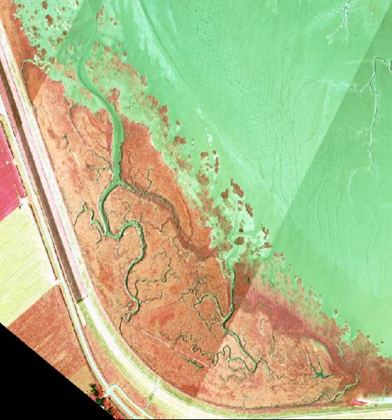
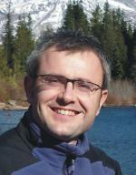
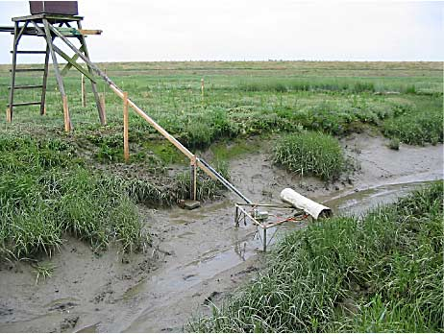
Example: Paulinaschor
Stijn Temmerman
University of Antwerp
Formerly at NIOZ/NIOO-CEME

Slide 8
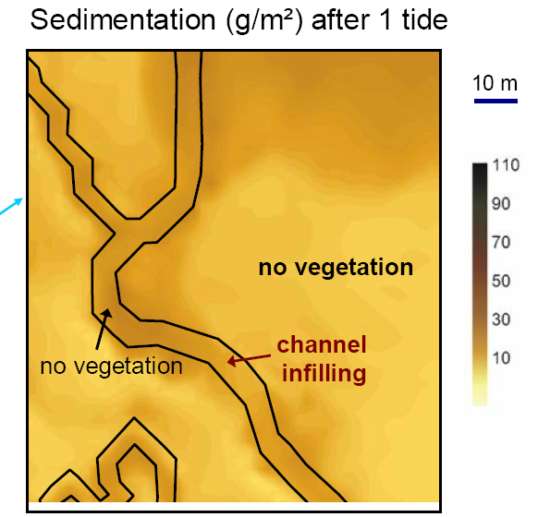
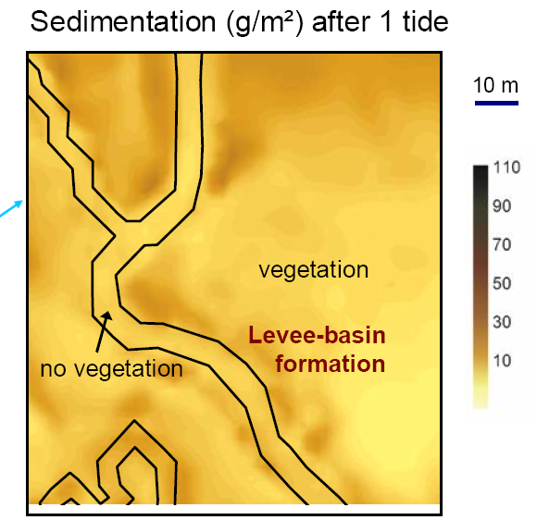
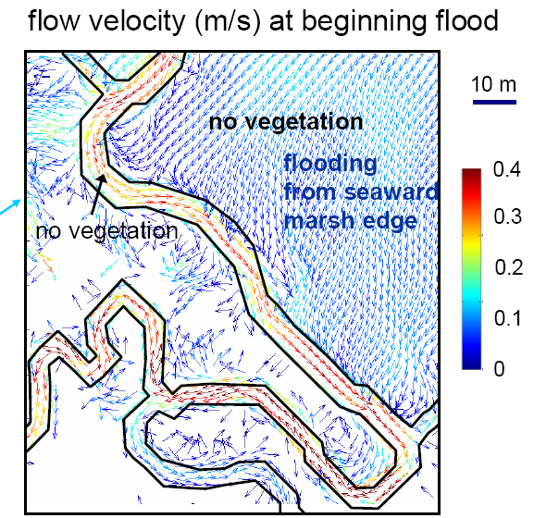
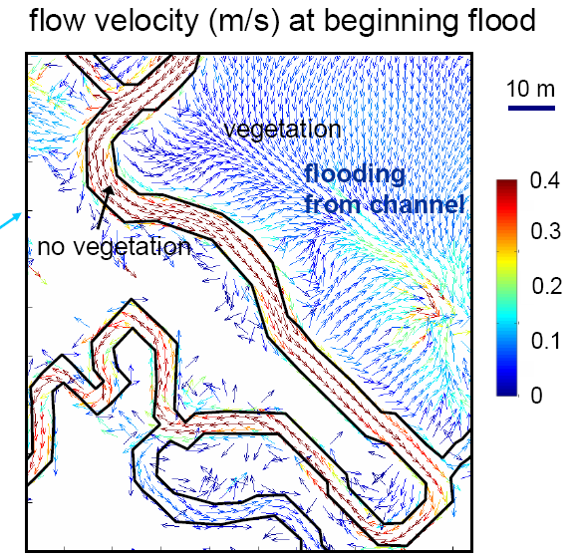
Example: Paulinaschor
Temmerman S, Bouma TJ, Govers G, Wang, ZB, de Vries MB, Herman, PMJ. 2005. Impact of vegetation on flow routing and sedimentation patterns: Three-dimensional modeling for a tidal marsh. Journal of Geophysical Research-Earth Surface 110 (F4): Art. No. F04019.

Slide 9
Linking processes – water quantity
Vegetation
Delft3D-Flow
Propagule
dispersal
Hydromorphology
Flow velocity
Attenuation
Inundation characteristics
Drought characteristics
Colonization
Flow (regime)
Development
Hydraulic resistance
Sedimentation
Substrate conditions
Burial
Cohesion
Mortality
Erosion
Scouring

Slide 10
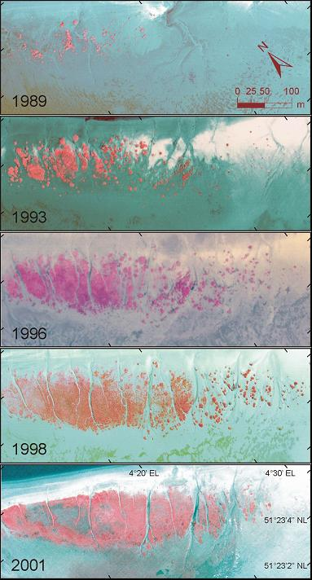
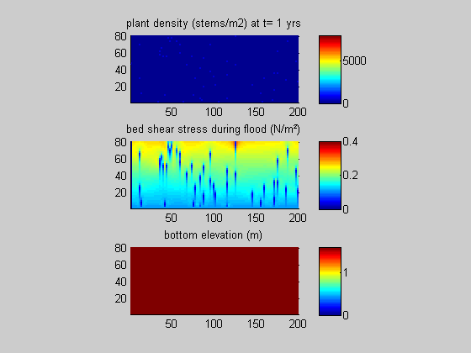

Example: intertidal flat
Rigid vegetation
Flexible vegetation
T₀: Tidal flat MSL+1.4m , random vegetation seeding, 4.5m tide
Temmerman, S., T.J. Bouma, J. Van de Koppel, D. Van der Wal, M.B. De Vries, P.M.J. Herman. 2007. Vegetation causes channel erosion in a tidal landscape. Geology.

Slide 11
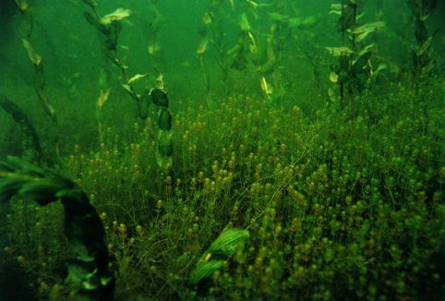
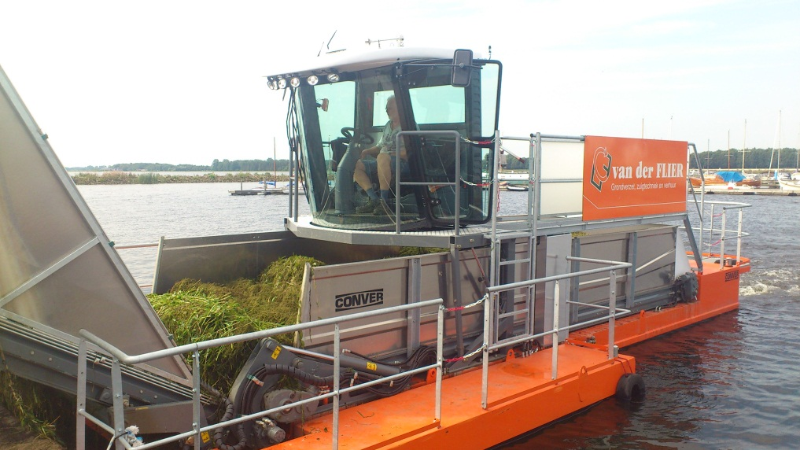
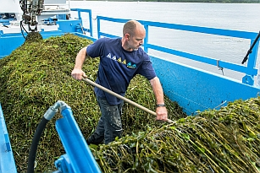
Summarizing: feedback mechanisms between plants and water quantity are important….
And how about plants and water quality?

Slide 12
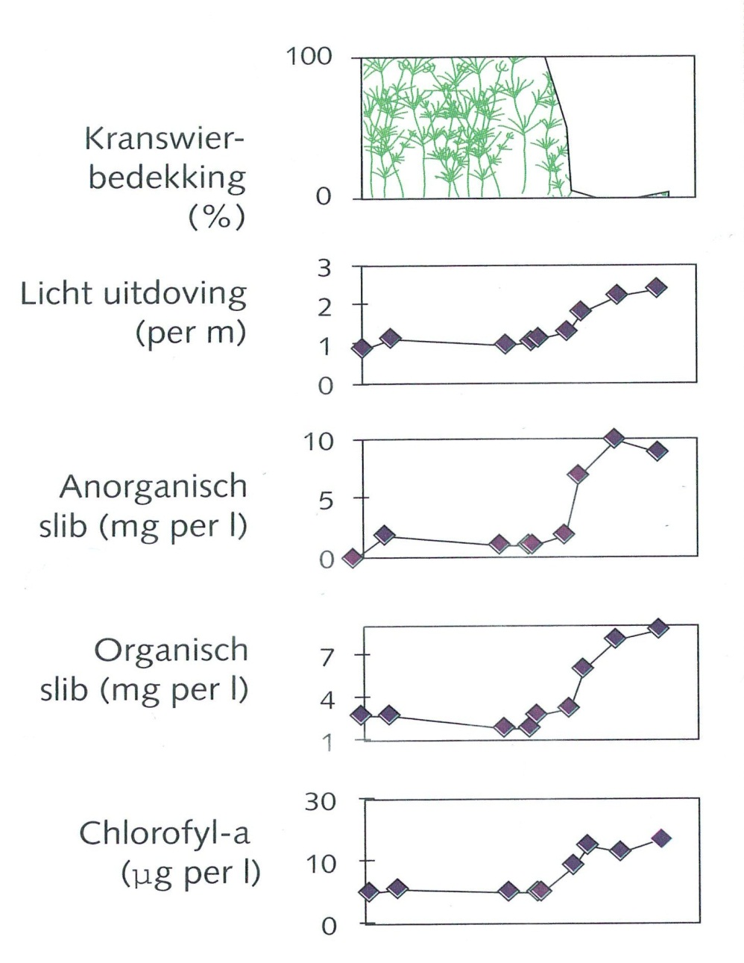
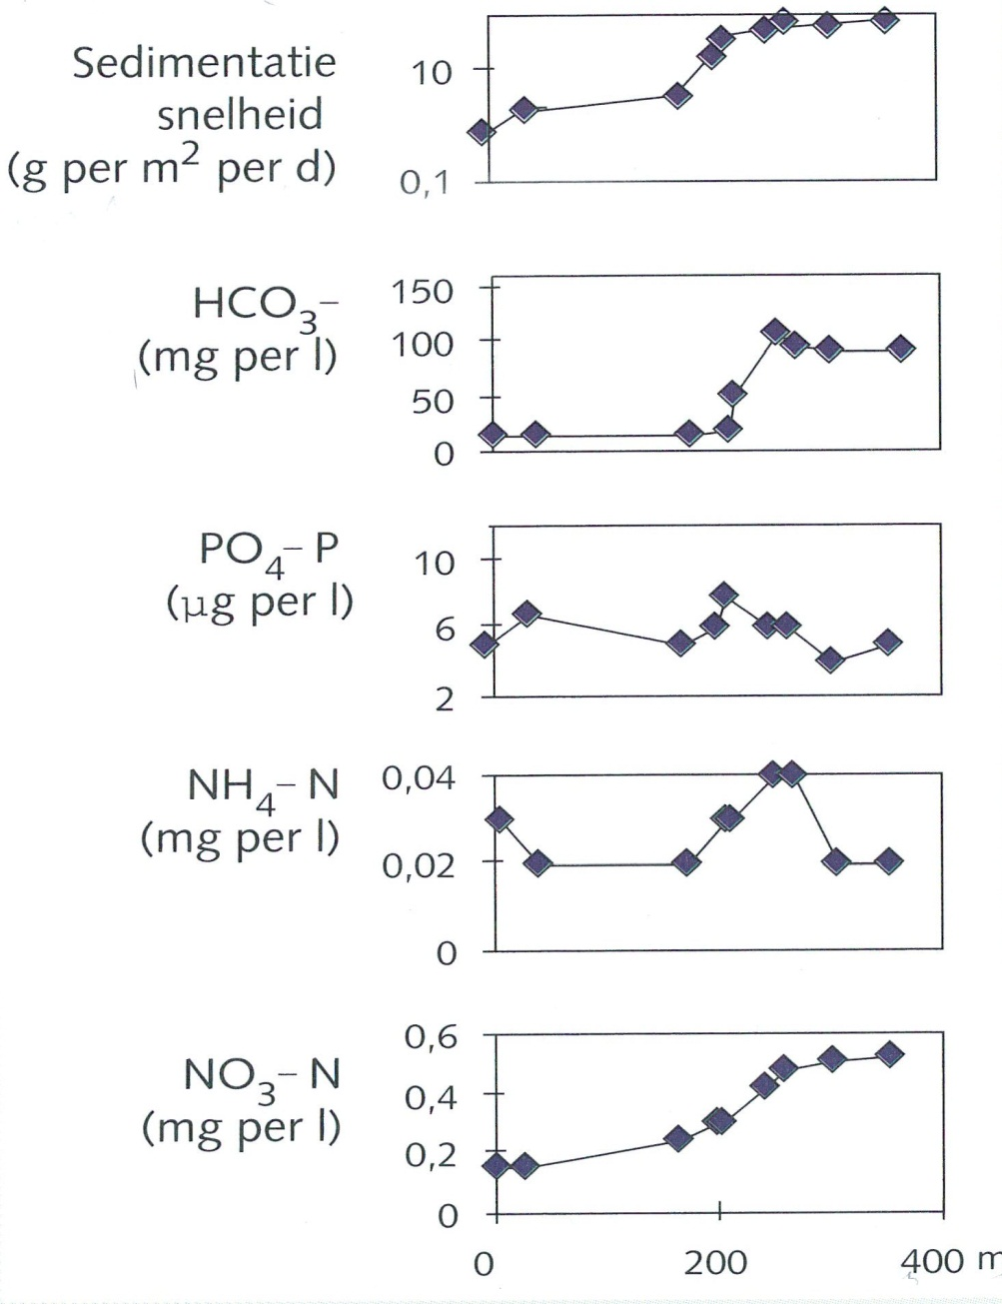
Spatial patterns in Lake Veluwemeer, 1994
(Van den Berg & Coops, 1998)
Chara cover
(%)
Light attenuation (m⁻¹)
Inorganic Susp.Sed.
(mg L⁻¹)
Organic Susp. Sed
(mg L⁻¹)
Chlorophyl-a
(ug L⁻¹)
Sedimentation
Speed
(g m⁻² d⁻¹)
HCO3-
(mg L⁻¹)
PO4-P
(ug L⁻¹)
NH4-N
(mg L⁻¹)
NO3-N
(mg L⁻¹)

Slide 13
Why a macrophyte module in Delwaq?
Delwaq before
Need for clear water situations predictions and hindcasting
Society: nuicance – ‘aquatic weeds’ , nutrient pumps => internal eutrophication
Water Framework Directive : macrophytes are good!
On-line community
Would like to model the role of vegetation, especially macrophytes, but also other vegetation, in water quality modelling
Vegetation = terrestrial/aquatic,/woody/flexible
Macrophyte = (semi-)aquatic, (semi-)flexible

Slide 14
Processes – water quality
Vegetation
DELWAQ
Suitable
Habitat
Water/soil chemistry
Seasonal fluctuations
Clear or turbid state
Higher trophic levels
grazing
Competition
Algae
Development
Uptake/excretion
Nutrient cycling
Substrate conditions
Burial/storage
Nutrient pump
Limiting factors
Mortality
Light/temperature
Total primary production

Slide 15
(7)
DELWAQ: nutrient cycles
uptake
emergent
transport
(4)
respiration
grazing
(1)
(10)
dissolved nutrients (water)
storage
detritus (water)
decay
(11)
respiration
resuspension
submergent
uptake
Algae - BLOOM
transport
(8)
sedimentation
(2)
(5)
storage
water
(9)
uptake
sediment
roots
respiration
transport
(12)
detritus (sediment)
dissolved nutrients (sediment)
(3)
decay
(6)
storage
rhizome
New Macrophyte Module
(some) existing DELWAQ modules

Slide 16
Most prominent features
Plants can have roots, rhizomes, submerged and emerged sections
Up to 5 generic plants compete for resources (salt & fresh water)
Vertically structured biomass in water and soil
Competition with algae for light and nutrients (N, P, C)
Uptake from roots or shoots depending on availability and preference
Feedback to D3D-flow 1DV-plants feature (see poster Qinghua Ye)
Basic grazing/harvest function

Slide 17
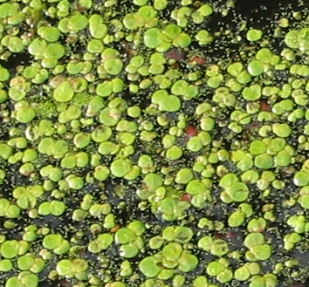
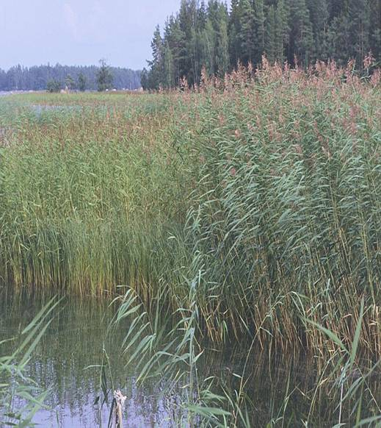
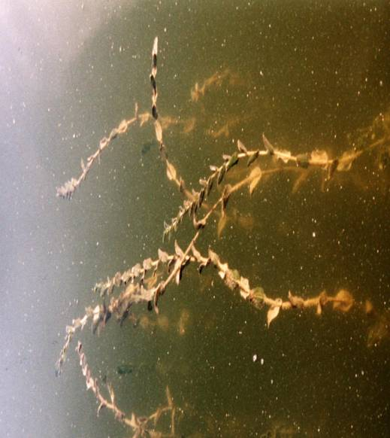
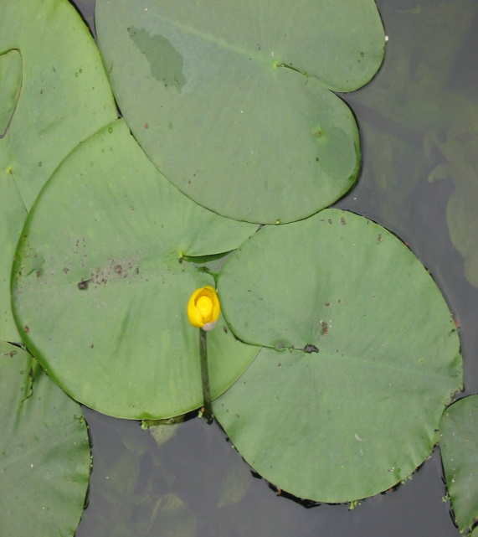
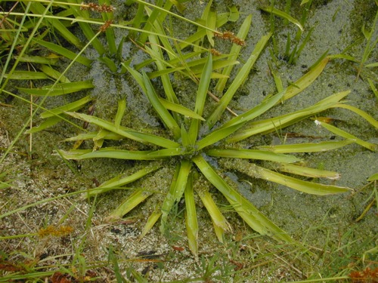
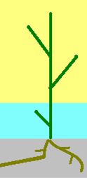
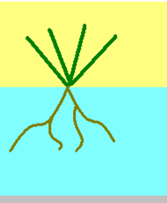
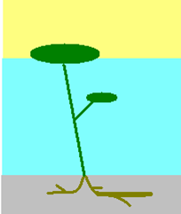
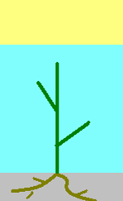

Lemna sp. (source M.Moeys)
Phragmites australis
(source Photo © M. Savela )
Potamogeton perfoliatius
(source: M. Moeys)
Plant morphologies
Stratiotes aloides (source The Virtual Field-Guide )
Nuphar lutea (source: M.Moeys
Emergent
Submergent
Floating rooted
Floating unrooted
Floating submergent
Notes:
different macrophyte growth forms based on different morphology/functioning
emergent: rooted with most of the leaf above water. not modeled
Submergent: rooted with all system under water. also macroalgae like characeae family
Floating rooted: underwater with leaves floatinf on the surface
floating unrooted: free floatin, small roots in the water
foating submergent: part floating, part submergent , roots in the water

Slide 18
Vertically structured: lineair / exponential
Biomass is vertically distributed
This is input for the sub-modules that require such distribution:
  vertical distribution of light extinction
  => (self)shading and competition with other macrophytes and algae)
  Nutrient uptake per layer (and thereby competition with other prim.prod.)
  Feedback to D-FLOW
Linear or exponential distribution of biomass over the vertical layers
F = 0.001 | F = 5 | F = 20

Slide 19
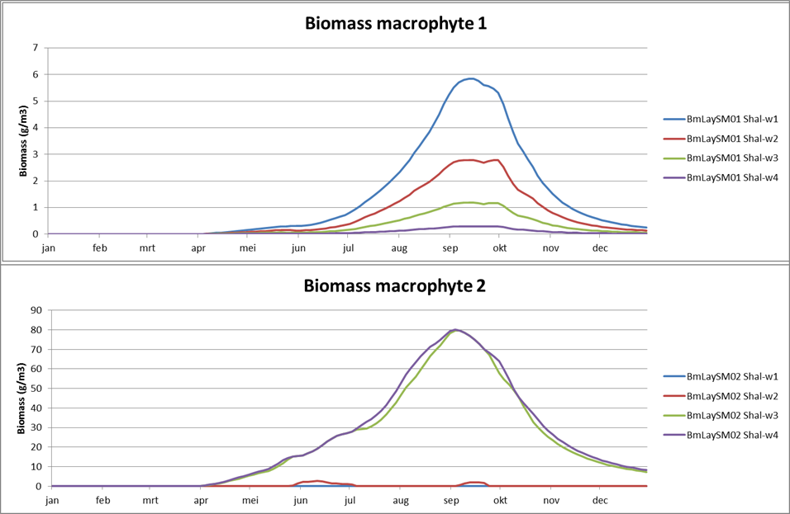
Biomass growth per layer

Slide 20
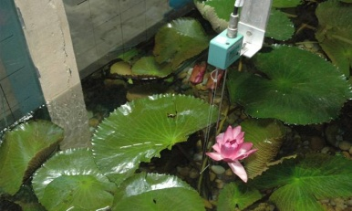
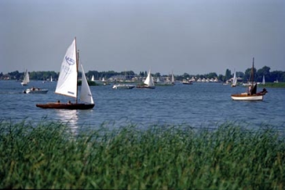

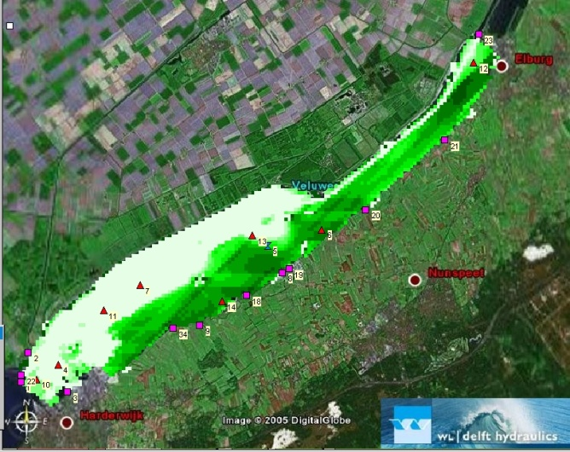
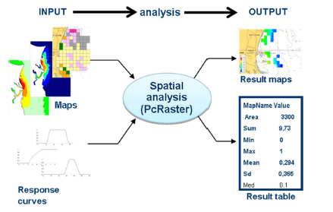
resuspension of sediments
Dynamic spatially distributed biomass modelling in lake Veluwemeer, via DELWAQ macrophyte module
Using substrate and exposure as initial HABITAT criteria for growth (Workshop B)
biomass distribution
Notes:
Note that the vegetation patch added to the maps on bottom shear stress shows a different shape than the modelled vegetation. This was done because we want to see more explicitly the functioning of the patch. it is a first, and therefore artificial trial. the biomass distribution uses a habitat suitability index procedure but is seasonally dynamic implemented in delwaq. light=> 4% must reach the bottom, temperature follows a sine function through the season, substrate must be sand, exposure to waves makes limited when depth is shallower than 20 cm. in the white area on the left side the lake is too deep. biomass only grows in the shallow areas on the right.

Slide 21
bed shear stress without macrophytes
bed shear stress with macrophytes
jan feb mar apr may june july aug sept oct nov dec ‘94
suspended inorganic matter without winddriven currents
with winddriven currents without macrophytes
with winddriven currents and macrophytes
jan feb mar apr may june july aug sept oct nov dec ‘94

Slide 22
bed shear stress
inorganic suspended matter
No plants
No plants
plants
plants
1-7-’94

Slide 23
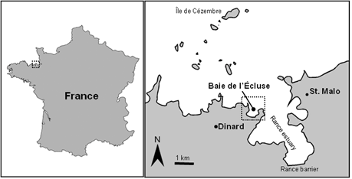
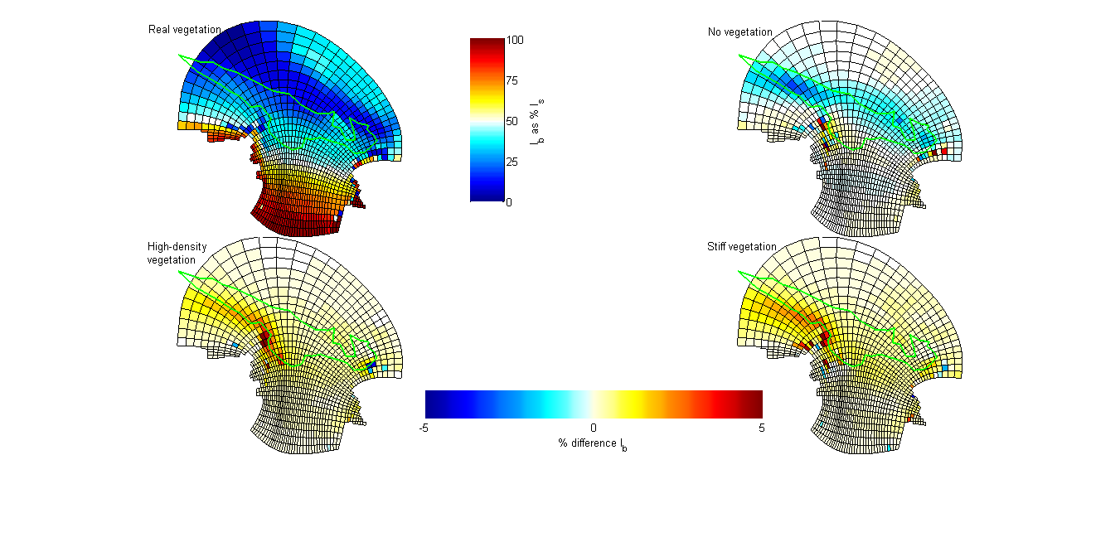
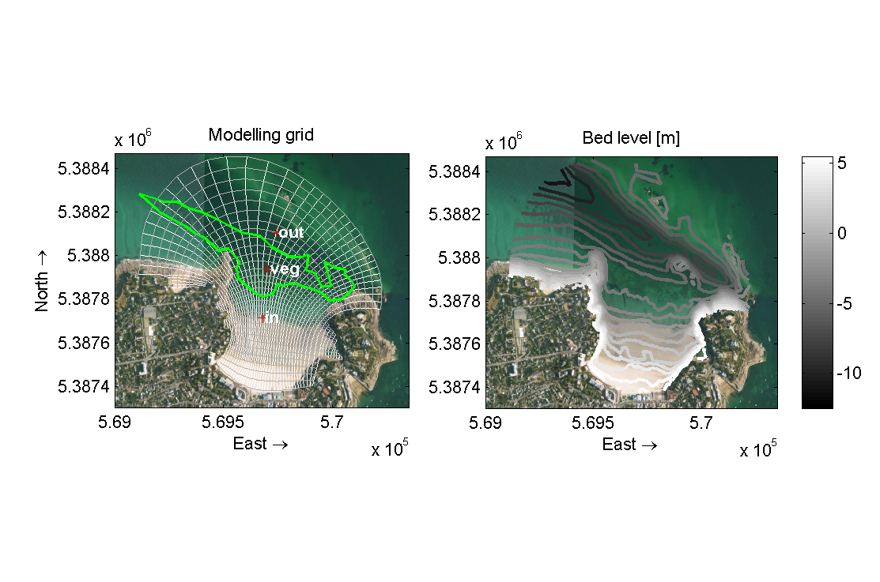
Example: link to water quality
Light at seabed
Seagrass
No vegetation
Dense seagrass
Rigid vegetation
Difference in light reaching the bed
Dijkstra JT, van Katwijk MM, (subm) Seagrass meadows reduce flow and sediment transport and improve underwater light climate. Validation and vegetation-scenario runs of a morphodynamic model. Submitted to Estuarine Coastal Shelf Science.

Slide 24
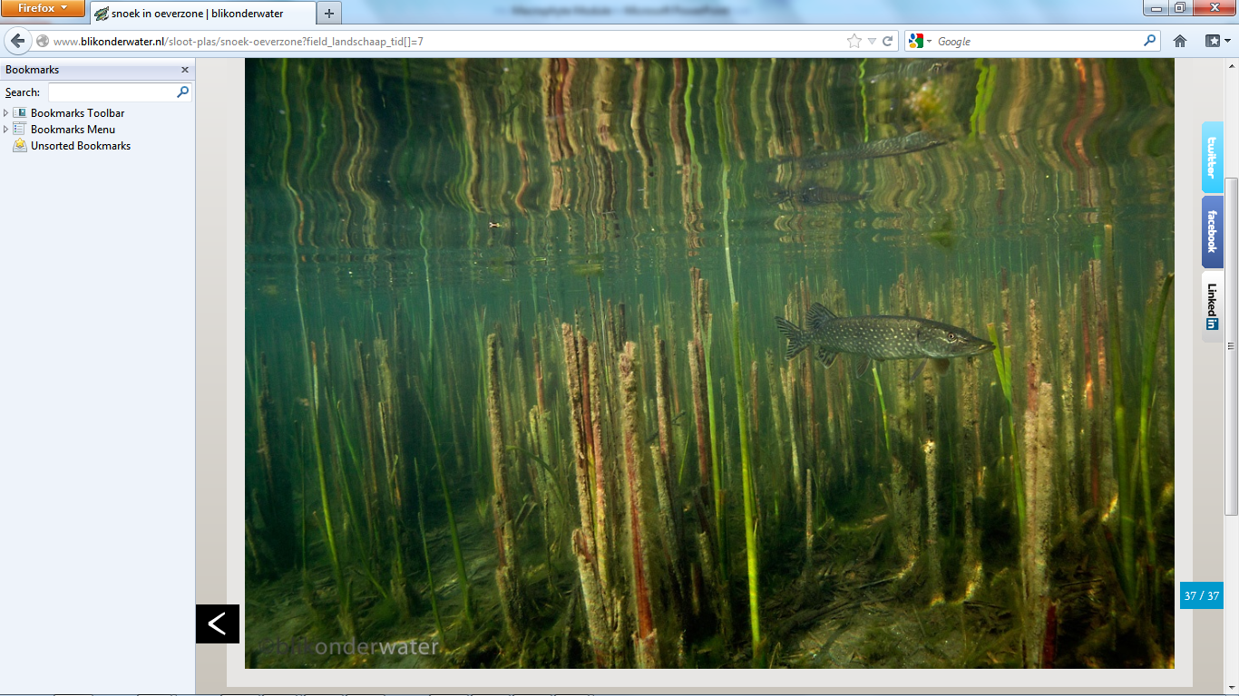
Thank you

Slide 25
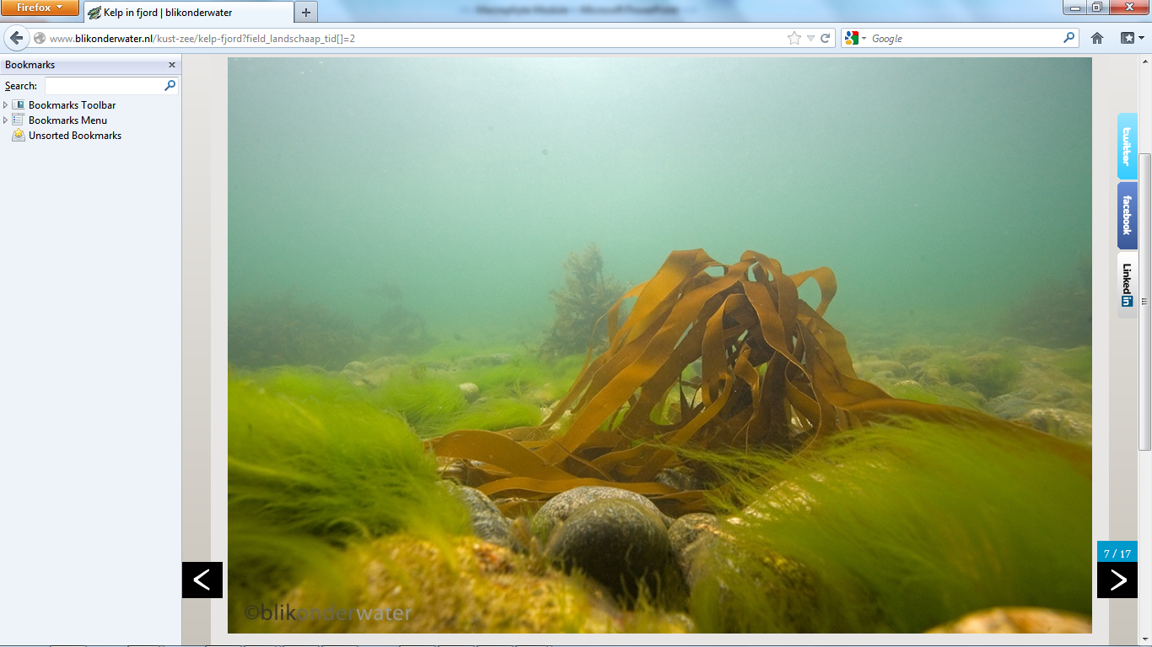
Thank you

